Slide 1
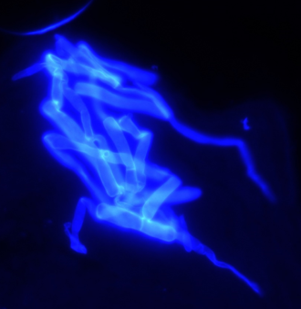
Progress in fungal diagnostics: the pros and cons
2th ISHAM Congress
20-24 September 2022
New Delhi, India
Cornelia LASS-FLÖRL
Medical University Innsbruck
Institute of Hygiene and Medical Microbiology
Innsbruck, Austria

Slide 2
Diagnostic Issues in Mycology
Significant increase opportunistic fungal infections due to the increase in immunocompromised hosts.
Cosmopolitan environmental fungi have emerged as causes of potentially life-threatening diseases.
Many emerging pathogenic fungi are inherently resistant to antifungal drugs.
Traditional identification techniques lack sensitivity & specificity, are slow, labor-intensive and require skilled personnel.
A number of pathogenic fungi are non-viable in samples (treatment).
Differentiation between colonization and infection.
Limited fungal burden even in the presence of fungaemia.

Slide 3
Diagnosis
Conventional tests (must have)
Antigen tests
(must have)
Molecular based tests (optional)
CT Imaging
Lab parameters
The patient

Slide 4
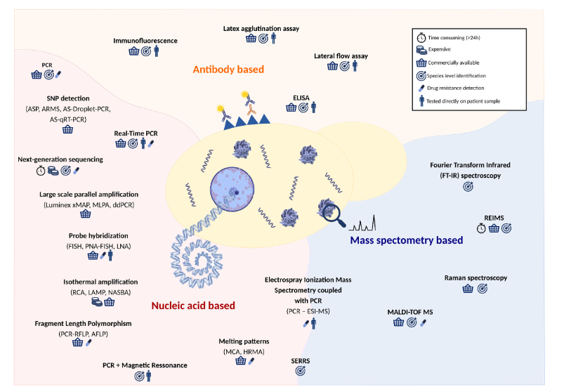
FEMS Microbiology Reviews, fuz015, 43, 2019, 517–547

Slide 5
What is new and what is hot?
PCR methods are part of probable IFI definitions; T2 and Aspergillus PCR incorporated for invasive candidiasis (IC) and invasive aspergillosis (IA).
ß-D-glucan is part of probable IFI definitions: patients with hematologic malignancies with and without neutropenia, neutropenia following HSCT, and certain patients in the ICU who are at higher risk (>10%) for IC as a result of gastrointestinal surgery with recurrent anastomotic leaks, perforations of the upper gastrointestinal tract, or necrotizing pancreatitis when there is clinical suspicion of infection. A single threshold (>80 pg/mL) using the Fungitell test (Associates of Cape Cod, Falmouth, MA) is recommended;
COVID associated aspergillosis (CAPA): CAPA emerged during the first months of the pandemic. However, incidence rates varied widely, probably because CAPA is difficult to diagnose in patients with COVID-19-associated acute respiratory distress syndrome (ARDS).
COVID associated mucormycosis (CAM): Indian population-based case rates of mucormycosis estimate the burden of CAM to be 70-times higher than the global rate, with predicted annual cases of >200,000 before the pandemic
COVID associated candidemia (CAC): Candida albicans is the most frequently reported yeast species in critically ill patients with COVID-19 (44% of candidemia cases in one US multicentre study) but in some geographical areas the emerging pathogen C. auris was predominant.
Nature Microbiology 7, 1127–1140 (2022)

Slide 6
Donnelly JP, et al. Clin Infect Dis. 2020;71(6):1367–76.
Host
Invasive pulmonary mould diseases
Candidiasis
Cryptococcosis
Pneumocystosis
Endemic mycosis
Any mould in non-sterile material and
antigenª and PCRª tests
BDG in ≥2 serum samples
or
T2Candida® panel
Positive culture: non-sterile material
PCR positive in respiratory tract specimen
BDG in ≥2 serum samples
Histoplasma or Blastomyces antigen in urine, serum or body fluid or
Coccidioides antibody in CSF
GM-EIA antigen/aspergillosis
Antigen detected in plasma, serum, BAL or CSF;
Several tests are on the market
Any one of the following:
Single serum or plasma: ≥1.0, ≥0.7 and BAL fluid ≥0.8
BAL fluid: ≥1.0
Single serum or plasma: CSF: ≥1.0
Aspergillus: Point of care tests
Lateral flow assay & Lateral flow device
Cut-off values are not defined yet, generally accepted > 0.5 (blood)
Less clinical data, however seem to be similar with GM-EIA (similar limitations)
Aspergillus PCR
Any one of the following:
Two or more consecutive PCR tests positive in plasma, serum or whole blood or BAL-fluids
At least one PCR test positive in plasma, serum or whole blood and one PCR test positive in BAL fluid
BDG
(Fungitell®) ≥80 ng/L (pg/mL) detected in at least two consecutive serum samples in haematological and ICU patients (gastrointestinal surgery with recurrent anastomotic leaks, perforations of the upper gastrointestinal tract or necrotising pancreatitis)

Slide 7
Molecular based diagnostics Invasive candidiasis
Culture-dependent methods
Culture independent methods

Slide 8
Blood culture-dependent tests
Product | Manufacturer |  | Candida spp. Detected | Assay Time | Method | Approval
Gram stain required
Candida QuickFISH® | OpGen | C. albicans C. parapsilosis, C. glabrata | 20 min | FISH | CE/IVD
Yeast Traffic Light PNA FISH® | OpGen | C. albicans/C. parapsilosis, C. tropicalis, C. glabrata/C. krusei | 90 min | FISH | CE/IVD
eplex® BCID FP Panel | GenMark Dx | C. albicans, C. auris, C. dubliniensis, C. famata, C. glabrata, C. guilliermondii, C. kefyr, C. krusei, C. lusitaniae, C. parapsilosis, C. tropicalis | 90 min | Multiplex PCR | CE/IVD
MALDI-TOF MS: matrix-assisted laser desorption/ionization time of flight mass spectrometry; CE/IVD: Conformitè Europëenne/in vitro diagnostic; FISH: fluorescence in situ hybridization.
Camp I et al. J. Fungi 2020, 6: 101

Slide 9
Candidiasis diagnostics: the pro and cons
Culture-dependent methods
These test systems are designed for use with aliquots of positive blood culture samples.
Thus, the time required for a positive blood culture cannot be eliminated.
As the pathogen load is high in positive blood culture bottles, sensitivity is not a challenge for these assays.
Detection of pathogens varies.
Hand on time is quite short.
The real clinical need?
Camp I et al. J. Fungi 2020, 6: 101

Slide 10
Blood culture-independent tests
Product | Manufacturer | Candida spp. Detected | Assay Time | Method |  | Approval | Comments
DNA extraction step required
Multiplex tests:
MagicplexTM Sepsis | Seegene | C. albicans C. tropicalis C. parapsilosis C. glabrata C. krusei | 6 h ^{b} | Multiplex PCR |  | CE/IVD
Broad-spectrum tests:
Hybcell Pathogens DNA xB | CubeDx | Microarray: C. albicans C. dubliniensis C. parapsilosis C. tropicalis C. glabrata + 1 panfungal target Sequencing: pan-Candida | 6 h ^{c} | Panfungal PCR (28s) & Microarray |  | CE/IVD
SepsiTestTM-UMD | Molzym Molecular Diagnostics | pan-Candida | 24 h | Broad-spectrum PCR (18S) |  | CE/IVD
MycoReal Fungi | Ingenetix | pan-Candida | 24 h | Broad-spectrum PCR (ITS2) |  | RUO
Fully automated:
T2 Candida Panel | T2 Biosystems | C. albicans/tropicalis C. glabrata/krusei C. parapsilosis C. auris | 3–5 h |  | Multiplex PCR followed by automated T2MR based detection | CE/IVD/FDA
ª excluding DNA extraction; ^{b} including DNA extraction; ^{c} if sequencing is not required. CE/IVD: Conformitè Europëenne/in vitro diagnostic; RUO: research use only; ITS: internal transcribed spacer 2 region.
Camp I et al. J. Fungi 2020, 6: 101

Slide 11
Candidiasis diagnostics: the pro and cons
Culture-independent methods
These test systems are designed for use with aliquots of blood.
Thus, the time required for a positive blood culture is not given.
As the pathogen load is low in blood, sensitivity & specificity is a challenge for these assays.
Detection of pathogens varies.
Hand on time is longer.
DNA extraction is an issue – different methods.
The real clinical need!
Camp I et al. J. Fungi 2020, 6: 101

Slide 12
T2Candida Strengths and Limitations
Prevalence of candidemia 10%: PPV and NPV 84% and 99%
Low prevalence: PPV will drop
High NPV across a broad range of prevalences supports use as NPV: discontinue treatment
Deep seated infection: no validation yet; preliminary results
Detects non viable (intact) cells – monitoring?
Frozen samples? Does not detect free DNA – discordant results
Combinded testing has greatest value
Empirical therapy may influence the T2 outcome
Prognostic indicator assay: 40% mortality in +ve pts
Pediatric pts: limited but good data
Non-blood specimens: encouraging data: peritoneal fluid, occular infection
Covers only 5 species
Interpretation of positive T2 cases but negative blood cultures?
C. auris swabs: sen 84% and spec 98%
C. auris pannel from whole blood and swabs
Unpublished: personal communication: various results
Arendrup et al. Open Forum Infect Dis 2019, 6, ofz163
Current Fungal Infection Reports (2021) 15:67–80
Monday LM et al. J. Fungi 2021, 7: 178
Mylonakis E et al. Clin Infect Dis 2015,60:892
Clancy CJ et al. Clin Infect Dis 2018,66:1678

Slide 13
Candidiasis diagnostics: the pro and cons
ß-D-glucan is part of probable IC definitions: patients with hematologic malignancies with and without neutropenia, neutropenia following HSCT, and certain patients in the ICU who are at higher risk (>10%) for IC as a result of gastrointestinal surgery with recurrent anastomotic leaks, perforations of the upper gastrointestinal tract, or necrotizing pancreatitis when there is clinical suspicion of infection. A single threshold (>80 pg/mL) using the Fungitell test (Associates of Cape Cod, Falmouth, MA) is recommended;
Probable definition: ß-D-glucan (Fungitell) ≥80 ng/L (pg/mL) detected in at least 2 consecutive serum samples provided that other etiologies have been excluded.
Confidence for true positive results increases with repeated positive tests and for values that greatly exceed the positivity threshold.
There may be variability in positive predictive value (PPV) and negative predictive value (NPV) based on patient population, but a single threshold is favored at this time.
(1,3)-beta-D glucan was not considered to provide mycological evidence of any invasive mold disease
Donnelly JP, et al. Clin Infect Dis. 2020;71(6):1367–76.

Slide 14
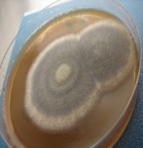
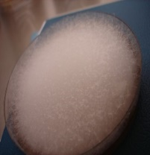
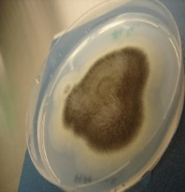
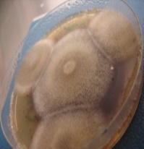
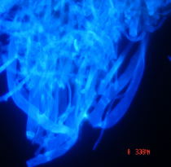
What is new and what is hot?
PCR methods are part of probable IFI definitions; T2 and Aspergillus PCR incorporated for invasive candidiasis (IC) and invasive aspergillosis (IA).
ß-D-glucan is part of probable IFI definitions: patients with hematologic malignancies with and without neutropenia, neutropenia following HSCT, and certain patients in the ICU who are at higher risk (>10%) for IC as a result of gastrointestinal surgery with recurrent anastomotic leaks, perforations of the upper gastrointestinal tract, or necrotizing pancreatitis when there is clinical suspicion of infection. A single threshold (>80 pg/mL) using the Fungitell test (Associates of Cape Cod, Falmouth, MA) is recommended;
COVID associated aspergillosis (CAPA): CAPA emerged during the first months of the pandemic. However, incidence rates varied widely, probably because CAPA is difficult to diagnose in patients with COVID-19-associated acute respiratory distress syndrome (ARDS).
COVID associated mucormycosis (CAM): Indian population-based case rates of mucormycosis estimate the burden of CAM to be 70-times higher than the global rate, with predicted annual cases of >200,000 before the pandemic
COVID associated candidemia (CAC): Candida albicans is the most frequently reported yeast species in critically ill patients with COVID-19 (44% of candidemia cases in one US multicentre study) but in some geographical areas the emerging pathogen C. auris was predominant.
(1,3)-beta-D glucan was not considered to provide mycological evidence of any invasive mold disease.
Nature Microbiology 7, 1127–1140 (2022)

Slide 15
Disease definitions based on clinical, host and mycological criteria
Disease definition | Important factors |  | Mycological criteria (at least one of the following criteria must be positive)
 | Host | Clinical
Probable pulmonary aspergillosis (EORTC/MSG) |  |  | Microscopy: fungal hyphae in sputum, BAL, bronchial brush or aspirates indicating Aspergillus Culture: Aspergillus spp. of BAL or bronchial secretions Biomarker: single serum or plasma GM ≥1.0, BAL GM ≥1.0, single serum or plasma GM ≥0.7 and BAL GM ≥0.8, CSF ≥1.0 Aspergillus PCR: ≥2 consecutive positive PCRs on plasma, serum or whole blood or ≥2 positive PCRs on BAL
Putative invasive pulmonary aspergillosis in critically ill patients |  |  | Positive Aspergillus-culture from lower respiratory tract and semi-quantitative culture of BAL without bacterial growth, together with a positive cytological smear showing branching hyphae
IAPA: Influenza-associated pulmonary aspergillosis |  |  | Serum GM >0.5, BAL GM ≥1.0, positive BAL or sputum culture (tracheobronchitis); hyphae via microscopy consistent with Aspergillus spp.
CAPA: Covid-associated pulmonary aspergillosis |  |  | Microscopy: fungal hyphae in BAL consistent with Aspergillus spp.; positive BAL culture or PCR; serum GM >0.5 or serum LFA >0.5; BAL GM ≥1.0 or BAL LFA index ≥1.0 ≥2 consecutive positive Aspergillus PCRs in plasma, serum or whole blood; a single positive Aspergillus PCR in BAL (<36 cycles); a single positive Aspergillus PCR in plasma, serum, whole blood and a single positive BAL (any threshold cycle permitted)
1
2
3
4
A
or
B
C
D
E
1
2
3
4
5
6
+
+
7
B
or
F
8
B
or
F
1
Neutropenia (>10 days EORTC)
7
Influenza-like illness
C
Refractory and fever despite antibiotics (48 h)
2
Prolonged corticosteroid use >0.3 mg/kg ≥3 weeks (EORTC)
8
COVID-19 disease
Pleuritic chest pain, pleuritic rub, dyspnoea, haemoptysis, worsening respiratory insufficiency
3
Haematological malignancy
Pulmonary aspergillosis CT: dense, well-circumscribed lesion +/- halo sign, air crescent, cavity, wedge-shaped and segmental or lobular consolidation
D
4
Receipt of allo-HSCT or SOT, treatment with T-cell immunosuppressants, B-cell receptor pathways, BCL2 inhibitors, inherited severe immunodeficiency, acute GvHD (grade III/IV)
A
E
Abnormal medical imaging
5
Oncological malignancy and cytotoxic agents
B
Tracheobronchitis: ulceration, nodules, pseudomembranes, plaque or eschar
F
Pulmonary infiltrate or cavitary infiltrate
6
Acquired immunodeficiency
allo-HSCT, allogeneic haematopoietic stem-cell transplantation; BAL, bronchoalveolar lavage; BCL2, B-cell lymphoma 2; CAPA, COVID-19-associated pulmonary aspergillosis; CSF, cerebrospinal fluid; CT, computerised tomography; EORTC/MSG, European Organisation for Research and Treatment of Cancer/Mycoses Study Group; GM, galactomannan; GvHD, graft-versus-host disease; h, hour; IAPA, influenza-associated pulmonary aspergillosis; LFA, lateral flow assay; PCR, polymerase chain reaction; SOT, solid organ transplantation
Lass-Flörl C, et al. Clin Microbiol Infect. 2021, 16:S1198

Slide 16
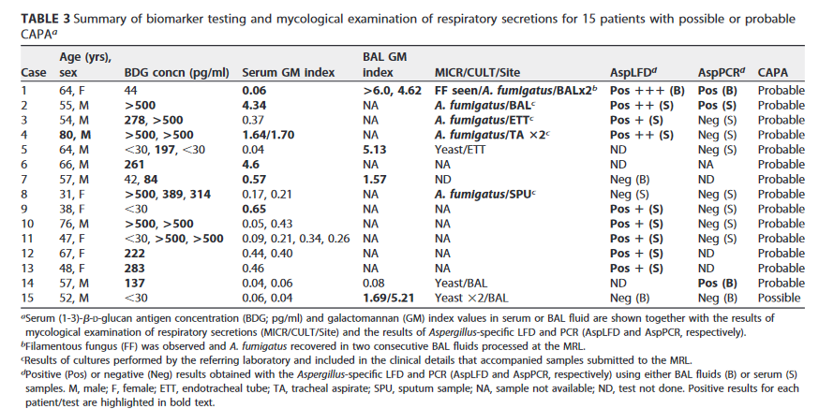

Slide 17
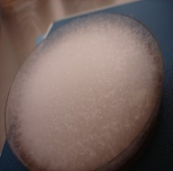
Mold diagnostics (CAPA): the pro and cons
No study evaluated the diagnostic performance of existing definitions against histology!
In “all” lab and clinical assessments, culture and/or PCR and/or microscopy are considered equally! But only the presence of hyphae in sterile body regions supports disease! Culture positivity could display colonization and /or infection; without the presenece of hyophae – we lacke the proof!
Mycological criteria were part of the assessment – in several studies – bias?
Personal opinion, Lass-Flörl

Slide 18
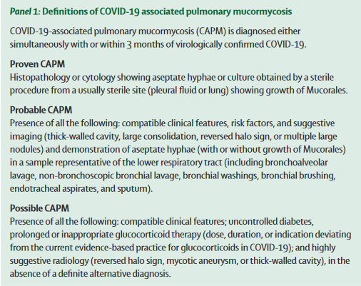
Valliappan Muthu, et al. www.thelancet.com/infection Published online April 4, 2022 https://doi.org/10.1016/S1473-3099(22)00124-4

Slide 19
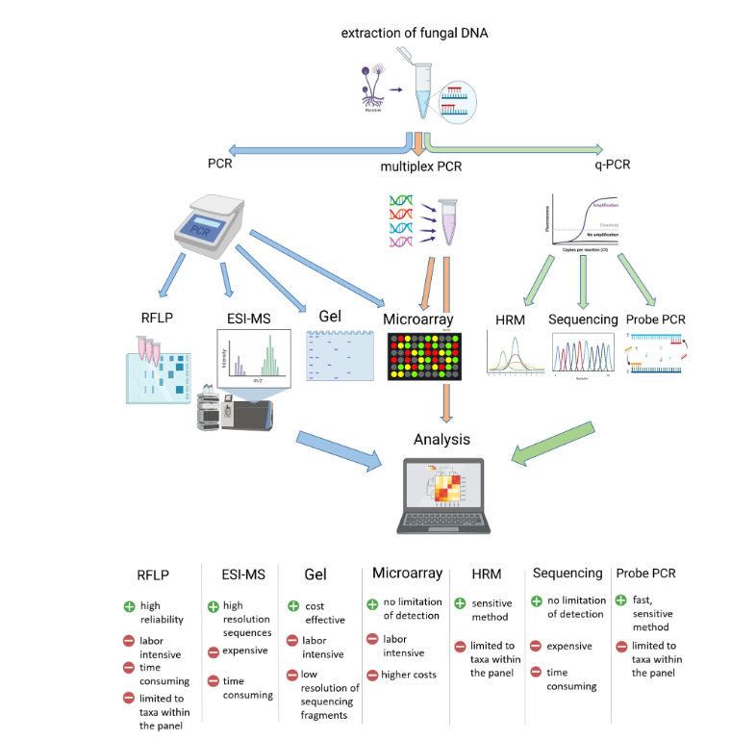
Detection of DNA
Mucorales DNA was found to be very high – angioinvasive nature?
Various methods tested in tissue samples, BAL and blood – variable outcome.
Primers: species/genus specific, order Mucorales, pan-fungal PCRs
Urine samples (spore coating encdoing proteins (CotH) – universal biomarker for mucormycosis? J Clin Microbiol 56, e746.
Cell wall carbohydrate fucomannan ? (Oral presentation, ECCMID 2020)
Whole genome sequencing – for outbreaks.
May allow a quick diagnosis, sensitiv –specificity?
Do not cover all taxa – very complex!
Lack of standardization in the clinical setting.
Microorganisms 2021, 9(7): 1518

Slide 20
C. auris diagnostics (CAC): the pro and cons
In some studies, a two- to tenfold higher incidence of candidemia has been reported in patients with COVID-19 compared with patients without COVID-1950
C. albicans is most frequently reported ICU patients with COVID-19, but some geographical areas the emerging pathogen C. auris was predominant.
C. auris is a budding yeast, which almost never forms short pseudohyphae and does not form germ tubes. Some strains form aggregates of cells, whereas others do not. Unlike most other Candida species, it grows well at 40–42º C on CHROMagar. C. auris colonies appear white, pink, red, or purple.
Tian S et al. Emerg Microbes Infect. 2018

Slide 21
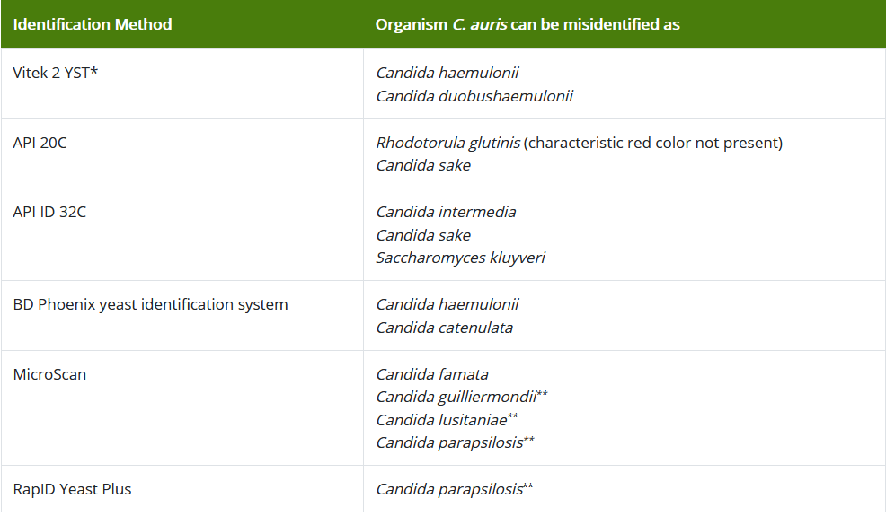
C. auris diagnostics (CAC): the pro and cons
* A confirmatory test such as cornmeal agar may be warranted for these species.
** C. guilliermondii, C. lusitaniae, and C. parapsilosis generally make pseudohyphae on cornmeal agar. If hyphae or pseudohyphae are not present on cornmeal agar, this should raise suspicion for C. auris as typically make no hyphae or pseudohyphae.
https://www.cdc.gov/fungal/candida-auris/identification.html

Slide 22
C. auris diagnostics (CAC): the pro and cons
Matrix-assisted laser desorption/ionization time-of-flight (MALDI-TOF) can differentiate C. auris from other Candida species, using the updated Bruker FDA-approved MALDI Biotyper CA System library (Version Claim 4) or their “research use only” libraries (Versions 2014 [5627] and more recent) and using the bioMérieux VITEK (MALDI-TOF) MS using the FDA-approved IVD v3.2 or their “research use only” libraries (with Saramis Ver 4.14 database and Saccharomycetaceae update).
Sequencing the D1-D2 region of the 28s rDNA or the Internal Transcribed Region (ITS) of rDNA also can identify C. auris.
The GenMark ePlex Blood Culture Identification Fungal Pathogen (BCID-FP) Panel is the first FDA-approved molecular test for C. auris identification.
Du H et al. PLoS Pathog. 2020

Slide 23
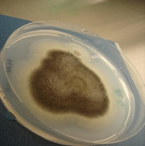
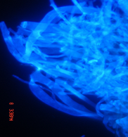
Lab-based diagnosis
Conventional tests:
Culture & microscopy
Antigen tests
Molecular based tests
C: Viable fungus
Conidida or hyphae
M: hyphae
Proliferating fungus, hyphae
DNA, dead or viable fungus
Polysaccharide:
Galactomannan (GM)

Slide 24
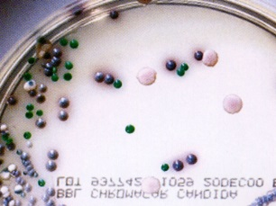
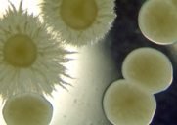
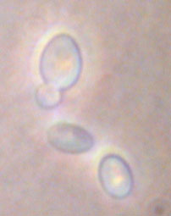
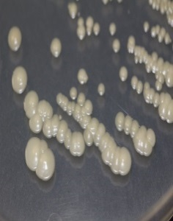
Thank you for your attention!

