Slide 1


Current treatment options for CPA and future directions
David W. Denning
The University of Manchester
Global Action For Fungal infections
ddenning@manchester.ac.uk

Slide 2

Disclosures
Shareholder | F2G
Consultant (last 3 years) | Biosergen, Pulmatrix, Pulmocide, Zambon, TFF Pharma, Cipla, Omega, Novacyt, Pfizer
Speaker’s bureau | Merck/MSD, Pfizer, Gilead, Hikma, BioRad

Slide 3
CPA and TB in India – new modelling
About 2 million cases of pulmonary TB in India annually
Denning DW, submitted for publication and https://gaffi.org/policy-briefs/
Notes:
3

Slide 4
CPA - symptoms
Common symptoms
Cough, usually productive
Shortness of breath
Weight loss
Tiredness
Coughing up blood
Chest ache / discomfort
Occasionally
Fever
Severe chest pain from rib fracture
Additional chest infections
Co-morbidity common

Slide 5
CPA - symptoms
Common symptoms
Cough, usually productive
Shortness of breath
Weight loss
Tiredness
Coughing up blood
Chest ache / discomfort
Occasionally
Fever
Severe chest pain from rib fracture
Additional chest infections
Some patients have no symptoms or trivial symptoms – CPA can be a very ‘quiet’ condition
Co-morbidity common

Slide 6
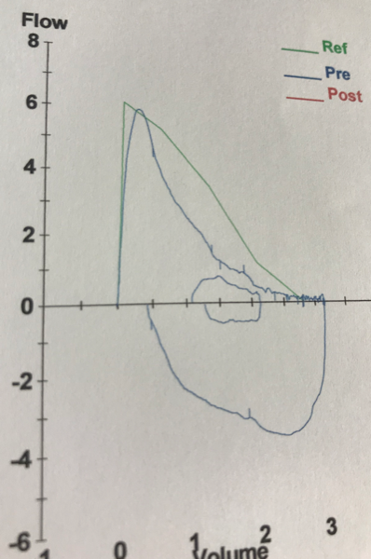
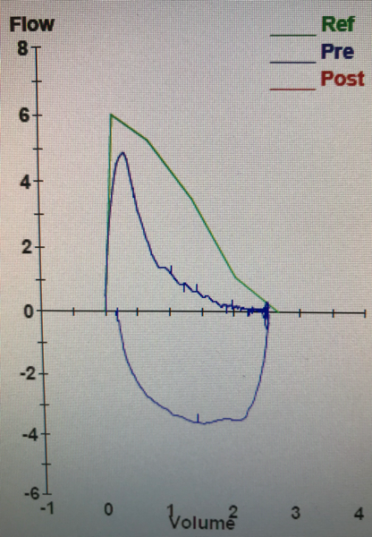
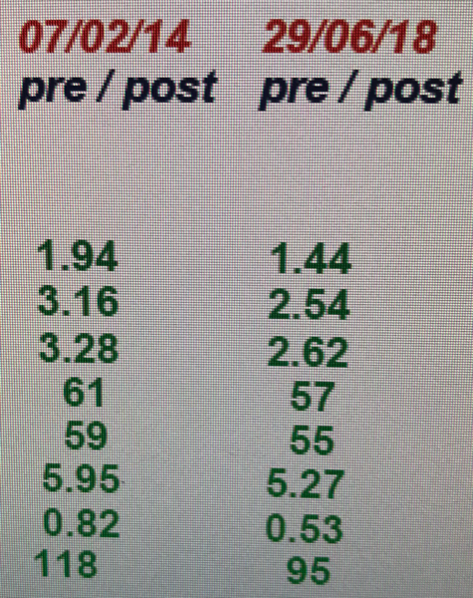
Relapse 3 years after stopping antifungal therapy of CPA
More breathless, no cough, no wheeze, no weight loss, no fatigue
Aspergillus IgG= 120mg/L
FEV1
FVC
Notes:
6

Slide 7
Objectives of antifungal therapy for CPA
Very ill patients:
Save their lives with (usually) IV and then oral therapy
Quite ill patients:
Improve quality of life by minimising symptoms
Prevent further haemoptysis (coughing blood)
Stop progression of scarring in the lung
Prevent the emergence of antifungal resistance
Avoid antifungal toxicity
Patients with few symptoms
Stop progression of scarring in the lung
Prevent the emergence of antifungal resistance
Avoid antifungal toxicity
Notes:
7

Slide 8

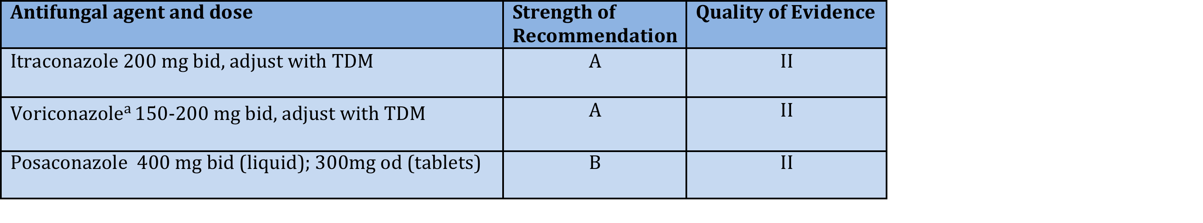
Oral triazole therapy for CPA
a Lower doses advised in those over 70 years, low weight, significant liver disease and those of NE Asian descent who may be slow metabolisers
TDM = therapeutic drug monitoring
Denning et al, Eur Resp J 2016;47:45

Slide 9
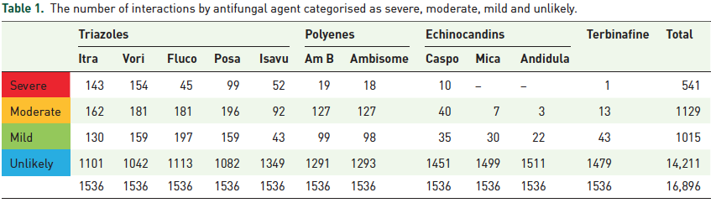
Antifungal drug interactions
Section on drug interactions which you can search very quickly - www.aspergillus.org.uk
+ app for android (search antifungal interaction)
Niazi-Ali S, Ther AdvInfect Dis 2021;8:1-9 www.aspergillus.org.uk

Slide 10
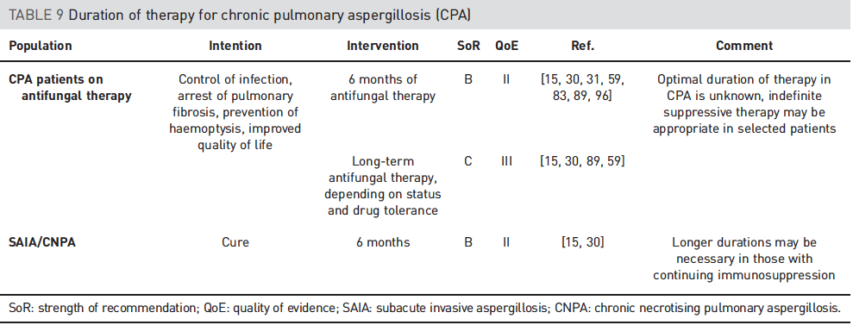
Duration of therapy for CPA
Denning et al, Eur Resp J 2016;47:45

Slide 11
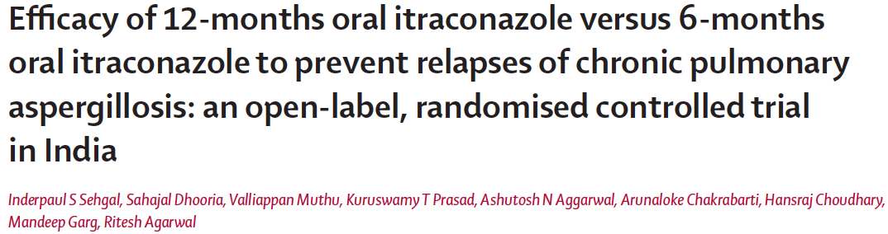
81 patients randomised to 6 months and 83 to 12 months itraconazole 200mg BD
Primary endpoint was relapse after stopping therapy
Relapse after stopping treatment was defined as:
persistent worsening (more than 2 weeks) of symptoms (systemic or respiratory)
and
worsening imaging
with or without
microbiological evidence of aspergillus on sputum culture
Other causes of worsening, including bacterial pneu­monia, pulmonary tuberculosis, or worsening of underlying pulmonary condition were excluded.
Sehgal I et al, Lancet Infect Dis 2022;online
Notes:
11

Slide 12
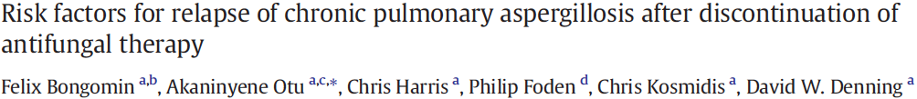
102 patients who discontinued therapy – retrospective analysis
Relapse was defined as a deterioration in any two of the following:
clinical, radiological, serological, or sputum microbiological markers of CPA activity.
Clinical deterioration - any deterioration in systemic or respiratory symptoms, as reported by the patient and documented in the patient's notes.
Radiological deterioration - worsening of respiratory imaging, either chest X-ray or chest CT scan, according to the reporting radiologist.
Serological deterioration - any increase in Aspergillus IgG.
Microbiological deterioration - a new positive culture of Aspergillus from respiratory secretions or a positive Aspergillus PCR or galactomannan, deemed to represent a significant result.
The clinical decision of the treating physician to re-institute antifungal therapy was used as a surrogate marker of relapse.
Clinical and radiological deterioration should not have been attributable to other disease processes, notably concurrent pulmonary infection (e.g. bacterial super-infection or NTM infection), overt deterioration in underlying disease (e.g. sarcoidosis, rheumatoid arthritis or lung cancer) or toxicity of non-antifungal drugs.
Bongomin F et al, Clin Infect Pract 2020;5:100015
Notes:
12

Slide 13

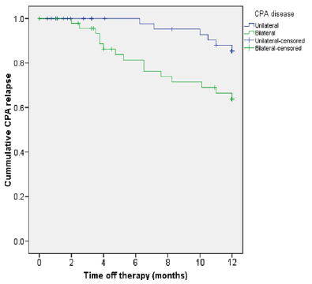
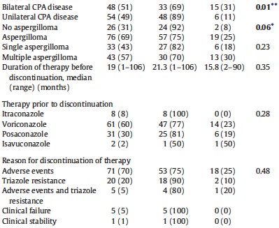
The median duration of continuous triazole therapy before discontinuation of therapy was 19 months (range: 1–106)
Only bilateral CPA was significant in multivariate analysis
OR 3.0;
95% CI 1.0–8.8;
p = 0.044
Bongomin F et al, Clin Infect Pract 2020;5:100015
Notes:
13

Slide 14

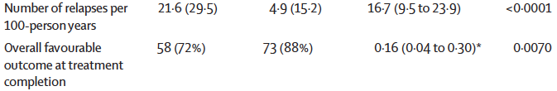
Sehgal I et al, Lancet Infect Dis 2022;online
Notes:
14

Slide 15
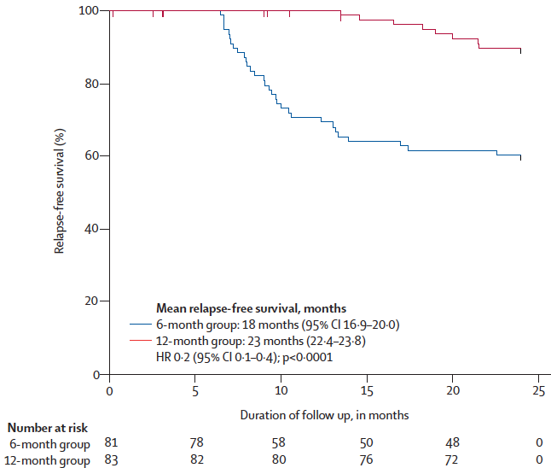
Sehgal I et al, Lancet Infect Dis 2022;online
Notes:
15

Slide 16
Duration of therapy for CPA
12
A
I
Denning et al, Eur Resp J 2016;47:45

Slide 17
Duration of therapy for CPA
12
A
I
Optimal duration of therapy in CPA is unknown, indefinite suppressive therapy may be appropriate in selected patients
Denning et al, Eur Resp J 2016;47:45

Slide 18
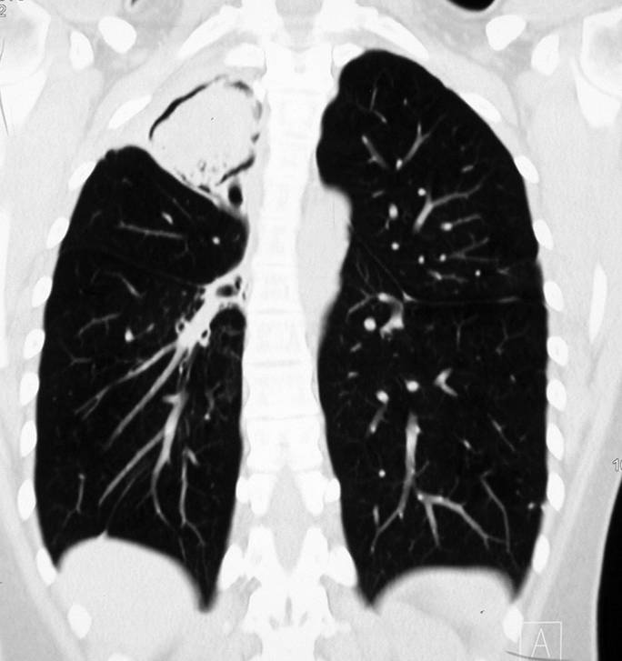
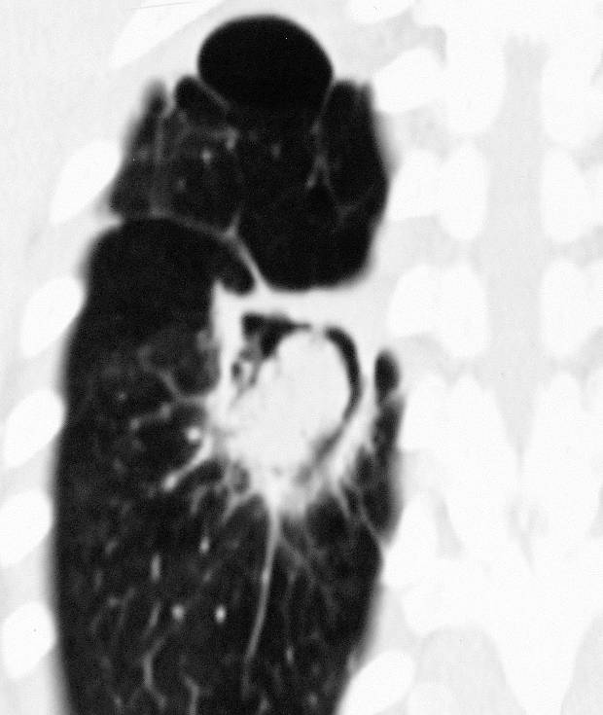
32 yr old from Malawi, on HAART Rx
- haemoptysis
- Aspergillus precipitin titre 1/16
CT scan shows 2 large cavities with aspergillomas, with additional lesions (October 2005)
Chronic cavitary pulmonary aspergillosis (CCPA) in HIV February 2005
Surgical removal would require a pneumonectomy
So treated with itraconazole
Notes:
18

Slide 19
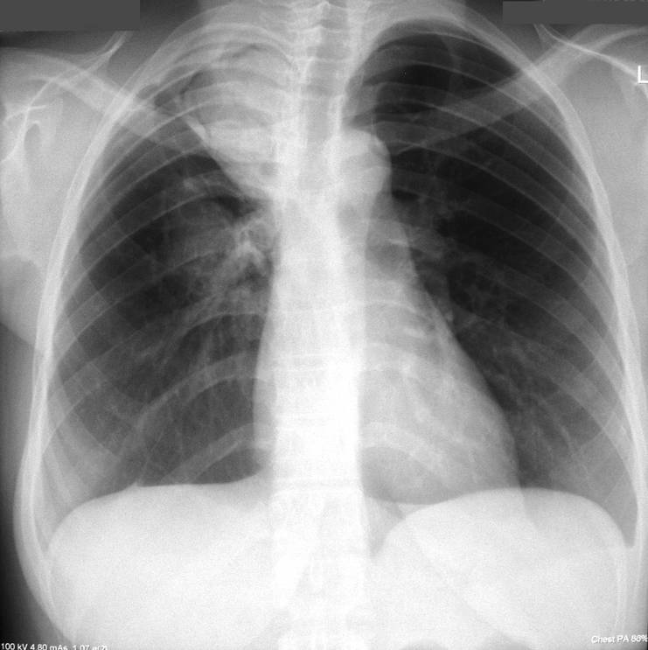
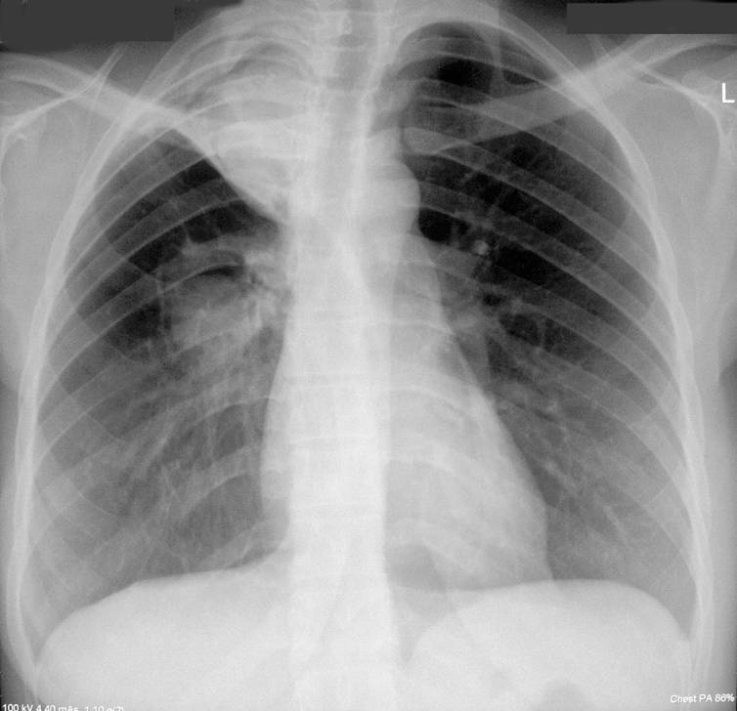
On HAART Rx, with low viral load, CD4 count >200
- New haemoptysis
- Aspergillus precipitin titre 1/32
CXR & CT scan showed expansion of inferior cavity
CCPA in HIV February 2007
MICs A. fumigatus Feb 2007
Itraconazole = >8.0mg/mL
Voriconazole = 0.5 mg/mL
Posaconazole = 1.0 mg/mL
February 2007
April 2007
Notes:
19

Slide 20

223 referrals to NAC over 24 months
Excluded
Missing data
(n=17)
Eligible patients (n=206)
Treatment naïve [n=142]
Previous or current antifungal
therapy (Group B)[n=64]
Followed-up
off antifungals
(n=10)
Treatment initiated at
NAC (Group A)[n=132]
Itraconazole [n=105]
Voriconazole [=27]
Same
[n=49]
Same
[n=14]
Changed [n=33]
Changed [n=7]
Discontinued [n=23]
Discontinued [n=6]
Bongomin et al. PLoS ONE 2018;13(4):e0193732
Howard et al, Emerg Infect Dis EID 2009; 15:1068

Slide 21
223 referrals to NAC over 24 months
Excluded
Missing data
(n=17)
Eligible patients (n=206)
62/196 (32%) CHANGED therapy
Treatment naïve [n=142]
Previous or current antifungal
therapy (Group B)[n=64]
Followed-up
off antifungals
(n=10)
56/196 (29%) DISCONTINUED therapy
Treatment initiated at NAC(Group A)[n=132]
Posaconazole [=2]
Voriconazole [=16]
Itraconazole [=46]
78/196 (40%) SAME therapy
Same
[n=1]
Same
[n=7]
Same
[n=7]
Itraconazole [n=105]
Voriconazole [=27]
Changed [n=4]
Changed [n=18]
Same
[n=49]
Same
[n=14]
Discontinued [n=1]
Discontinued [n=5]
Discontinued [n=21]
Changed [n=33]
Changed [n=7]
Discontinued [n=23]
Discontinued [n=6]
Bongomin et al. PLoS ONE 2018;13(4):e0193732
Howard et al, Emerg Infect Dis EID 2009; 15:1068

Slide 22
223 referrals to NAC over 24 months
Excluded
Missing data
(n=17)
Eligible patients (n=206)
13/151 (8.6%) developed itraconazole resistance
Treatment naïve [n=142]
Previous or current antifungal
therapy (Group B)[n=64]
Followed-up
off antifungals
(n=10)
2/43 (4.7%) developed voriconazole resistance
Treatment initiated at NAC(Group A)[n=132]
Posaconazole [=2]
Voriconazole [=16]
Itraconazole [=46]
Same
[n=1]
Same
[n=7]
Same
[n=7]
Itraconazole [n=105]
Voriconazole [=27]
Changed [n=4]
Changed [n=18]
Same
[n=49]
Same
[n=14]
Discontinued [n=1]
Discontinued [n=5]
Discontinued [n=21]
Changed [n=33]
Changed [n=7]
Discontinued [n=23]
Discontinued [n=6]
Bongomin et al. PLoS ONE 2018;13(4):e0193732
Howard et al, Emerg Infect Dis EID 2009; 15:1068

Slide 23
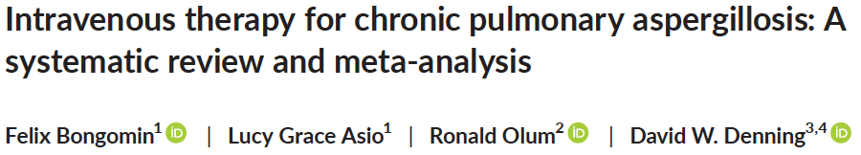
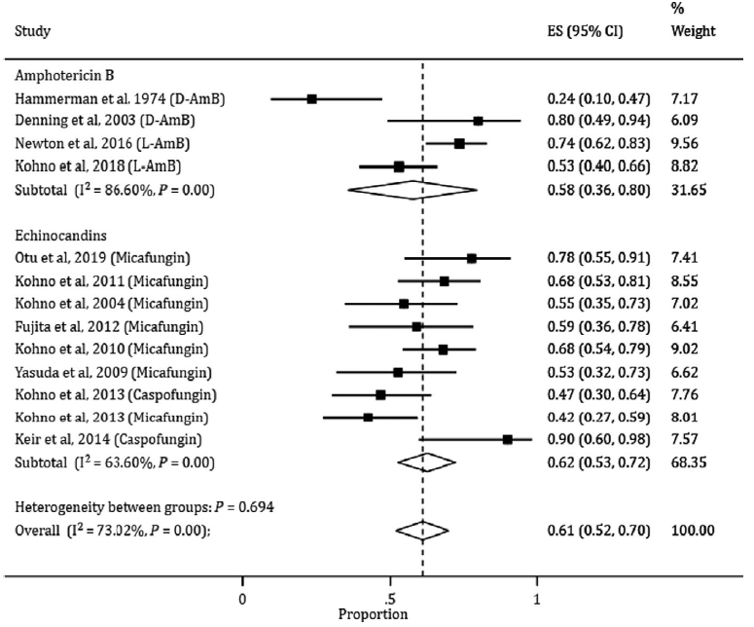
Amphotericin B
Echinocandins
Mostly
micafungin
61% response
Bongomin F et al, Mycoses 2020;63:921
Notes:
23

Slide 24
Is my patient immunodeficient?

Slide 25
T, B and NK cell subsets in CPA
Low CD4 (n=25)
0
Low CD3 (n=48)
Low CD8 (n=46)
0
0
0
2
0
0
4
0
10
0
1
1
4
1
6
2
1
1
9
6
1
4
3
2
0
0
0
15
18
10
Low CD19 (n=62)
Low CD56 (n=62)
Bongomin et al, J Fungi 2017;:37: 26

Slide 26
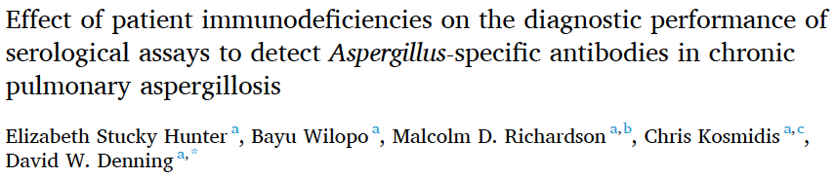
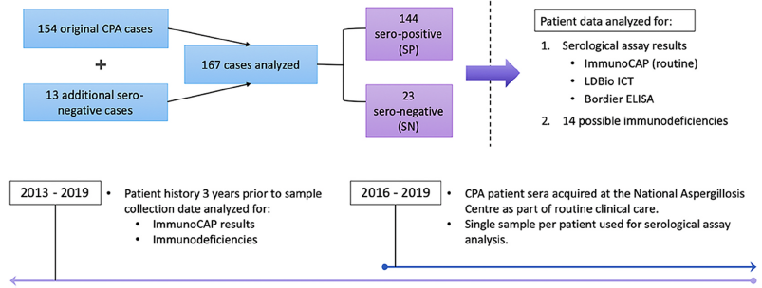
ImmunoCap IgG <40 mgA/mL
Stucky Hunter E et al, Resp Med 2021;:178:106290

Slide 27
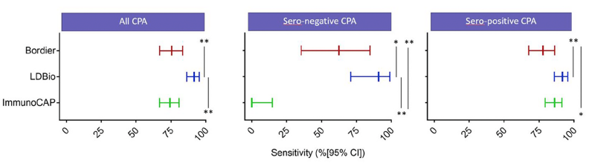
Stucky Hunter E et al, Resp Med 2021;:178:106290

Slide 28
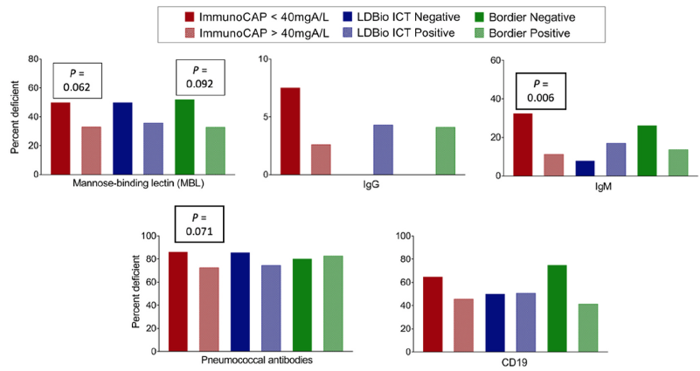
Stucky Hunter E et al, Resp Med 2021;:178:106290

Slide 29
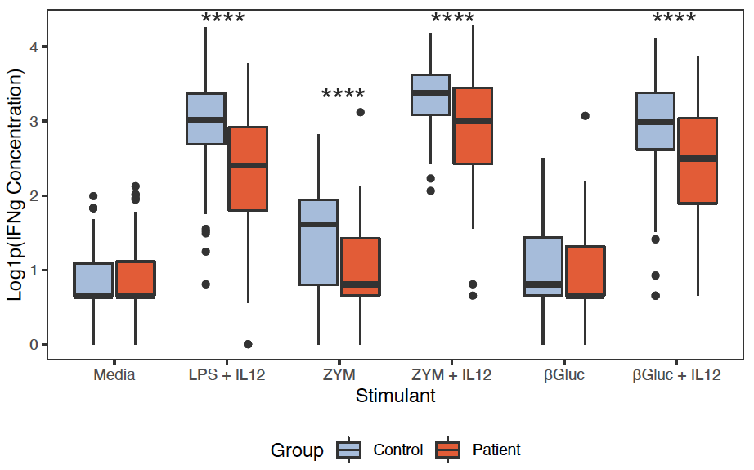
Gamma interferon is often deficient in CPA patients
Colombo SAP, J Infect Dis 2022;225:1822

Slide 30
Gamma interferon reduces bacterial exacerbations in CPA patients
Reduction in hospital admissions/year (0.8 to 0.3, p=0.04)
Monk E, Thorax 2020;75:513-6

Slide 31
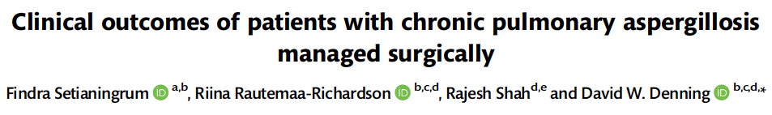
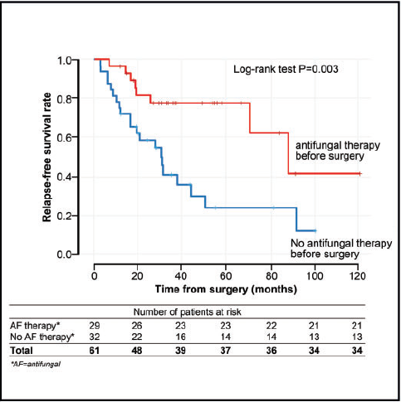
Setianingrum F et al, Eur J Cardiothor Surg 2020;58:997
Notes:
31

Slide 32
Conclusions
Itraconazole remains the initial treatment for CPA.
Voriconazole is a good second choice
Azole resistance occurring on therapy is relatively frequent
Limited data on posaconazole and isavuconazole
Patients who cannot tolerate azoles or who develop resistance may respond to IV micafungin or amphotericin B
Gamma interferon production poor in many CPA patients and supplementation may be helpful
Relapse after surgical resection common, but reduced by antifungal therapy before and during surgery

Slide 33


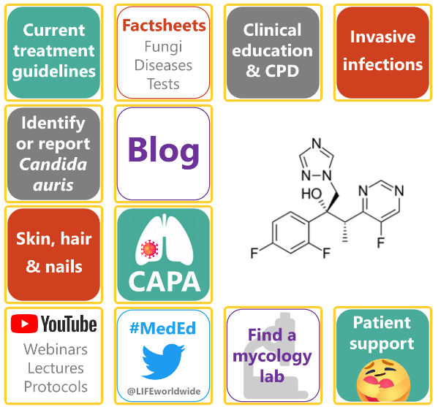

Educational website – www.fungaleducation.org
Free to use
Improved navigation
Easy access organism, condition and treatment factsheets
Video library, featuring content on procedures and lab techniques
Tailored to students and early-career healthcare professionals
Comprehensive and up-to-date guidelines
Drug interactions
Links to commercially available tests

