Slide 1
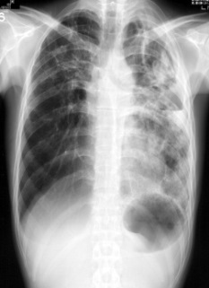
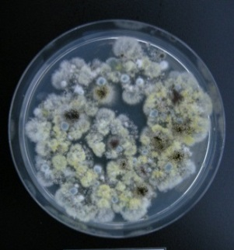
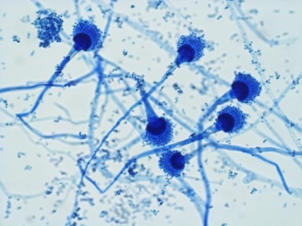
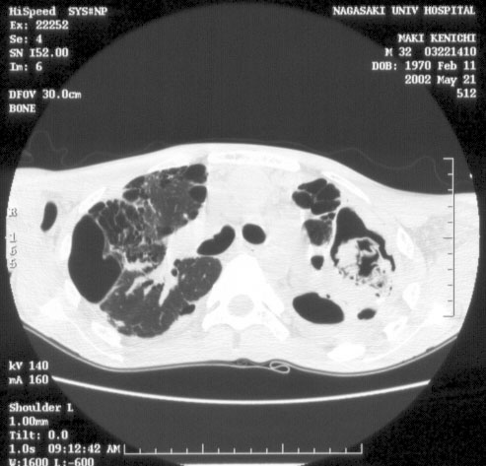
ISHAM 2022・New Delhi, India
Symposium, S10.4
Emerging antifungal resistant fungi
Pathophysiology, Diagnosis, and Management of Chronic Pulmonary Aspergillosis
Department of Infectious Diseases
Nagasaki University Graduate School of Biomedical Sciences
Koichi IZUMIKAWA, M.D., Ph.D.
Notes:
Good afternoon, ladies and gentlemen, it is my great honor to have a talk in this symposium. Thank you for inviting me for this. I would like to talk about Pathophysiology, Diagnosis, and Management of Chronic Pulmonary Aspergillosis and azole resistance related to CPA

Slide 2
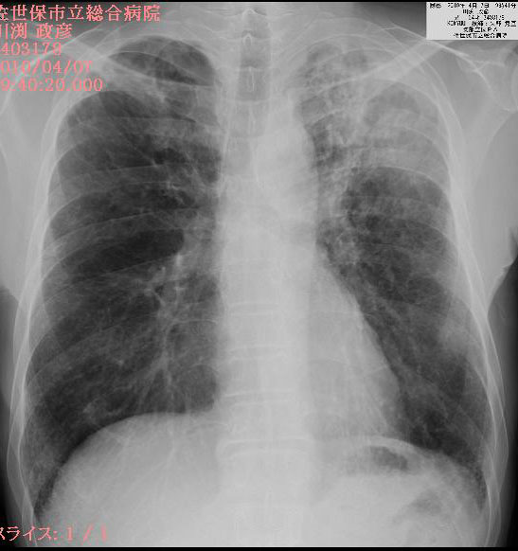
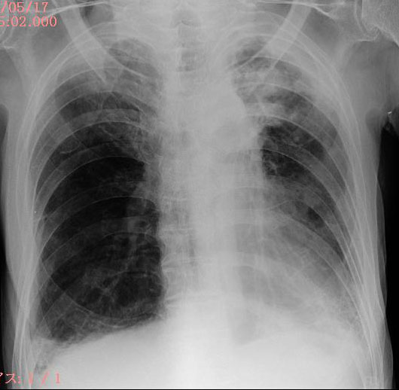
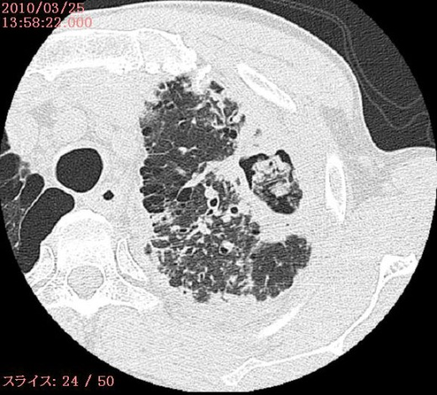
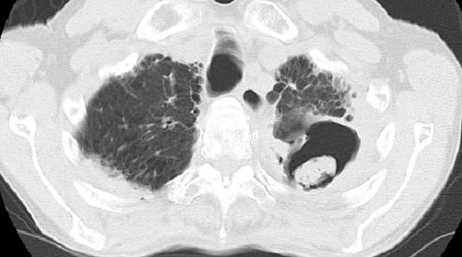
Chronic Pulmonary Aspergillosis
familial cases, Sasebo, JAPAN
2
54 years old, male, SON
82 years old, male, FATHER
slowly progressive inflammatory pulmonary syndrome due to Aspergillus spp.
Notes:
CPA can be defined as slowly progressive inflammatory pulmonary syndrome due to Aspergillus spp.
These are typical chronic pulmonary aspergillosis cases seen in father and his son in same residence. This is very interesting and we have been to their house to research the environment.

Slide 3
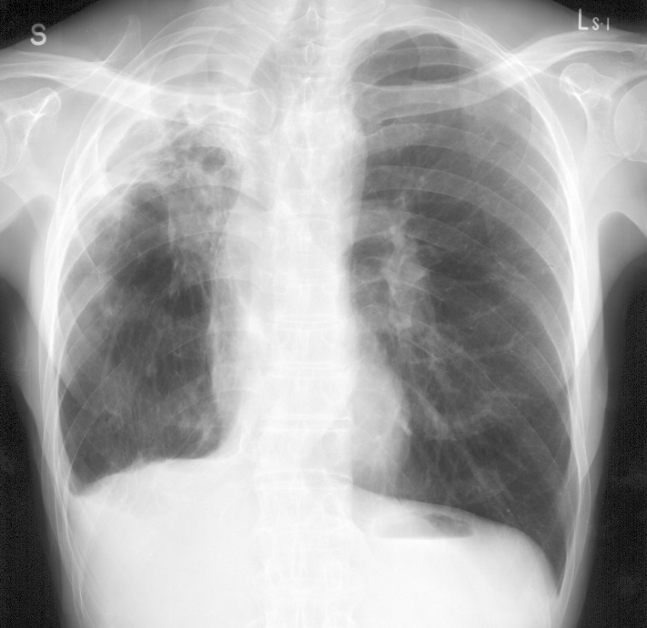
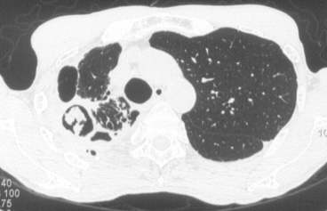
Typical CPA (Chronic Cavitary Pulmonary Aspergillosis) case
Chronic symptoms
[case]65 Y, Male
[CC] hemosputum, cough
[PI]
1998：right upper lobectomy (Tbc)
2005~：cough, hemosputum
2006~: hemosputum increased
chest CT：fungus ball like shadows in right lower lung.
Platelia EIA: positive, Aspergillus Ab: positive
β-D-glucan 35.0pg/ml
A. fumigatus isolated from BALF
NO OTHER MICROORGANISMS isolated
admission for further treatment
[PE] Height 161cm, Weight 44.3kg, BMI 17.1,
Body temp. 36.8℃, pulse 68/min, regular rhythm
Pulmonary underlying disease
Radiological finding
Microbiological & serological findings
Notes:
This is the typical CCPA cases. This cavitary lesion was produced by tuberculosis prior infection, so that pre-existed cavity was existed. The patient is 65 years old with tuberculosis treatment history including right upper lobectomy in past history. He complained hemosputum, and cough. The chest x-ray and laboratory findings showed fungus ball like shadows in right upper lung field. And serum tests showed positive of antigen and antibody and β-D-glucan also elevated.

Slide 4
CPA has lately been recognized as a significant global health burden
Rate of existence of Tuberculosis as complication
15% (U.K.) ～ 93% (Korea）
Rate of incidence of aspergilloma（U.K.）
  A year after termination of Tbc treatment: 14%
  (Positivity rate of Aspergillus precipitation Ab test：25%)
  Four years after termination of Tbc treatment ：22%
World wide：
There may be lots of CPA patients after Tbc infection
Thorax-2015-Kosmidis, Denning 270-7
Notes:
Dr. Denning from Manchester, UK said that CPA has lately been recognized as a significant global health burden. it is high Rate of existence of Tuberculosis as complication 15% (U.K.) ～ 93% (Korea）
Approx. one point two million CPA patients after Tbc infection is recognized.

Slide 5
CPA diagnosing flow
Underlying diseases (COPD, old Tuberculosis, thoracic surgery…)
Mild immunosuppression
Symptoms (fever, cough, sputum, hemoptysis, body weight loss…)
Inflammatory markers
Radiological deterioration (new cavities, fungus balls, enlargement of cavities, thickening of cavity wall, infiltration…)
Exclusion of Mycobacterium infections
Interferon gamma release assay, anti MAC antibody
Acid fast bacteria staining/PCR/ culture of sputum
Fungal culture of sputum
(±Drug sensitivity test)
Positive
Treatment
Negative (or not obtained)
Aspergillus IgG antibody (EIA)
Positive
Negative
*Optional
Bronchoscopy (BAL)
Histopathology/cytology
Fungal culture →Drug sensitivity test
(GM/β-D-glucan/PCR)
PCR of azole resistant related gene (AsperGenius®)
Positive
Bronchoscopy (BAL)
Histopathology/cytology
Fungal culture →Drug sensitivity test
GM/β-D-glucan/PCR
(PCR of azole resistant related gene (AsperGenius®))
Positive
Negative
Follow up
Reconsider differential diagnosis
Treatment
Takazono, Izumikawa: Frontiers in Microbiology, 2018

Slide 6
different forms of chronic pulmonary aspergillosis
Aspergillus nodule (s)
Chronic cavitary pulmonary aspergillosis
Single/simple aspergilloma
Subacute invasive aspergillosis or
chronic necrotizing pulmonary aspergillosis
Denning et al. Eur Respir J. 2016 Jan;47:45-68
Notes:
These are typical radiography for each four CPA group. I will explain one by one briefly.

Slide 7
different forms of chronic pulmonary aspergillosis
Single/simple
aspergilloma
CPA is an umbrella term
sometimes, we cannot be on the same PAGE due to complexity
Subacute invasive aspergillosis or
chronic necrotizing pulmonary aspergillosis
Aspergillus nodule (s)
Chronic cavitary pulmonary aspergillosis
Chronic fibrosing pulmonary aspergillosis
Denning et al. Eur Respir J. 2016 Jan;47:45-68
Notes:
In this GL, CPA has been divided into 5 major groups, Aspergillus nodule, SA, SIA (CNPA), CCPA and CFPA/ As you can see here,
All forms except CFPA are overlapped somehow.

Slide 8
Guidelines, good for standardization
IDSA
ESCMID/ERS/ECMM

Slide 9
epidemiology of CPA
9
CPA affects approx. 3,000,000 people
(possibly underestimated…..)
Morbidity and mortality
five-year survival rate, 15-60%
depending on comorbities and age
Van Braeckel E, Page I, Davidsen JR, et al. Treatment outcome definitions in chronic pulmonary aspergillosis: a CPAnet consensus statement. Eur Respir J 2022; 59: 2102950
Notes:
9

Slide 10
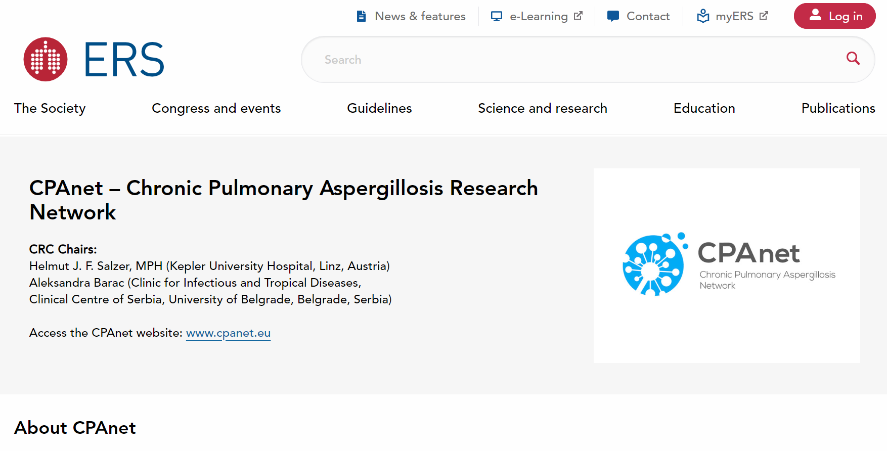
CPA community (CPAnet)

Slide 11
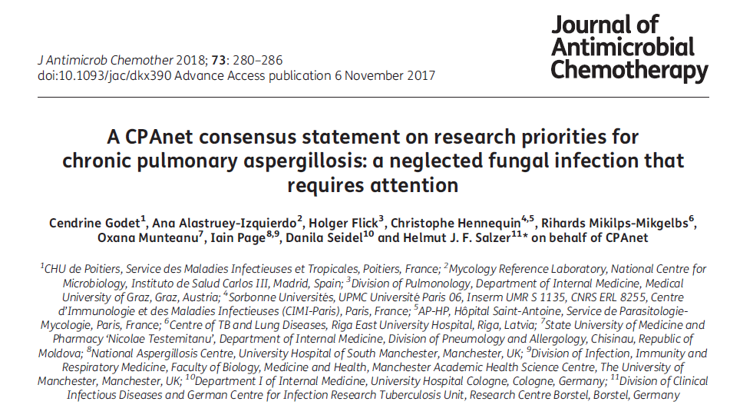
CPA community (CPAnet)

Slide 12
The Lancet Respiratory Medicine, Editorial
February, 2016
Requiring more strong RCT data
⇒set up ‘treatment definition’
Needs new drugs
Prevalence rate ? in developing countries
Notes:
From a couple years ago, several issues have been raised such as RCT data? Off course we need definitely newer drugs and prevalence especially in developing countries.

Slide 13
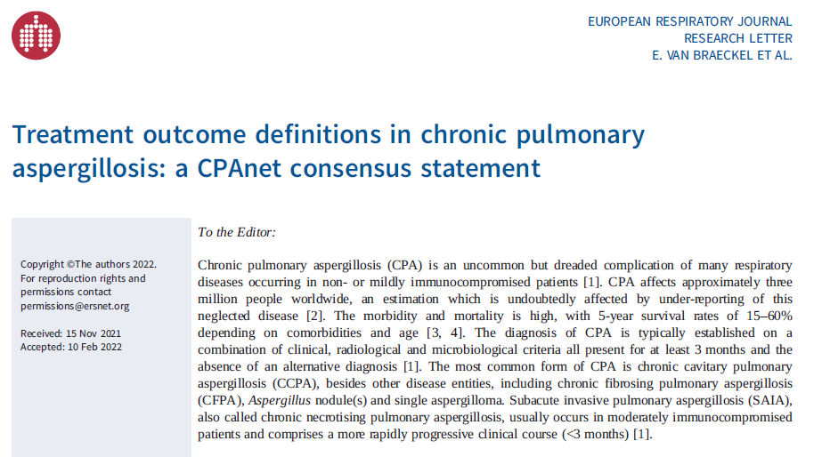
Activity of CPAnet
Treatment outcome definitions in CPA

Slide 14
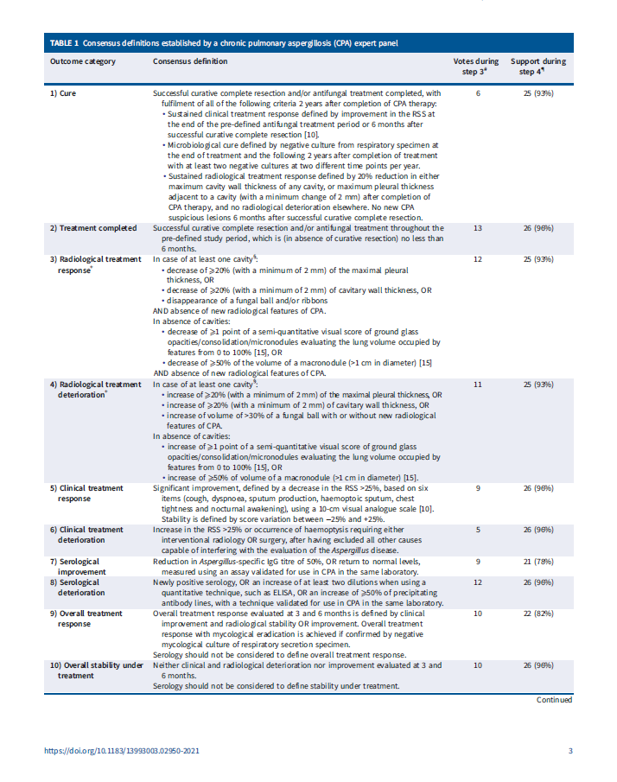
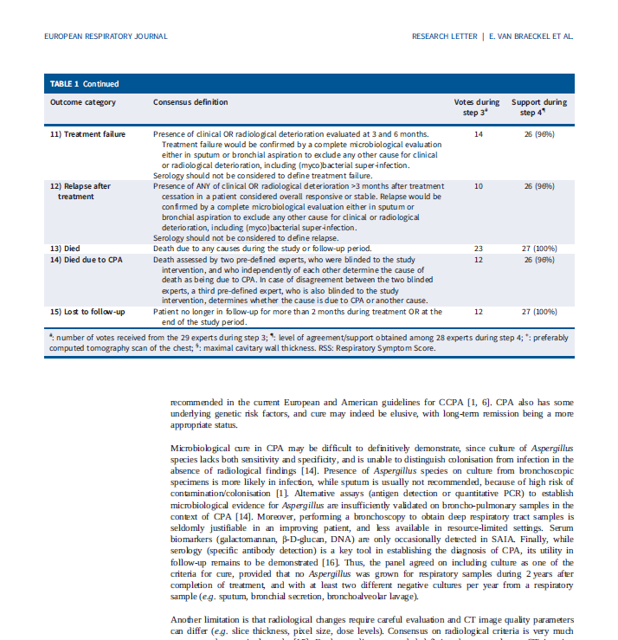
Treatment outcome definitions in CPA
expert opinion basis

Slide 15
Diagnostic methods of CPA
Test | Specimen | Sensitivity (%) | Specificity (%) | Note | Ref.
Culture | Respiratory specimen | 11.8-81.0 | - |  | Kitasato et al, 2009; Kohno et al; 2010, Nam et al, 2010; Shin et al, 2014
β-D-glucan | Serum | 5.4-26.7 | 96.8 |  | Kitasato et al, 2009; Kohno et al, 2010; Urabe et al, 2017
 | BALF | 77.8 | 72.5 | Cut-off ≧ 100 (Wako assay) | Urabe et al, 2017
Galactomannan | Serum | 22.6-66.7 | 63.5 | Cut-off values differ in each study between 0.5 to 1.0 | Kitasato et al, 2009; Kohno et al; 2010, Izumikawa et al, 2012; Shin et al, 2014
 | BALF | 77.2-77.8 | 77-90 | Cut-off values differ in each study between 0.4 to 0.5 | Izumikawa et al, 2012; Urabe et al, 2017
Aspergillus precipitating antibody | Serum | 56-89.3 | 100 |  | Kitasato et al, 2009; Kohno et al; 2010, Baxter et al, 2013; Page et al, 2016
Aspergillus IgG antibody | Serum | 93.2 | 98.2 | Bio-Rad | Page et al, 2018
 |  | 83.8-98 | 84-98 | ImmunoCAP | Fujiuchi et al, 2016; Page et al, 2016, 2018
 |  | 92.9-96 | 98-99.3 | Immulite | Page et al, 2016, 2018
 |  | 84.2-90 | 91-98 | Serion | Page et al, 2016, 2018
 |  | 77 | 97 | Dynamiker | Page et al, 2016
 |  | 76 | 99 | Genesis | Page et al, 2016
PCR | BALF | 66.7-86.7 | 84.2-94.2 | non-standarized method | Urabe et al, 2017
Takazono, Izumikawa: Frontiers in Microbiology, 2018

Slide 16
Performance of AspLFD test (OLM Diagnostics, U.K.)
CPA diagnosed by ERS/ECMID GL
 | Sensitivity (%) | Specificity (%) | Positive predictive value (%) | Negative predictive value (%)
AspLFD | 62 | 67.7 | 59.6 | 69.8
GM (C.O.I. 0.5) | 64 | 43.1 | 46.3 | 60.8
GM (C.O.I. 1.0) | 34 | 72.3 | 48.5 | 58.8
GM (C.O.I. 1.54) | 22 | 92.3 | 70.6 | 61.2
BDG (cut off 19.3 pg/ml) | 48 | 90.8 | 80 | 69.4
BDG (cut off 20.0 pg/ml) | 46 | 90.7 | 79.3 | 68.6
Aspergillus precipitating antibody | 70 | - | - | 81.3
Takazono T, Izumikawa K. et al. J Clin Microbiol. 2019 Mar 6
Notes:
Fifty patients with chronic pulmonary aspergillosis and 65 patients with respiratory disease, as a control, were enrolled in this study. The majority of the CPA disease entities were chronic pulmonary aspergillosis (64.0%, n = 32), followed by subacute invasive pulmonary aspergillosis (IPA) (20.0%, n = 10) and simple pulmonary aspergilloma (SPA) (16.0%, n = 8). The sensitivity and specificity of the AspLFD test in serum samples were 62.0% and 67.7%, respectively. The GM test (cutoff index, 1.54) showed a sensitivity of 22% and a specificity of 92.3%, while the sensitivity and specificity of the BDG test (cutoff, 19.3 pg/ml) were 48% and 90.8%, respectively. In bronchoalveolar lavage fluid samples, the AspLFD test showed a sensitivity of 66.7% and a specificity of 69.2%, while those of the GM test (cutoff index, 0.6) were 72.7% and 83.1%, respectively. The Aspergillus precipitating antibody test had 70% sensitivity. Unlike the Aspergillus precipitating antibody test, the AspLFD on serum samples showed similar sensitivity to non-fumigatus Aspergillus species. Patients with false-positive results for the AspLFD on serum samples were of a significantly higher age and had a higher prevalence of cavitary lesions in chest computed tomography than patients with negative results in the control group. Given the results in this study, the performance of the AspLFD using serum was acceptable as a point-of-care test for the diagnosis of CPA.

Slide 17
Aim and discontinuation of CPA treatment
（ERS/ESCMID GL 2016）
Prevention of haemoptysis and further fibrosis are key goals of therapy, even patients with stable disease may benefit by not deteriorating further.
Relapse is common, but not universal, on discontinuation of therapy.
Those with only stable disease may not benefit from long-term therapy, but each case must be assessed on its merits, with factors such as respiratory disability, tolerability of medication, need for alternative interacting medication and cost taken into account.
Denning et al. Eur Respir J. 2016 Jan;47:45-68

Slide 18
CPA treatment oral antifungals
（ERS/ESCMID GL 2016）
Treatment | SoR | QoE
ITCZ 400mg/day | A (strongly) | II
VRCZ 300-400mg/day＊ | A (strongly) | II
PSCZ 800mg/day | B (moderate) | II
Isavuconazole | - | -
＊varied depends on weight or age
Denning et al. Eur Respir J. 2016 Jan;47:45-68 w/ minor modification

Slide 19
Comparison of outcomes between groups that received initial maintenance therapy with oral itraconazole or oral voriconazole
 | Oral ITCZ |  | Oral VRCZ |  | P Value
 | (n=59) |  | (n=101)
Duration of initial maintenance therapy, median (2.5%–97.5%), d | 212 | (15-1713) | 116 | (5-841) | 0.110
Outcome at the end of observation, # (%)
Improved | 10 | (18.2 %) | 38 | 40.0 %) | 0.174
Stable | 18 | (32.7 %) | 12 | (12.6 %)
Worsened | 3 | (5.5 %) | 5 | (5.3 %)
Dead | 24 | (43.6 %) | 40 | (42.1 %)
Hospital readmission, No. (%) | 17 | (29.3 %) | 14 | (14.0 %) | 0.020
Treatment discontinuation due to adverse events, No. (%) | 12 | (20.3 %) | 19 | (18.8 %) | 0.470
Shifted to another antifungal agent due to insufficient efficacy of initial maintenance therapy, No. (%) | 16 | (27.6 %) | 8 | (8.0 %) | <0.001
Second-line antifungal agent used after initial maintenance therapy, No. (%)
ITCZ | 3 | (5.1 %) | 14 | (14.1 %) | 0.652
VRCZ | 12 | (20.3 %) | 17 | (17.2 %)
MCFG | 5 | (8.4 %) | 4 | (4.0 %)
None | 36 | (61.0 %) | 63 | (63.6 %)
Dose and number of cases treated with ITCZ
capsule 47 cases（400mg, 3; 200mg, 32; 150mg, 4; 100mg 8）
oral solution 11 cases（200mg, 10; 100mg, 1）
Tashiro M, Izumikawa K et al, CID 2019 Apr 9. pii: ciz287

Slide 20
Duration of therapy for chronic pulmonary aspergillosis
（ERS/ESCMID GL 2016）
Population | Intention | Intervention | SoR | QoE | comment
CPA patients on antifungal therapy | control of infection, arrest of pulmonary fibrosis, prevention of hemoptysis, improved quality of life | 6 months of antifungal therapy | B | II | Optimal duration of therapy in CPA is unknown, indefinite suppressive therapy may be appropriate in selected patients
 |  | Long-term antifungal therapy, depending on status and drug tolerance | C | III
Subacute invasive aspergillosis/CNPA | cure | 6 months | B | II | Longer durations may be necessary in those with continuing immunosuppression
Denning et al. Eur Respir J. 2016 Jan;47:45-68
Notes:
New ERS/ESCMID GL indicated ideal duration of CPA treatment with oral antifungals. as you can see at least 6 months treatment is recommended.

Slide 21
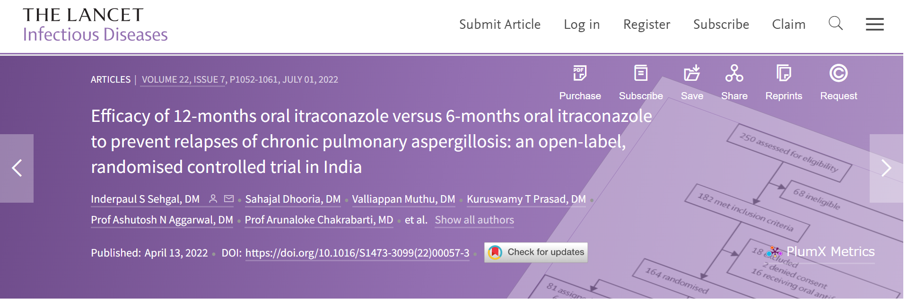
Duration of therapy for chronic pulmonary aspergillosis
Recent evidence of itraconazole
164 cases, 81 patients (6-month group) and 83 patients (12-month group).
The proportion of patients experiencing relapse was significantly lower in the 12-month group, 31 (38%) had a relapse in the 6-month group compared with 8 (10%) in the 12-month group, with an absolute risk reduction of 0.29 [95% CI 0·16–0·40].
The mean time to first relapse was 23 months in the 12-month group, which is significantly longer than the mean of 18 months in the 6-month group (p<0.0001).
There were 16 deaths in total, eight in each group.
Ten (12%) of 81 patients in the 6-months group and 18 (22%) of 83 patients in the 12-months group had adverse effects, with none requiring treatment modification.
Sehgal et al. Lancet Infect Dis. 2022 April 13
Notes:
New ERS/ESCMID GL indicated ideal duration of CPA treatment with oral antifungals. as you can see at least 6 months treatment is recommended.

Slide 22

long administration of ITCZ and azole resistance induction
800
r = 0.5700
n = 154
p <0.0001
100
p =0.03
600
*
80
ITCZ was used at 200mg/day (low dose) in many cases
↓
low conc. of ITCZ exposure may induce Cyp51A mutation
400
Total duration of ITCZ exposure (days)
60
Rate of none ITCZ treatment （%）
40
200
20
0
0
0.12
0.25
0.5
1
2
4
8
>8
0.25
0.5
1
2
ITCZ MIC（μg/ml）
ITCZ MIC (μg/ml)
Tashiro M, Izumikawa K et l. , AAC, 2012
Notes:
We investigated administration of ITCZ and MIC correlation. As you can see here, The longer administration of ITCZ causes higher MIC of ITCZ. The possible reason for this is that ITCZ was used at 200mg/day in many cases in Japan and such lower conc of ITCZ may cause Cyp51A mutation.

Slide 23
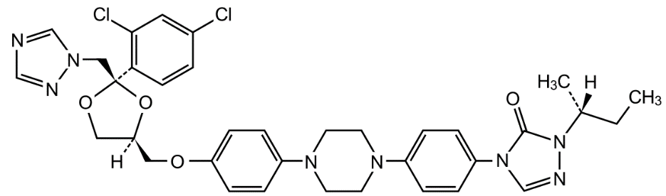
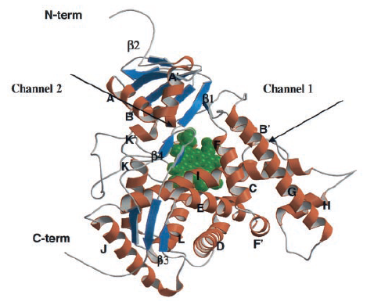
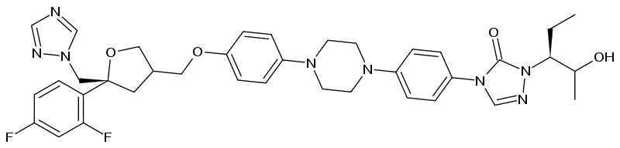
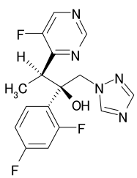
Structure of A. fumigatus CYP51A and azoles
ITCZ
CYP51A
POSA
VRCZ
Xiao, AAC, 48: 568-574, 2004
Notes:
This is the structure of CYP51A and azoles. These azoles binds to CYP51A

Slide 24
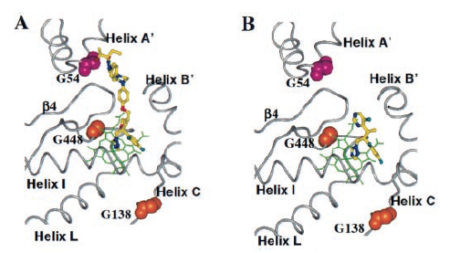
binding site of azoles in CYP51A
G54 mutation is not related to VRCZ binding
POSA (ITCZ)
VRCZ
Xiao, AAC, 48: 568-574, 2004
Notes:
Again, G54 mutation is not related to VRCZ. This reminds that we should know that detailed drug-susceptibility especially for CPA treatment, which requires ling term administration of azoles.

Slide 25
Azole-resistant A. fumigatus
SNPs multiple steps
multiple SNPs are acquired in 4 months (median) during treatment
months
-3
0
10
20
30
M220K
G54E
1
ITCZ
ITCZ
G54R
2
ITCZ
VRCZ
G54R
G54E
G448S
3
ITCZ
VRCZ
4
VRCZ+CASP
CPFG+POSA
Case number
G448S
5
VRCZ
L-AMB
+CASP
M220I
G54R
6
ITCZ
ITCZ
L-AMB
+ITCZ
WT
7
ITCZ
8
G54E
ITCZ
POSA
F219I
P216L
L-AMB
L-AMB
+CASP
Camps, AAC, 56: 10-16, 2012
Notes:
This is the interesting report from Dr. Camps. They studied the cyp51a mutation during treatment. And the conclusion is that multiple SNPs are acquired in 4 months (median) during treatment
This data indicates that long use of azoles are one of risk factors for azole-resistance.

Slide 26
Expert opinion for management of CPA with azole-resistant A. fumigatus
CPA requires long-term treatment with oral azoles
L-AMB or echinocandins
selection of azole-resistant A. fumigatus
Expert opinion
periodic culture and susceptibility testing of all isolates from patients on long-term azole therapy
the standard use of high volume sputum culture with early screening of resistance using azole-containing agar plates testing of multiple colonies from sputum cultures and using primary plates to detect resistance
ensuring that identified isolates are sent to a reference center for confirmation of the resistance mechanism
Verweij PE, et al. Drug Resist Updat. 21-22: 30-40, 2015
Notes:
Here is the opinion for CPA. only L-^Amb or echinocandins are option for the treatment. In order to isolate azole resistant strain, following tips are important for practice.
periodic culture and susceptibility testing of all isolates from patients on long-term azole therapy
the standard use of high volume sputum culture with early screening of resistance using azole-containing agar plates testing of multiple colonies from sputum cultures and using primary plates to detect resistance
ensuring that identified isolates are sent to a reference center for confirmation of the resistance mechanism
Finally, we should follow these tend of resistant in order to optimize treatment. Additionally, we should improve treatment strategy not inducing resistant during CPA treatment.

Slide 27
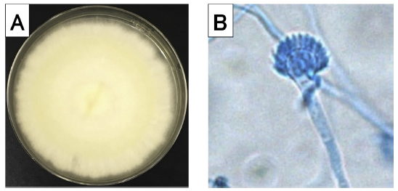
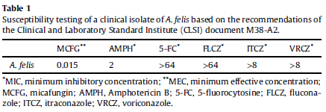
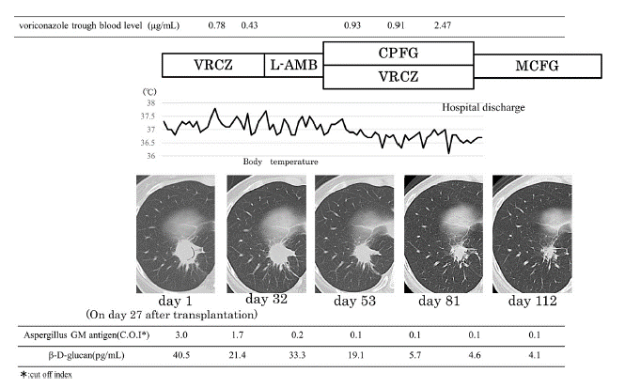
Aspergillus felis
emergence of cryptic species
J Infect Chemother. 2019 Apr;25(4):307-310.
Notes:
Fig. 2. Aspergillus culture. (A) Image of Aspergillus felis culture in Sabouraud Dextrose agar at 30 C on day 9. (B) Microscopical examination of lactophenol cotton blue stain of
Aspergillus felis.

Slide 28
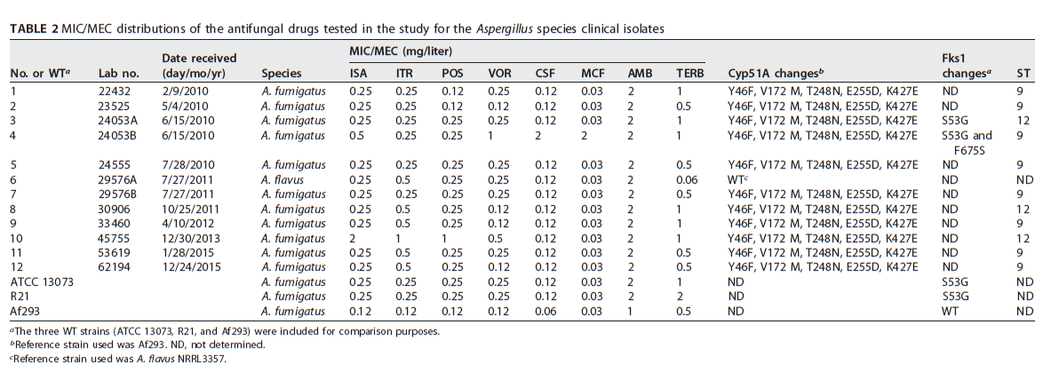
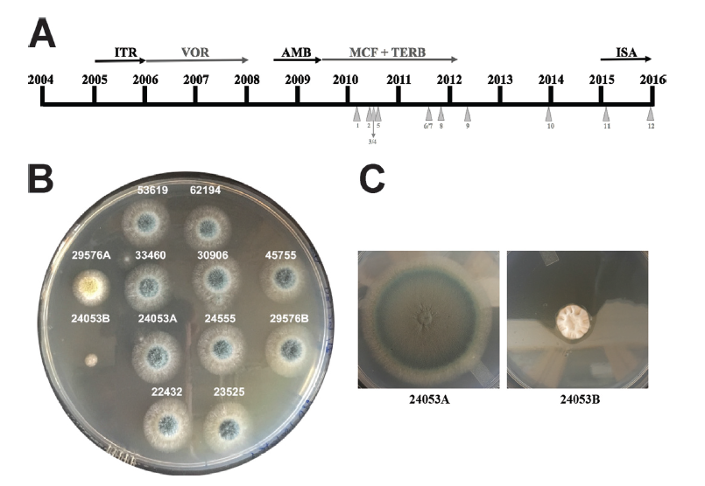
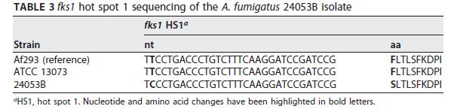
echinocandin resistant Aspergillus fumigatus in CPA case
Antimicrob Agents Chemother, 2017
Antimicrob Agents Chemother. 2017 Nov 22;61(12). pii: e01277-17

Slide 29
Summary
Pulmonary underlying disease such as prior tuberculosis, COPD and others are important
    → many potential CPA patients exist in countries with high Tbc prevalence
CPA requires long-term azole therapy
    → may cause-azole resistance during treatment
    → new oral antifungals with different mechanism of action essential
Monitoring and understanding the relations between azole resistance and virulence are important
    → utilize drug-susceptibility tests among hospitals
    → basic research for reducing resistance by PK/PD theory required
    → needs animal model

Slide 30


Thank you for your attention

