Slide 1
How to standardize Aspergillus PCR protocols for testing various specimens
Dr P. Lewis White
FRCPath, FECMM
Public Health Wales, Microbiology Cardiff

Slide 2
Disclosures
Company | Advisory Panel | Sponsorship | Grant | Speaker
Gilead | ✓ | ✓ | ✓ | ✓
MSD |  |  |  | ✓
Bruker |  | ✓ | ✓ | ✓
Launch |  | ✓ |  | ✓

Slide 3
Know your process
Disease manifestation
Organ infected
Incidence
Frequency of testing
Testing strategy
Underlying condition
Contamination
Specimens available
Inhibition
Targets available
Governs methods
Result interpretation
Frequency of testing
Testing strategy
Underlying condition
Disease manifestation

Slide 4
Achieving standardisation – Step 1
IA Pathology
Incidence
Specimens available
Literature review/Expert discussion
Determine preferred specimens/targets
Testing strategy
Notes:
4

Slide 5
Know your disease

Slide 6

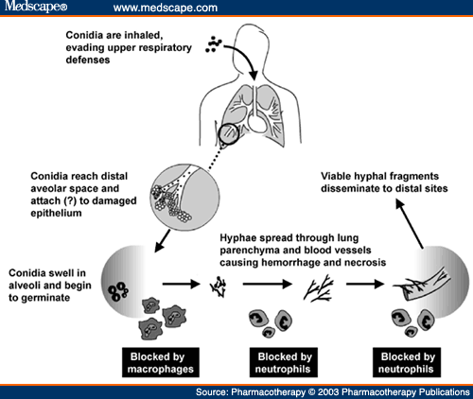
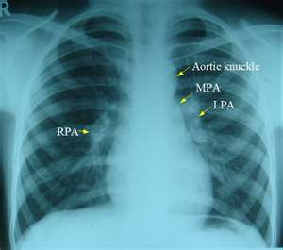
Invasive Aspergillosis – Disease process
DOH!

Slide 7
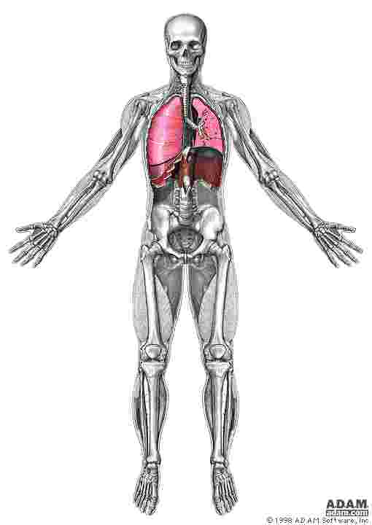
Aspergillosis – Disease spectrum
Cerebral
Sinusitis
Disseminated
Pulmonary
Cutaneous
Endocarditis
Osteomyelitis
Disease presentation,
Invasive, non-invasive, localised, allergic, chronic, acute:
Optimal Specimen type
Common species:
A. fumigatus, A. flavus, A. niger A. terreus, A. nidulans,
A. versicolor
Analytical specificity

Slide 8
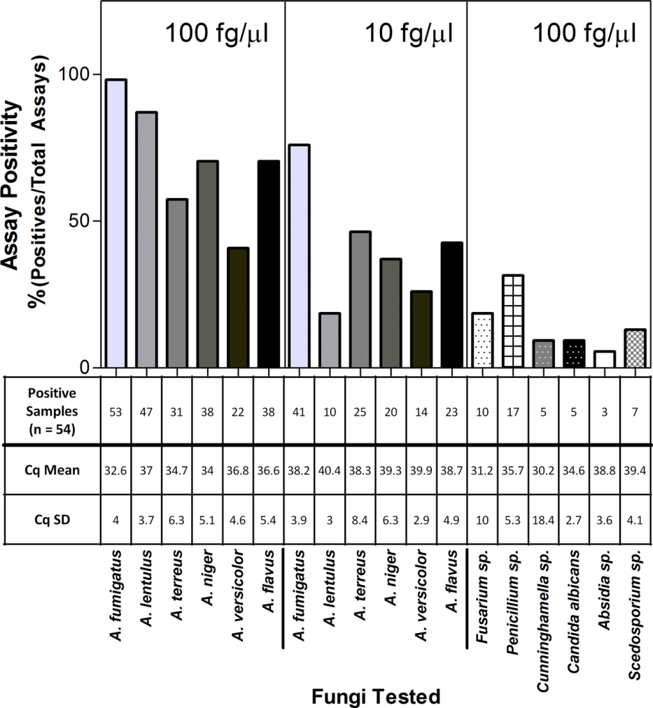
Determining Analytical Specificity
Range of Aspergillus sp detected
Cross reactivity
18 DNA samples
    12 from Aspergillus sp
    6 from other fungi
28 centres/33 datasets
Morton et al. Medical Mycology 2016

Slide 9
Analytical Specificity - Summary
Current Aspergillus PCR assays are better suited for detecting A. fumigatus
Inferior detection of other Aspergillus species.
  Geographical variation is important when developing assays
Genus sp assays increase detection range but compromise analytical specificity
Current strategies for IA are better suited to excluding disease – assay sensitivity is paramount
The use of an Aspergillus genus specific PCR assay targeting the rRNA genes is preferential.
Morton et al. Medical Mycology 2016

Slide 10
Sample Choices

Slide 11
IA and the host
White and Barnes 2018

Slide 12
Choice of Specimen for IA
  BAL
    Inhalation of Aspergillus spores
    Invasive
    Extensive successful studies
  CSF/Tissue samples
    Limited studies
    Invasive
  Serum/Plasma
    Extensive successful studies
    Targets Circulating DNA
  Whole Blood
    Extensive successful studies
    Targets DNA, fungal fragments
    Extended extraction procedure
Diagnostic Confirmation
Screening/Pre-emptive
Notes:
The choice of specimen can limit the available target type and may have effects on the PPV of the assay. Several publications have linked PCR positive BAL specimens with cases of IA. However inhalation of spores and/or colonisation of the lung may give rise to false positive results. In addition, the invasive nature of obtaining a BAL specimen often limits the use of the procedure. This is also true for CSF sample and the difficulty in obtaining control samples, initial, and repeat clinical specimens has lead to limited studies. Nevertheless PCR positive CSF samples should be considered significant.

Slide 13
Biomarker Performance – BAL
Infrequent test
Diagnostic: Confirms disease in symptomatic patients
  High Specificity / PPV
Parameter | GM-EIA |  | PCR
Reference | Zuoª | Guo^{b} | Tuon^{c} | Sun^{d} | Avni^{e}
Sample | BAL | BAL | BAL | BAL | BAL
Sensitivity | 83.6% | 85.7% | 78.4% | 79.6% | 76.8%
Specificity | 89.4% | 89.0% | 93.7% | 94.1% | 94.5%
LR +tive: >12
Overall comparable performance
Despite limited standardisation
BDG – Poor specificity (38.5%)^{f}
Culture – Poor sensitivity
(50% IA cases)
ªZuo et al. PLoS One. 2012;7(8):e43347; ^{b}Guo et al. Chest 2010; 138:817-824; ^{c}Tuon FF. Rev Iberoam Micol. 2007;24:89–94; ^{d}Sun et al. Plos One 2011; 6(12): e28467; ^{e}Avni et al. J Clin Microbiol. 2012;50:3652–8; ^{f}Mutschlechner W, et al. Transplantation. 2015;99:e140–4
GM-EIA: galactomannan enzyme immunoassay; PPV: positive predictive values

Slide 14

Biomarker Performance- Blood
High frequency screening test
Excludes fungal disease
  High sensitivity / NPV
Beneficial for low incidence disease
Parameter | GM-EIA |  | β-D-Glucan |  |  | PCR
Reference | Leeflangª | Pfeiffer^{b} | Lamoth^{c} | Karageorgopoulos^{d} | He^{e} | Mengoli^{f} | Arvanitis^{g}
Sample | Serum | Serum | Plasma/Serum | Plasma/Serum | Plasma/Serum | Blood | Blood
Sensitivity | 79.3% | 79.3% | 56.8% | 77.1% | 77.0% | 88.0% | 84.0%
Specificity | 80.5% | 86.3% | 97.0% | 85.3% | 81.3% | 75.0% | 76.0%
Comparable performance despite limited standardisation
LR -tive: 0.15 = Negative results exclude IA^{f}
ªLeeflang et al. J Clin Epidemiol. 2009;62:5-122009; ^{b}Pfeiffer et al. Clin Infect Dis 2006; 42:1417-27; ^{c}Lamoth et al. Clin Infect Dis. 2012;54:633–43; ^{d}Karageorgopoulos et al. Clin Infect Dis. 2011;52:750–70.; ^{e}He et al. J Microbiol Immunol Infect 2015;48:351–61; ^{f}Mengoli C, et al. Lancet Infect Dis. 2009;9:89–96; ^{g}Arvanitis M, et al. J Clin Microbiol. 2014;52:3731–42
IA: invasive aspergillosis; LR: likelihood ratio; NPV: negative predictive values; PCR: polymerase chain reaction

Slide 15
Determine preferred specimen
Based on optimal use of test
  IA Incidence: 5-15%
  Screening strategy
Overuse of unnecessary AFT
Ease of obtaining samples
  Invasive vs Non Invasive
  High frequency
Blood
  WB or serum or plasma
BAL methodology: secondary evaluation
  Confirmation of IA

Slide 16
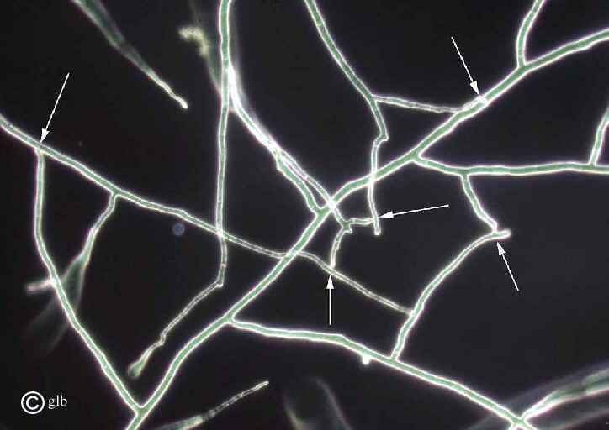
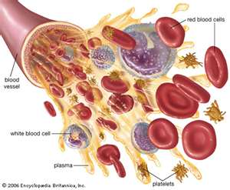

Potential targets in blood
Invading hyphal fragments
Circulating DNA
Viable
DNAemia
Angioinvasion and dissemination
Release Mechanism:
Hyphal damage
Interstitial pressures
Autolysis,
immune system, antifungal activity
Non viable
Platelet attachment
Phagocytosis
Alveolar MC translocation

Slide 17
Achieving standardisation – Step 2
Determine preferred specimens/targets
Distribution of QC panels – contrived samples
Evaluate existing methodology
Analysis of results
KEY PARAMETER
Determine optimal protocol through analytical validity
Provide methodological recommendations
Multi-centre evaluation of recommendations
Distribution of QC panels – contrived samples
Acceptable analytical performance
Analysis of results
KEY PARAMETER
Methodological Recommendations confirmed
Notes:
17

Slide 18


Extraction recommendations
“Nucleic Acid extraction is the critical step”
 | Serum/Plasma Testing | Whole Blood testing
Sample type | N/A | EDTA only
Sample volume | ≥0.5ml | ≥3.0ml
Potential target | Free circulating DNA | Phagocytosed fungal fragments
Extraction requirements | Commercial extraction kits | Red and White cell lysis, Bead-beating, commercial extraction kits.
Elution volume | Elute in <100µl,
Special requirements | Screen all reagents for contamination with fungal DNA. Positive and negative extraction controls recommended. PCR testing in duplicate. Perform an IC PCR (Ct typical of Aspergillus PCR +tve, not human DNA, can be incorporated into extraction process)
White et al 2010a, 2010b, 2011 and Loeffler et al. 2015

Slide 19
Achieving standardisation – Step 3
Methodological Recommendations confirmed
Animal model validation
Multi-centre clinical evaluation
Define clinical validity and utility
Inclusion in disease defining criteria

Slide 20

Dynamics of release
IAAM - Guinea pig inhalation IA model
  43 immunosuppressed (cyclophosphamide and cortisone acetate)
    30 exposed to A. fumigatus – Cases
    13 immuosuppressed high risk controls
  13 Immunocompetent low risk controls
  Euthanized: 1 hour, 5, 7 and 9 days
Testing
  Aspergillus PCR
    3ml EDTA WB for testing by 3 EAPCRI centres
    0.5ml serum for testing by 1 EAPCRI centre
  GM-EIA and β-D-Glucan
    Performed on serum by IAAM centre
White et al. JCM 2016

Slide 21
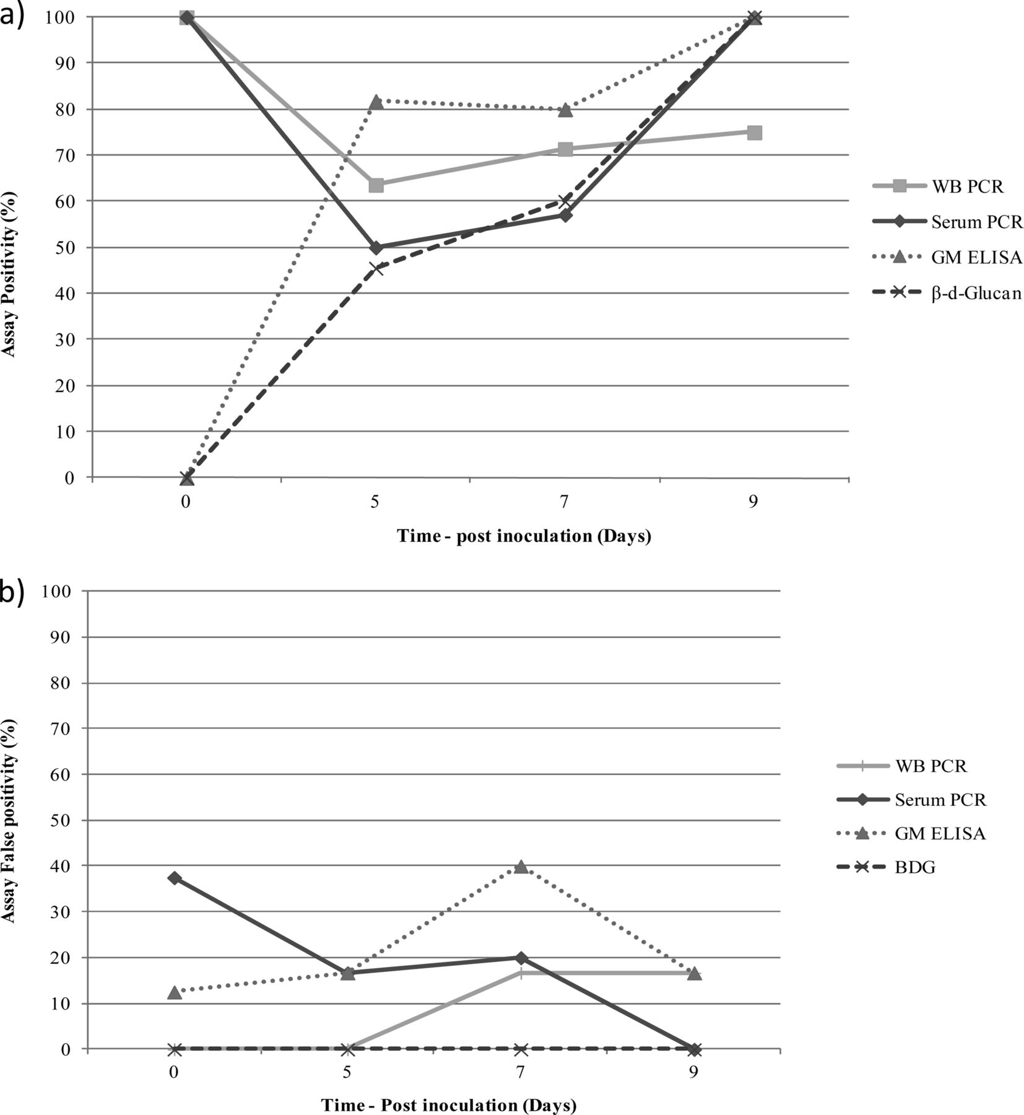
Assay positivity across the experiment
1) PCR positivity is an early indicator of exposure/infection:
pre-emptive strategies
Primary test in screening
Cases
Controls
White et al. JCM 2016
Notes:
Galactomannan, β-d-glucan, and PCR positivity for the individual time points across the time course of the experiment: (a) infected animals and (b) uninfected animals. Galactomannan positivity was determined using a threshold index of 0.5, and β-d-glucan positivity was determined using a threshold of 80 pg/ml. All PCR positives were confirmed by repeat testing.

Slide 22
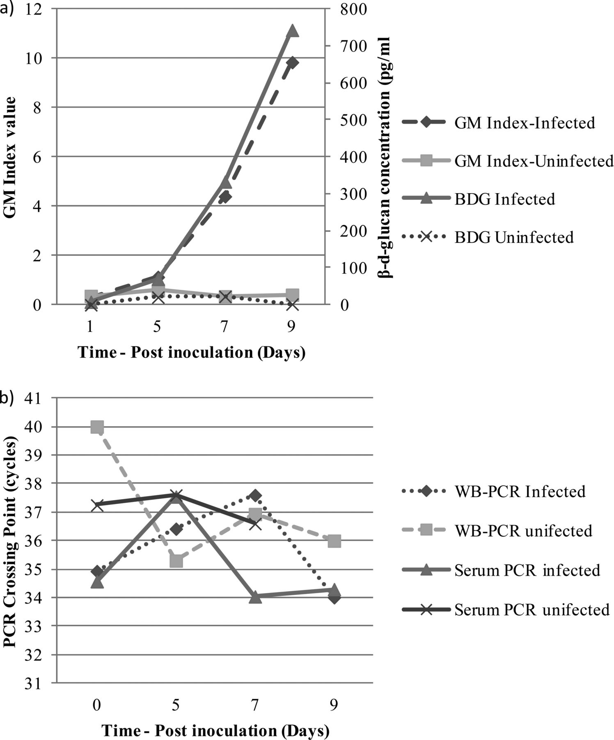
Monitoring disease progression
GM/BDG are indicators of disease progression
White et al. JCM 2016

Slide 23
Assays | Sensitivity (%) | Specificity (%) | Accuracy (%) | LR+ | LR- | AUC
WB PCR | 73 | 92 | 82.7 | 9.5 | 0.3 | -
Serum PCR | 65 | 79 | 72.0 | 3.1 | 0.4 | -
GM | 68 | 80 | 74.5 | 3.4 | 0.4 | 0.77
BDG | 46 | 100 | 74.5 | >455 | 0.6 | 0.82
Serum/WB PCR | 91/33 | 65/100 | 77/68 | 2.6/>330 | 0.1/0.7 | 0.84
BDG/WB PCR | 86/24 | 91/100 | 89/64 | 9.6/>240 | 0.2/0.8 | 0.90
GM/WB PCR | 100/33 | 78/96 | 89/66 | 4.5/8.3 | <0.001/0.7 | 0.91
BDG/Serum PCR | 76/33 | 74/100 | 75/68 | 2.9/>330 | 0.3/0.7 | 0.79
GM/Serum PCR | 90/43 | 61/96 | 75/70 | 2.3/10.8 | 0.2/0.6 | 0.82
GM/BDG | 81/38 | 83/100 | 82/70 | 4.8/>380 | 0.2/0.6 | 0.85
White et al. JCM 2016

Slide 24
Assays | Sensitivity (%) | Specificity (%) | Accuracy (%) | LR+ | LR- | AUC
WB PCR/GM/BDG | 100/67/14 | 78/96/100 | 89/82/59 | 4.5/16.8/>140 | <0.001/0.3/0.9 | 0.95
Serum PCR/GM/BDG | 100/48/33 | 61/96/100 | 80/73/68 | 2.6/12/>330 | <0.002/0.5/0.7 | 0.88
WB/Serum PCR/BDG | 90/71/10 | 65/100/100 | 77/86/57 | 2.6/>710/>100 | 0.2/0.3/0.9 | 0.90
WB/Serum PCR/GM | 100/81/14 | 57/91/100 | 77/86/59 | 2.3/9/>140 | <0.002/0.2/0.9 | 0.92
All four assays | 100/91/44/10 | 57/91/100/100 | 77/91/73/57 | 2.3/10.4/>429/>950 | <0.001/0.1/0.6/0.9 | 0.95
Overall PCR performance is comparable with established antigen tests
Combination testing is optimal: PCR, β-D-Glucan and GM
White et al. JCM 2016

Slide 25
Standardization has improved Clinical Performance
EAPCRI recommendations improved PCR performance
  Independent analysis
Sensitivity: 87% vs 82%
Specificity: 98% vs 85%
Not total compliance with EAPCRI recommendations (1 deviation)
Arvanitis M, et al. J Clin Microbiol. 2014;52:3731–42

Slide 26

EORTC/MSG definitions - Proposal
Aspergillus PCR– Mycological criterion
  Serum, Plasma, WB
  BAL
  2 or more consecutive positives
  Positive in both blood and BAL
  Combination biomarker testing
    PCR and GM >0.5
      Blood or BAL
    PCR and BDG >80pg/ml
      Blood or BAL?
Manuscript in preparation

Slide 27
What about BAL
Manuscript in preparation
Tomorrow @ 10.30:
S10.2 ISHAM Working Group: Fungal PCR Initiative
Room E106

Slide 28

Summary
“You never really learn much from hearing yourself speak.”
Know your disease
  Incidence
  Pathology
Know your preferred sample type
  Testing strategy
  Obtainability
Know your potential NA sources
  Between samples
  Suitability of extraction process
NA extraction is critical
  Evaluate and optimize
  PCR amplification is only as efficient as the NA extraction technique will allow.
PCR – Determine analytical specificity
International standard for Aspergillus PCR
Extensive collaboration essential
  No room for egos!

Slide 29

Acknowledgements
All members of the EAPCRI, now known as the FPCRI
IAAM/AsTeC
Public Health Wales

Slide 30
Achieving standardisation
IA Pathology
Incidence
Specimens available
Literature review/Expert discussion
Determine preferred specimens/targets
Testing strategy
Distribution of QC panels
Negative validation
Evaluate existing methodology
Analysis of results
KEY PARAMETER
Determine optimal protocol by analytical validity
Provide methodological recommendations
Positive validation
Multi-centre evaluation of recommendations by QC
Negative validation
Animal model validation
Protocol reassessment
Negative validation
Multi-centre clinical evaluation
Positive validation
Multicentre QC evaluation of modified protocol
Define clinical validity and utility
Inclusion in disease defining criteria
Notes:
30

