Slide 1

FPCRI – Laboratory Aspects
Dr P. Lewis White
FRCPath, FECMM
Public Health Wales, Microbiology Cardiff

Slide 2
Disclosures
Company | Advisory Panel | Sponsorship | Grant | Speaker
Gilead | ✓ | ✓ | ✓ | ✓
MSD |  |  |  | ✓
Bruker |  | ✓ | ✓ | ✓
Launch |  | ✓ |  | ✓

Slide 3

FPCRI – Laboratory Working Parties
Steering committee
LWP
CWP
SWP
EAPCRI Steering committee
FPCI Steering committee
LWP
CWP
SWP
Aspergillus
Candida
Mucorales
Pneumocystis
Tissue
Aspergillus
Candida
Mucorales
Pneumocystis
Tissue
EAPCRI
FPCRI

Slide 4
Aspergillus PCR-LWP

Slide 5
Extraction recommendations
“Nucleic Acid extraction is the critical step”
 | Serum/Plasma Testing | Whole Blood testing
Sample type | N/A | EDTA only
Sample volume | ≥0.5ml | ≥3.0ml
Potential target | Free circulating DNA | Phagocytosed fungal fragments
Extraction requirements | Commercial extraction kits | Red and White cell lysis, Bead-beating, commercial extraction kits.
Elution volume | Elute in <100µl,
Special requirements | Screen all reagents for contamination with fungal DNA. Positive and negative extraction controls recommended. PCR testing in duplicate. Perform an IC PCR (Ct typical of Aspergillus PCR +tve, not human DNA, can be incorporated into extraction process)
White et al 2010a, 2010b, 2011 and Loeffler et al. 2015

Slide 6
Dynamics of release
IAAM - Guinea pig inhalation IA model
  Euthanized: 1 hour, 5, 7 and 9 days
  Aspergillus PCR
  GM-EIA and β-D-Glucan
PCR: early indicator of exposure – 1h
Antigens: indicators of disease progression
Combination testing optimal
Assays | Sensitivity (%) | Specificity (%) | Accuracy (%) | LR+ | LR- | AUC
WB PCR/GM/BDG | 100/67/14 | 78/96/100 | 89/82/59 | 4.5/16.8/>140 | <0.001/0.3/0.9 | 0.95
Serum PCR/GM/BDG | 100/48/33 | 61/96/100 | 80/73/68 | 2.6/12/>330 | <0.002/0.5/0.7 | 0.88
WB/Serum PCR/BDG | 90/71/10 | 65/100/100 | 77/86/57 | 2.6/>710/>100 | 0.2/0.3/0.9 | 0.90
WB/Serum PCR/GM | 100/81/14 | 57/91/100 | 77/86/59 | 2.3/9/>140 | <0.002/0.2/0.9 | 0.92
All four assays | 100/91/44/10 | 57/91/100/100 | 77/91/73/57 | 2.3/10.4/>429/>950 | <0.001/0.1/0.6/0.9 | 0.95
White et al. JCM 2016

Slide 7
Standardization has improved Clinical Performance
EAPCRI recommendations improved PCR performance
  Independent analysis
Sensitivity: 87% vs 82%
Specificity: 98% vs 85%
Not total compliance with EAPCRI recommendations (1 deviation)
Arvanitis M, et al. J Clin Microbiol. 2014;52:3731–42

Slide 8
What about BAL?
Pig BAL – Screened negative for Aspergillus contamination
Potential targets
  Organism (A. fumigatus conidia)
  Free DNA (A. fumigatus genomic DNA)
Panel developed containing both targets
  Participants informed
  Not to the individual potential target within sample
  In 2014 - Avoid changes in procedure
In 2016 - Recommended extraction method

Slide 9
Potential methods
Centrifuge at 10000xg for 10 mins
Target Intracellular Fungal DNA
Decant supernatant
Targets Intracellular and free Fungal DNA
Discard supernatant
Mechanical Fungal cell lysis - bead-beating
DNA purification/
precipitation/
elution <100µl
Retain supernatant
Use supernatant to wash beads post lysis
Targets free Fungal DNA
Minimum starting volume: 0.5ml
Optional: For mucoid samples digestion with 0.2% SDS and proteinase K
Decant supernatant
Dicard Pellet
Discard Pellet and use supernatant
DNA purification/
precipitation/
elution <100µl

Slide 10
2014 v 2016
Combined
  Overall Se 2014: 64% 2016: 67% P: 0.34
  Overall Sp 2014: 87% 2016: 78% P: 0.19
  Se ≤10 ge 2014: 50% 2016: 56% P: 0.28
DNA
  Overall Se 2014: 64% 2016: 74% P: 0.05
  Se ≤10 ge 2014: 53% 2016: 66% P: 0.07
Conidia
  Overall Se 2014: 63% 2016: 61% P: 0.66
  Se ≤10 ge 2014: 48% 2016: 46% P: 0.89

Slide 11
Conidia vs DNA (2016)
50% Probability of detection
  DNA: 4ge
  Conidia: 7ge
PCR efficiency
  DNA: 90%
  Conidia: 59%
ROC analysis
  DNA AUC: 0.82
  Conidia AUC: 0.69

Slide 12
Compliance with recommendations
Compliant datasets = 20
  followed recommended protocol using >250ul of SN to wash beads
Partially compliant datasets = 10
  followed recommended protocol using ≤250ul of SN to wash beads
Non-compliant datasets = 6
  did not follow recommended protocol

Slide 13
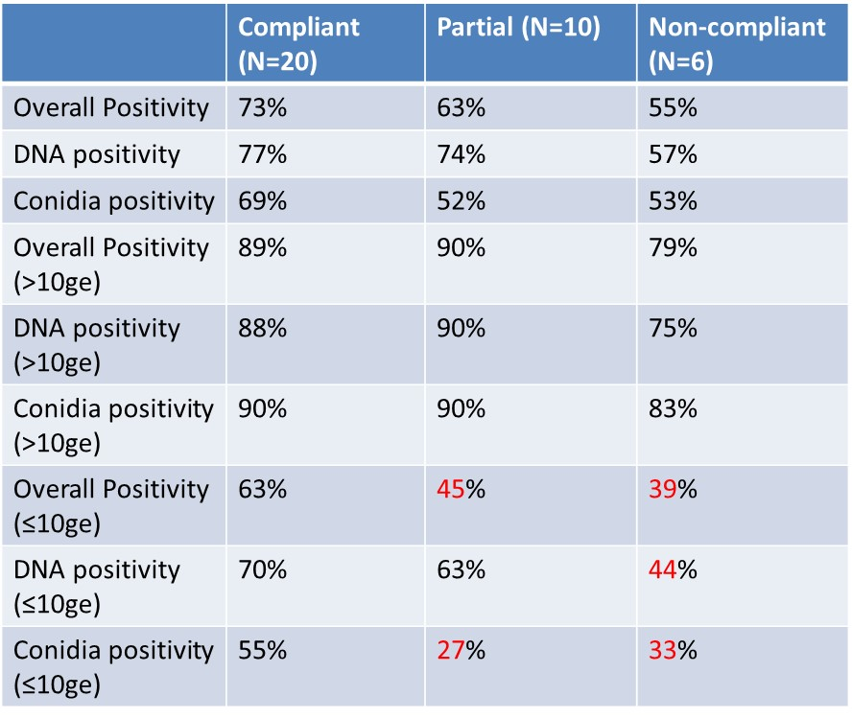
The influence of compliance on the 2016 results

Slide 14
Compared to the 2014 BAL panel
No difference in positivity when detected burdens >10ge
Burdens ≤10ge
  DNA/Conidia combined
    2014: 50% 2016 Compliant: 63% P=0.0381
  DNA
    2014: 53% 2016 Compliant: 70% P=0.0465
  Conidia
    2014: 48% 2016 Compliant: 55% P: 0.4194

Slide 15
Analytical Specificity - Summary
Current Aspergillus PCR assays are better suited for detecting A. fumigatus
Inferior detection of other Aspergillus species.
  Geographical variation is important when developing assays
Genus sp assays increase detection range but compromise analytical specificity
Current strategies for IA are better suited to excluding disease – assay sensitivity is paramount
The use of an Aspergillus genus specific PCR assay targeting the rRNA genes is preferential.
Morton et al. Medical Mycology 2016

Slide 16


International
Aspergillus PCR Standard
  Independent International Calibratorª
    Compare performance of PCR systems
    Develop international standard for PCR
    Negates the need for an individual test?
      Multiple PCR assays for other infections exist
      HIV/HEP C/CMV – international standard
  Source material: Plasma
ª Lyon et al. 2013

Slide 17
Pneumocystis PCR-LWP
Alexandre Alanio

Slide 18
The panel: sample preparation
Pool of 50 human DNA from negative BAL (Extraction Qiasymphony, with Diagenode IC)
Pool of 3 human DNA from positive BAL
5 samples generated (IC tested: no inhibitors)
3 positives : pooled negative BAL spiked at different ratio the positive pool in negative BAL
Aliquoted in 40 tubes
Send in dry ice in small styrene boxes and handled by Fedex

Slide 19
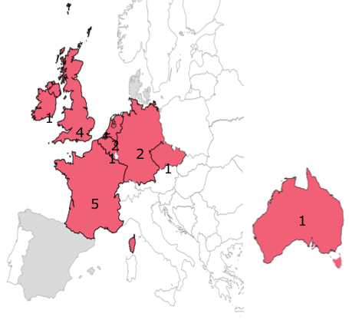
Samples
5 samples of 15µL
3 positive (high/medium/
low fungal loads) and
2 negative samples
PCR with 5µL of DNA in
duplicates
8 countries

Slide 20
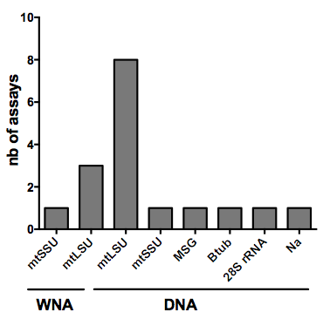
Diversity of the targets/assays evaluated

Slide 21
Commercial assays
12 in house real-time qPCR assays
5 commercial assay
  RIDAGENE Pneumocystis jirovecii REAL TIME PCR
  TIB Molbiol LightMix Modular Pneumocystis jiroveci
  PneumoGenius multiplex PN-600
  Fast track diagnostics Pneumocystis
  Pneumocystis jirovecii (carinii) Real-TM

Slide 22
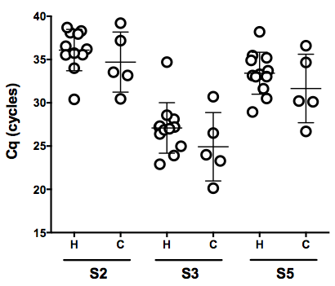
In house vs. Commercial

Slide 23
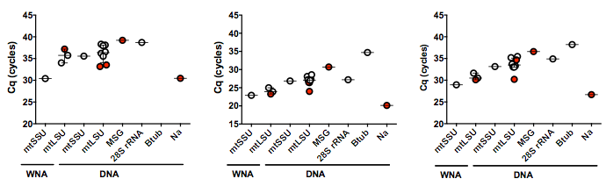
In house vs. Commercial
samples 2
samples 3
samples 5

Slide 24
Conclusions
WNA > DNA assays
Absence of detection of low fungal load (S2) with beta-tubulin target (single copy)
mtSSU > mtLSU > MSG > tubulin
PCR from the same primers gives more homogenous results
All commercial kits are not equivalent

Slide 25
Candida PCR-LWP
Rebecca Gorton

Slide 26
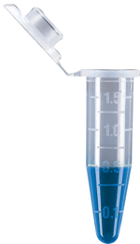
FPCRI Candida panel 1.0 – Specificity
12 samples – extracted DNA (100μl, clinically relevant concentrations
      Includes the ‘top 5’; C. albicans (2 dilutions), C. glabrata (2 dilutons),
      C. parapsilosis, C. krusei and C. tropicalis
      Includes 4 other yeast species implicated in IC (did not include A. fumigatus)
      Includes a negative control

Slide 27
Strain selection – Candida Panel 1.0
Species | Genome size | NCBI Reference | ATCC
C. albicans | 15.6 Mb | ID: 21 | 18804
C. glabrata | 12.7 Mb | ID: 192 | 2001
C. tropicalis | 14.9 Mb | ID: 212 | 750
C. krusei | 10.4 Mb | ID: 14557 | 32196
C. parapsilosis | 13 Mb | ID: 930 | 22019
Other 1 | 12.5 Mb | ID: 38761 | Clinical strain
Other 2 | 11.99 Mb | n/a | 34449
Other 2 | 41.3 Mb | ID: 34452 | 62400
Other 3 | 29.3 Mb | ID: 18 | 6260

Slide 28
FPCRI Candida panel 1.0
Timeline for panel 1.0
  Core group distribution – June 2018
    10 panels distributed so far, 5 left
  Extended group distribution July 2018
    Awaiting addresses etc
Future panels
  Panel 2.0 Sensitivity panel (DNA) – in progress
  Panel 3.0 Serum DNA panel
  Panel 4.0 Whole blood yeast whole cell panel

Slide 29
MUcorales PCR-LWP
Laurence Millon

Slide 30

Muc lab Working group – 1st Panel – July 2017
Muc PCR-First panel (associated with the Modimucor InterLab Control)
  5 control serum inoculated with DNA from several Mucorales species
  Sent on July 2017, to 23 labs
    12 Labs / Fungal PCRI (europe)
      shipment : -20° (dry ice +T° tracker) / Cryoexpress (220€)
    11 french Labs (9 modimucor/ 2 Fungal PCRI + Modimucor)
    shipment : +4° / TSE Express medical (free)
  Samples received by all the labs < 2 days / cold
  Results returned by 30 September (20/23 labs )

Slide 31
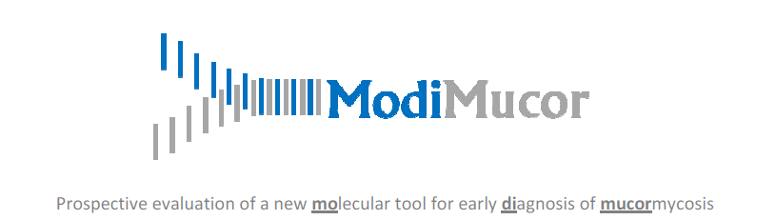
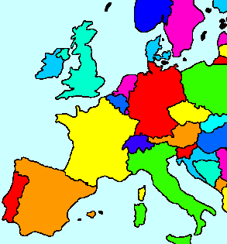
T Chouaki - CHU Amiens, France
F Dalle - CHU Dijon, France
D Dupont - CHU Lyon , France
F Botterel – APHP -Mondor Créteil, France
F Morio - CHU Nantes, France
ME Bougnoux - APHP - Necker Paris, Fance
V Letscher-Bru - CHU Strasbourg, France
X Iriart - CHU Toulouse, France
P Poirier - CHU Clermont Ferrand, France
S Bretagne, A Alanio- APHP -Saint Louis Paris, France
L Millon, E Scherer, S Rocchi, Besançon, France
Technical Information and results returned
M Lackner- Innsbruck, Austria
M Blatzer, W Posch, Innsbruck, Austria
B Willinger, Vienna Austria
C Halliday, Westmead, Australia
M Lengerova , Brno, Czech Republic
B Sendid, Lille, France
J Springer, J Loeffler, Wuersburg, Germany
M Cogliati, Milan, Italy
F Hagen, Nijmegen, The Netherlands
L White, Cardiff, United Kingdom
L Novak-Frazer, Manchester, United Kingdom
K Jaton-Ogay, Lausanne, Switzerland

Slide 32
  1 recommendation
  DNA extraction using 1 ml serum
  Diversity of techniques
  5 different extraction kits
  Several techniques for DNA identification/quantification
    Combination 3 specific QPCR (18S) (Millon, 2013) : 14 labs
    Mucorales-specific QPCR (Springer, 2016) : 2 labs (18S and 28S)
    Other techniques : 4 labs (ITS2, Rnl(mitochondrial)
  7 different master mix
  9 different QPCR platforms

Slide 33
sample number | Inoculated DNA | Cq average [SD] Labs using combination of 3 specific QPCR (n=14) | Cq Cunnighamellla specific QPCR (n=1) | Cq average [SD] All labs -All techniques (n=18)
S1 | Rhizomucor pusillus | 34.0 [2.45] | - | 34,8 [2,96]
S2 | None | NEG | - | NEG
S3 | Rhizopus oryzae | 30,1 [1.74] | - | 30,8 [2.23]
S4 | Cunninghamella bertholletiae | NEG | 32.8 | 35.4*
S5 | Lichtheimia corymbifera | 33,3 [1.61] | - | 33,7 [1,95]
→ Weak inter-laboratory variation
*Average Cq from the 3 labs which have detected Cunnighamella DNA in the sample S4.

Slide 34
Muc lab Working group – 2nd Panel –June/July 2018
Muc PCR-Second panel (associated with the Modimucor InterLab Control)
  control serum (n=7) inoculated with DNA from Mucorales, several concentrations
  Checking /participants in the second panel (12 positive answers from FPCRI members ) (e-mail 6 June)
  2nd panel : participation of 22 labs
    10 Labs / Fungal PCRI
    shipment : -20° (dry ice) / Cryoexpress
            sent on June 26th to 9 european labs (Samples received by all the labs < 2 days / cold)
            to be sent to Australia on July 5th
    12 french Labs (9 Modimucor / 1 FPCRI / 2 FPCRI + Modimucor)
          shipment : +4° / TSE Express medical
          to be sent on July 5th

Slide 35
Tissue PCR - LWP
Volker Rickerts

Slide 36
Previous attempts to create a tissue panel
FFPE tissue cuts from Galleria infection model
  variable fungal load
  limited amount of tissue
FFPE tissue cuts from veterinary cases
  variable fungal load
  limited mount of tissue
  Mostly exotic fungi (Dermatophytes, blackyeasts)

Slide 37
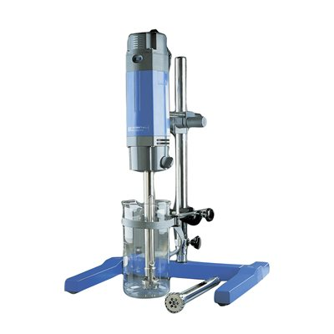
Frozen Tissue (Rebecca Gorton)
Candida mouse model
  2x10⁶ C.albicans
  Sacrificed after 1 week
  Liver
    in PBS
    tissue homogenizer
    Liquid nitrogen
    DNA extraction
    MP Yeast kit with bead beating
Microscopy (GMS)
broadrange qPCR
  28S 10f 12r: 340 Bp
  cybergreen with meltcurve-analysis
Internal amplification control
Notes:
30 fg (10 15) Candida 100 (10 9) ng human

Slide 38
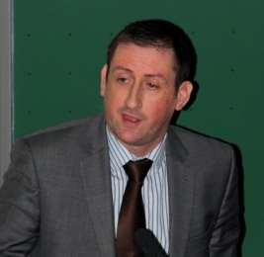



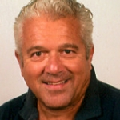



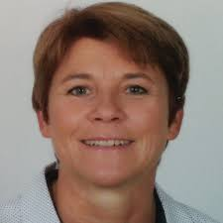
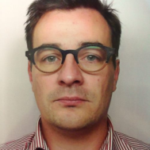
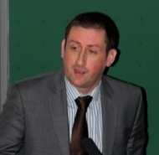
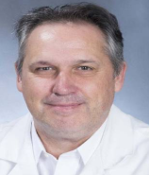
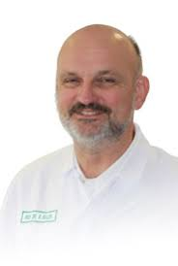
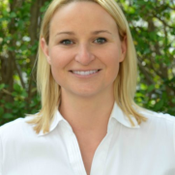

Stichting/ Foundation:
Europees Aspergillus PCR Initiatief/
European Aspergillus PCR Initiative
Lab WP
Secretary
Chair
Treasurer
Transl. WP
EAPCRI Steering Committee
Fungal PCR Initiative (FPCRI)
Chair of FPCRI
Laboratory Working Party
Clinical Translation Working Party
Candida WP
TissueWP
Mucorales WP
Pneumocystis WP
Aspergillus WP
Candida WP
TissueWP
Mucorales WP
Pneumocystis WP
Aspergillus WP

