Slide 1


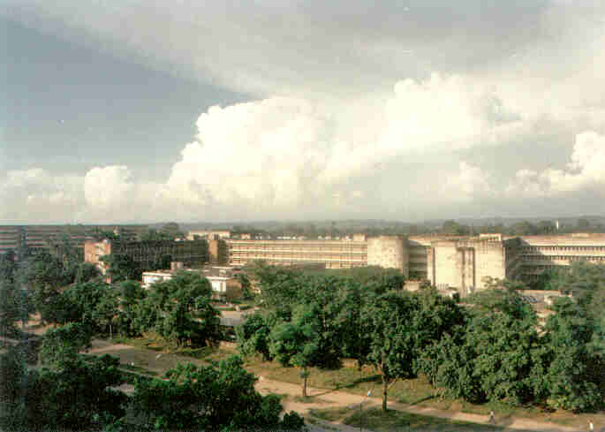
MALDI -TOF MS based identification of clinically important moulds is faster and reliable- an experience from India
Anup K Ghosh (Additional Professor)
Mycology Division (WHO Ref. Center)
Department of Medical Microbiology
Postgraduate Institute of Medical Education & Research
Chandigarh – 160012, India

Slide 2
Challenges in Management of Invasive Fungal Infections (IFI)
IFIs, a serious life threatening infection
Associated with high morbidity and mortality
Nonspecific presentation & inadequate diagnostic methods
Candidemia, a blood stream infection , mortality varies from 35-75%
Mycelial, Aspergillus, Fusarium, Apophysomyces, Rhizopus, Scedosporium causing IFI
More number of newer species causing IFI on the board

Slide 3
Challenges in Management of Invasive Fungal Infections (IFI)
Rising antifungal resistance, a growing concern
AFST for many pathogenic fungi are species specific
Intrinsic resistance of some moulds need to update the clinicians
Rapid and reliable identification could play an important role in optimizing therapy

Slide 4
Available identification procedures
Phenotypic
    Morphological
    Physiological
    Biochemical (API 20C, AUX, and VITEK-2)
Expensive, limited databases, and misidentifications are reported
Genotypic
    Identification by DNA sequencing of ITS, 28S by
    multiplex PCR or by real time PCR
  Expensive, time consuming, interlaboratotory standardization ?
  needs expertise

Slide 5
Matrix-assisted laser desorption/ionization time-of-flight mass spectrometry (MALDI TOF MS)
Identification of bacteria using mass spectrometry, proposed in 1975 by Anhalt
MALDI- Term was coined in 1985 by Franz Hillenkamp,
Michael Karas
Identification of microorganism by analyzing ribosomal protein
Introduced for rapid identification of bacteria as well as yeasts but mycelial fungi ???? Still evolving

Slide 6
S.No | Identification of melanized fungi | Time required for conventional identification (Days) | Time required for DNA sequencing (Days)
1 | Acrophialophora fusispora | 10-14 | 7-10
2 | Alternaria alternata | 5-7 | 5-7
3 | Bipolaris specifera | 5-7 | 5-7
4 | Chaetomium globosum | 7-10 | 5-7
5 | Cladophialophora bantiana | 5-7 | 5-7
6 | Cladophialophora carrionii | 7-10 | 5-7
7 | Colletotrichum truncatum | 10-14 | 7-10
8 | Curvularia lunata | 5-7 | 5-7
9 | Epicoccum nigrum | Non Sporulating | 7-10
10 | Exserohilumrostratum | 7-10 | 7-10
12 | Fonsecaeapedrosoi | 7-10 | 7-10
13 | Humicola fuscoatra | 10-14 | 7-10
14 | Lasiodiplodia theobromae | Non Sporulating | 7-10
15 | Medicopsis romeroi | Non Sporulating | 7-10
16 | Papulaspora equi | 10-14 | 7-10
17 | Phialophora verrucosa | 10-14 | 7-10
18 | Rhytidhysteron rufulum | Non Sporulating | 7-10
19 | Roussoella percutanea | Non Sporulating | 7-10
20 | Scytalidium lignicola | 10-14 | 7-10
21 | Ulocladium spp. | 10-14 | 7-10

Slide 7
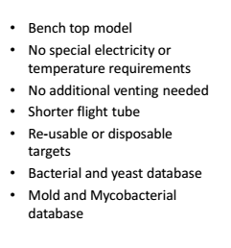
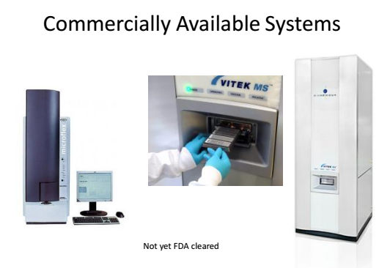
Commercially available MALDI TOF systems
US Food and Drug Administration (FDA) cleared for identification of microorganisms
Bruker Biotyper(MBT) BioMerieux MS

Slide 8
Uses of MALDI TOF MS (Biotyper or MS)
Identification of bacteria (aerobic & anaerobic)
Identification of Mycobacterium
Identification of fungi (yeast and moulds)
Antimicrobial Susceptibility Testing Using MALDI-TOF
Direct Testing of Clinical Samples
Typing Using MALDI-TOF MS

Slide 9
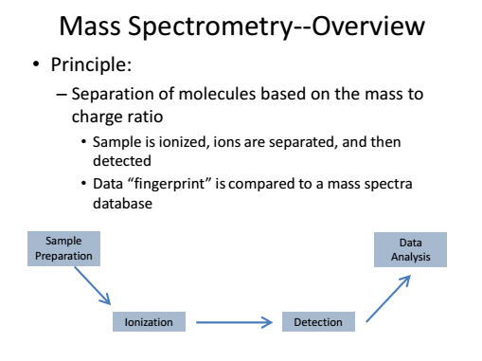
Matrix-assisted laser desorption ionization (MALDI-TOF MS)

Slide 10
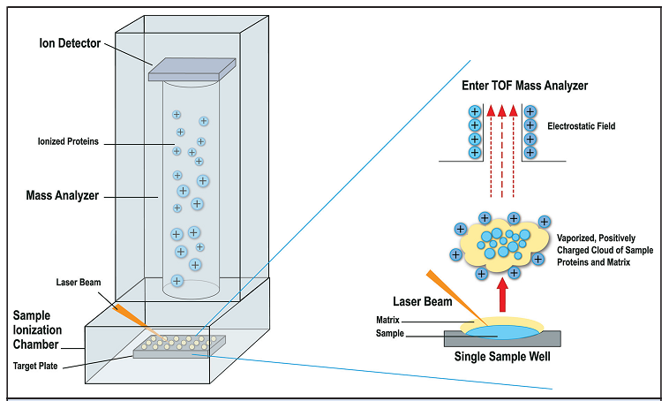
MALDI TOF MS (Biotyper )

Slide 11
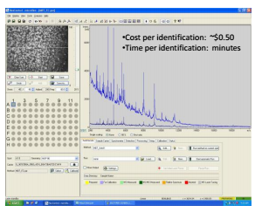
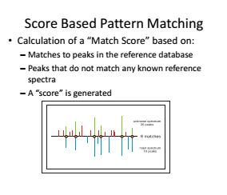
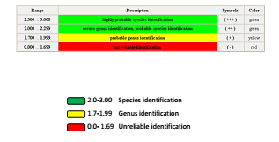
MALDI-TOF MS sample analysis and identification

Slide 12
Sample Preparation Methods
Direct “cell smear“ method
Simple method, applicable to many bacteria
On Plate extraction method
Formic acid extraction on the plate
Organic solvent extraction (Off plate)
Improved quality for difficult bacteria, yeast, fungi
Mechanical cell disruption (sonication,vortex etc.) In case of very ridgid cell walls

Slide 13
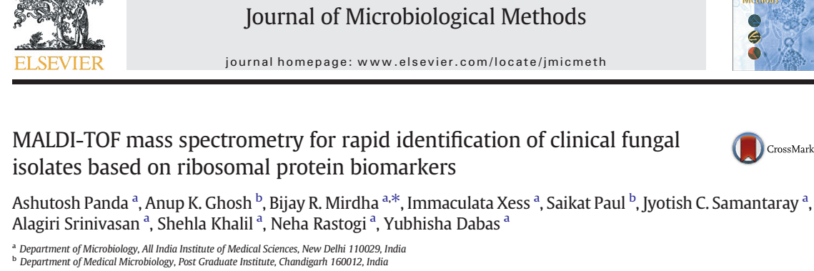
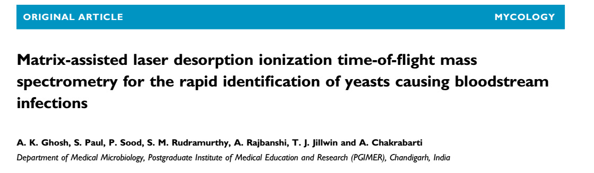
Our work at PGIMER : Yeast identification
2015,Feb:109:93-105

Slide 14


Our Sunny
Yeast Identification-
before MALDI-TOF
Yeast Identification-after MALDI-TOF

Slide 15
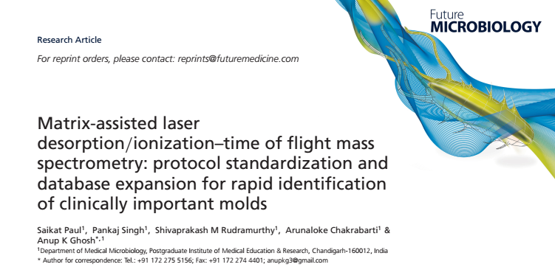
Identification of mould identification by MALDI-TOF MS was a challenge
Lack of standardized protein extraction protocol
Limited database

Slide 16
Fungal isolates included in the study
Melanized fungi
59 isolates for standardization & in-house database creation
Identification
Conventional
Hyaline fungi
Standardization: A. flavus (ATCC 204304), R. oryzae (CBS 131512) and F. solani (NCCPF 58A0057)
Validation: 153 hyaline fungi
In-house database creation: 30 isolates of 12 different species
DNA sequencing of ITS and 28S rDNA genes.
117 isolates for the validation of in-house database

Slide 17
Standardization of protein extraction protocol
Protocol-A
Direct plate extraction method from solid media growth
Protocol-B
Liquid nitrogen crush to make powder from solid media growth followed by off-plate extraction
Protocol-C
Off-plate extraction from growth on liquid media with some modifications
Protocol-D
Similar to protocol C, except growth from solid media with major modifications

Slide 18
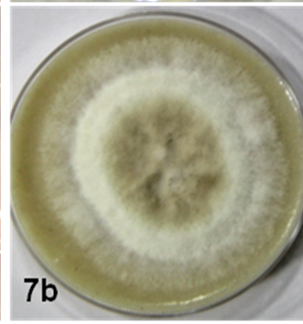
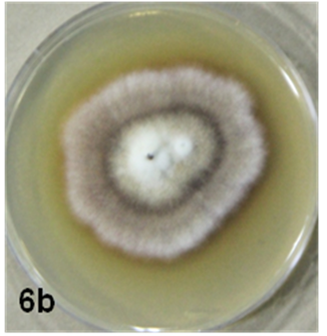
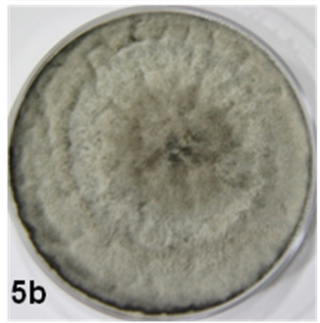
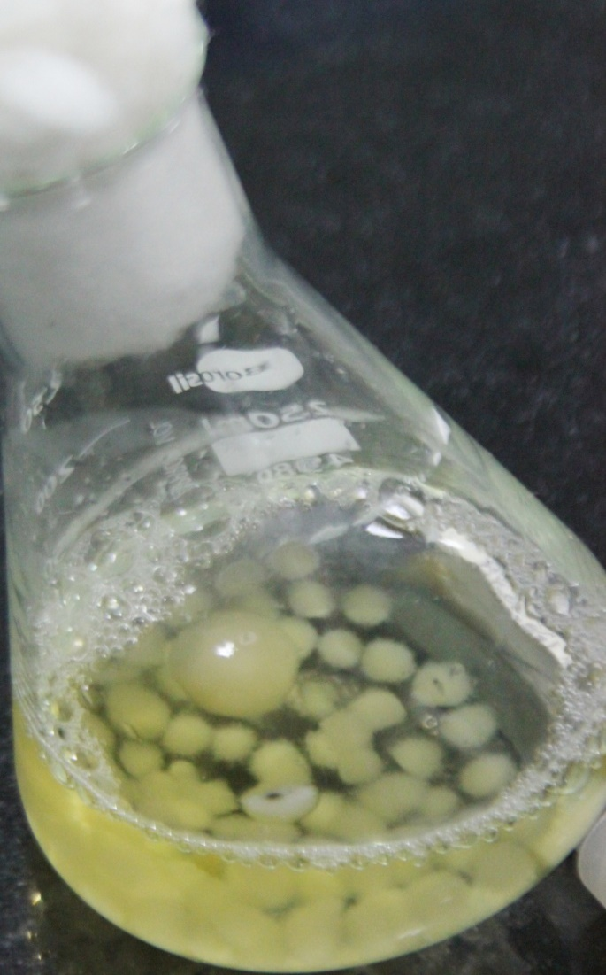
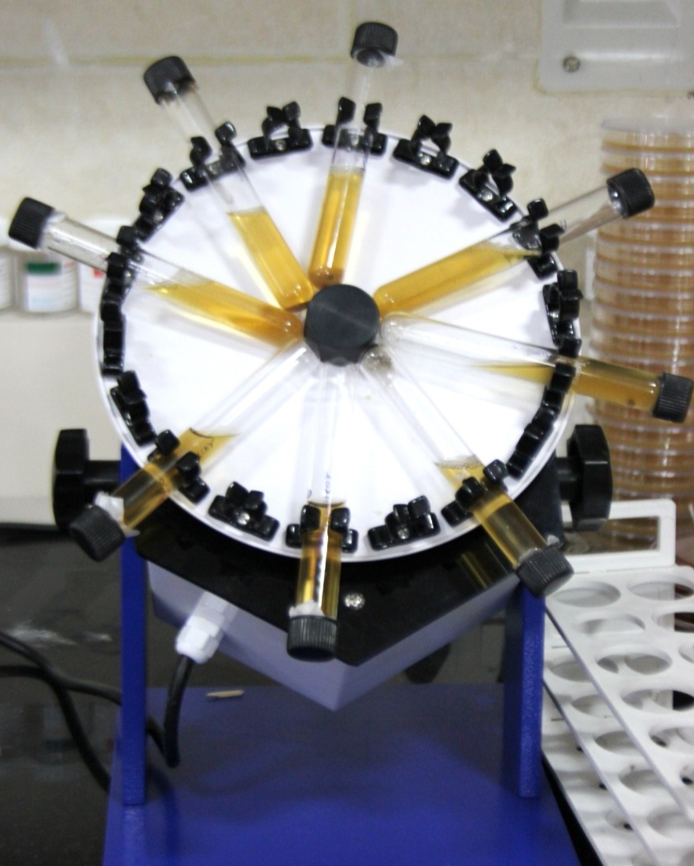
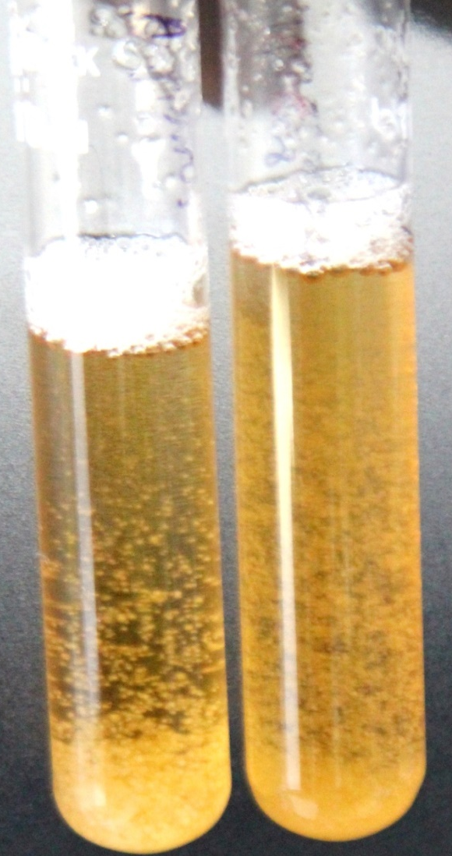
Mycelial growth for MALDI identification

Slide 19
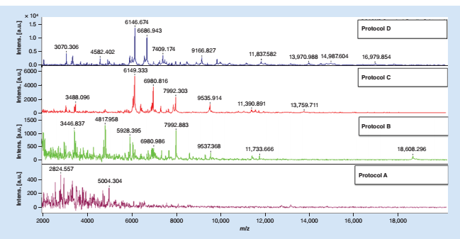
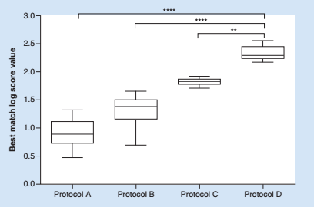
Protocol ‘D’ showed the best result

Slide 20
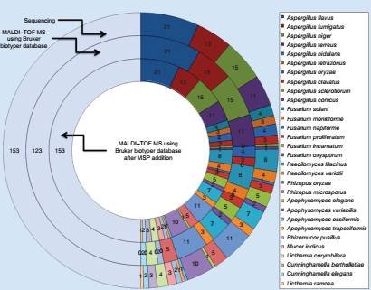
Modified protein extraction & expanded the existing database
S. No | Species | Bruker Database Mean log score ± SD | Bruker plus in-house database Mean log score ± SD
1 | A. nidulans | 1.54 ± 0.06 | 2.41 ± 0.19
2 | A. tetrazonus | 1.17 ± 0.11 | 2.52 ± 0.07
3 | A. sclerotiorum | 0.9 ± 0.0 | 2.5 ± 0.0
4 | A. conicus | 1.1 ± 0.0 | 2.46 ± 0.0
5 | Fusarium napiforme | 1.4 ± 0.0 | 2.5 ± 0.0
6 | Apophysomyces elegans | 0.87 ± 0.0 | 2.6 ± 0.0
7 | A.variabilis | 0.96 ± 0.11 | 2.15 ± 0.16
8 | A. ossiformis | 1.03 ± 0.0 | 2.57 ± 0.0
9 | A. trapeziformis | 1.01 ± 0.0 | 2.48 ± 0.0
10 | Mucor indicus | 0.97 ± 0.07 | 2.37 ± 0.22
11 | Cunninghamella bertholletiae | 1.04 ± 0.06 | 2.36 ± 0.24
12 | Lichtheimia ramosa | 1 ± 0.0 | 2.4 ± 0.0

Slide 21
Comparison of existing Bruker database with Bruker plus in-house database
Genus and species level identification by Bruker database and Bruker plus in-house database

Slide 22
Expanded in-house database and modified protein extraction protocol can identify black moulds faster & efficiently by using MALDI-TOF MS

Slide 23
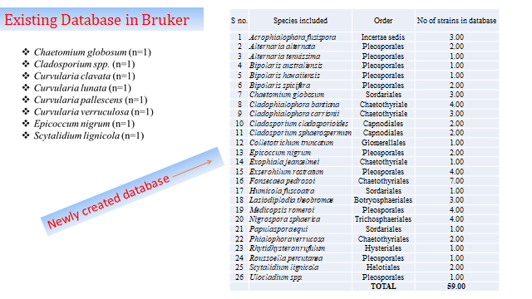

Slide 24
Differences is visible in protein profiling spectra even in
species level
Bipolaris australiensis
Bipolaris hawaiiensis
Bipolaris spicifera

Slide 25
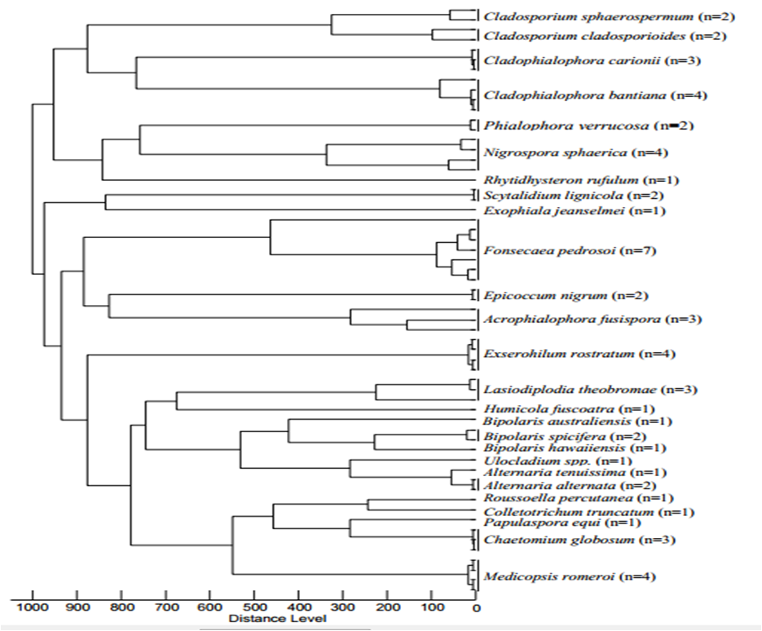
MALDI TOF MS based dendrogram shows the clear
difference in species

Slide 26
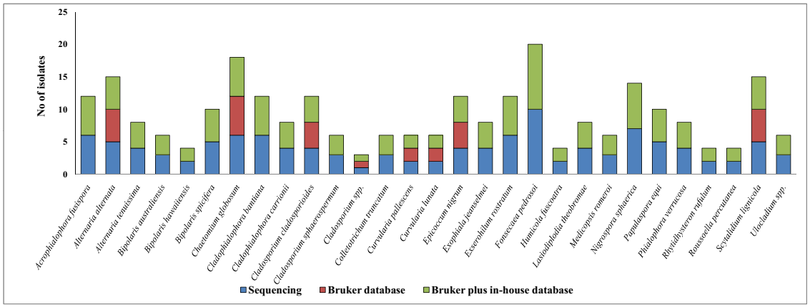
Comparison of MALDI-TOF MS with DNA sequencing before & after
database expansion
A stacked column chart depicting the species-specific distribution and performance of MALDI-TOF MS using existing Bruker database (middle column), DNA sequencing (lower column) and MALDI–TOF MS using Bruker plus in-house database (upper column) for the validation set of fungal isolates

Slide 27
S.No | IDENTIFICATION | Time required for MALDI (Days) | Time required for conventional identification (Days) | Time required for DNA sequencing (Days)
1 | Acrophialophora fusispora | 5-7 | 10-14 | 7-10
2 | Alternaria alternata | 3-5 | 5-7 | 5-7
3 | Bipolaris specifera | 3-5 | 5-7 | 5-7
4 | Chaetomium globosum | 3-5 | 7-10 | 5-7
5 | Cladophialophora bantiana | 3-5 | 5-7 | 5-7
6 | Cladophialophora carrionii | 3-5 | 7-10 | 5-7
7 | Colletotrichum truncatum | 5-7 | 10-14 | 7-10
8 | Curvularia lunata | 3-5 | 5-7 | 5-7
9 | Epicoccum nigrum | 5-7 | Non Sporulating | 7-10
10 | Exserohilum rostratum | 5-7 | 7-10 | 7-10
12 | Fonsecaea pedrosoi | 5-7 | 7-10 | 7-10
13 | Humicola fuscoatra | 5-7 | 10-14 | 7-10
14 | Lasiodiplodiatheobromae | 5-7 | Non Sporulating | 7-10
15 | Medicopsisromeroi | 5-7 | Non Sporulating | 7-10
16 | Papulaspora equi | 5-7 | 10-14 | 7-10
17 | Phialophora verrucosa | 5-7 | 10-14 | 7-10
18 | Rhytidhysteron rufulum | 5-7 | Non Sporulating | 7-10
19 | Roussoella percutanea | 5-7 | Non Sporulating | 7-10
20 | Scytalidium lignicola | 5-7 | 10-14 | 7-10
21 | Ulocladium spp. | 5-7 | 10-14 | 7-10

Slide 28
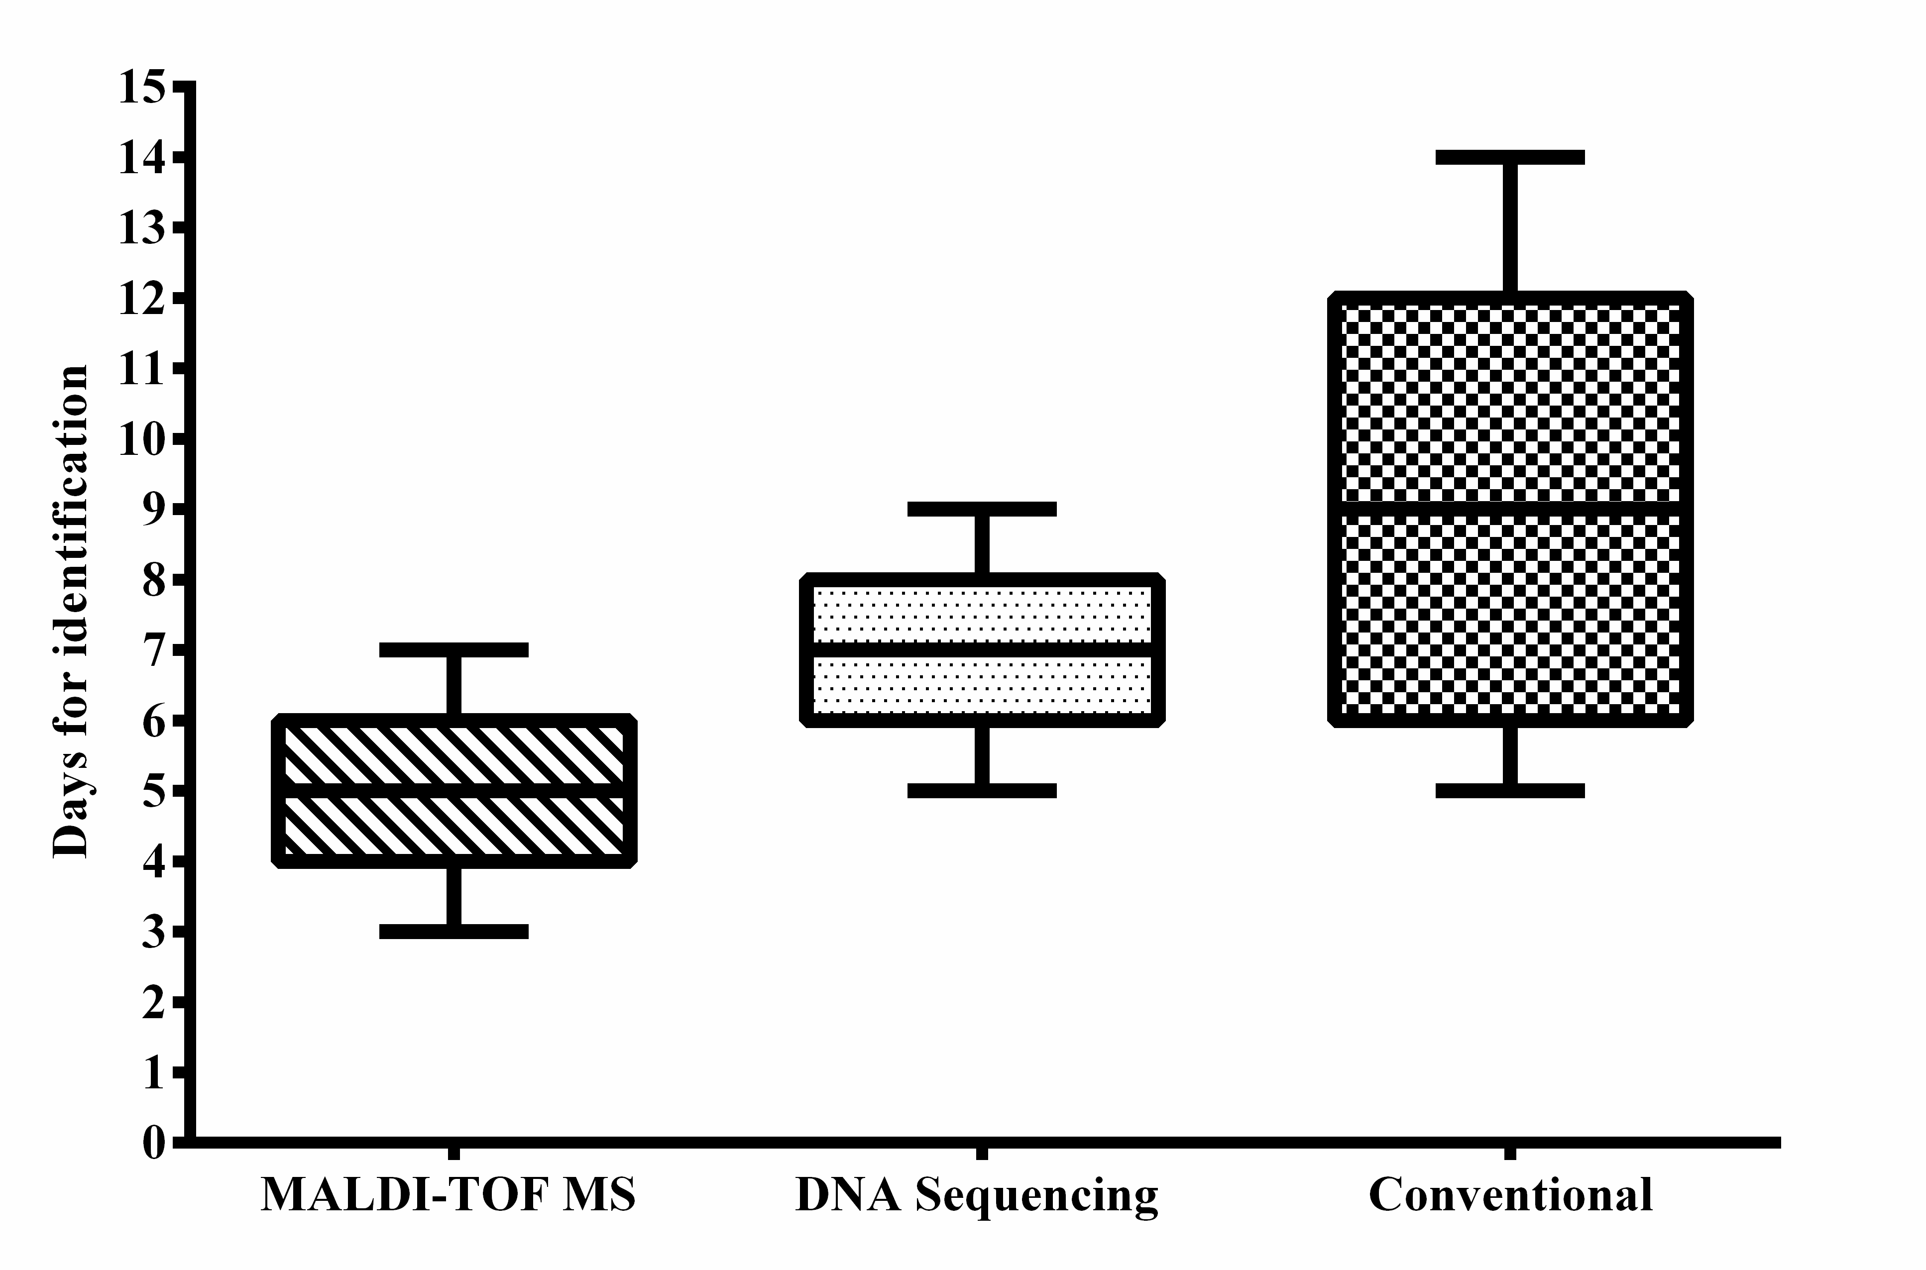
Turn Around Time (TAT) for mould identification
Comparison of identification time of MALDI-TOF MS, DNA sequencing and conventional method. A column chart depicting the average time required for identification of melanized fungi by MALDI-TOF MS and sequencing
Notes:
Epicoccum nigrum, Lasiodiplodia theobromae, Medicopsis romeroi, Rhytidhysteron rufulum, Roussoella percutanea

Slide 29
Development of in-house database for MALDI-TOF MS based identification of clinical isolates of Malassezia from India
Prasanna Honnavar^{1#}, Anup K Ghosh et. al.
Malassezia species | Strain used
 | Database generation (DNA sequence) | Clinical validation (PCR-RFLP)
M. furfur | 30 | 85
M. globosa | 29 | 49
M. restricta | 11 | 41
M. arunalokei | 5 | 7
M. slooffiae | 1 | 4
M. sympodialis | 2 | 4
M. japonica | 6
M. nana | 1
M. caprae | 1
M. dermatis | 1
M. yamatoensis | 1
Total | 88 | 190

Slide 30
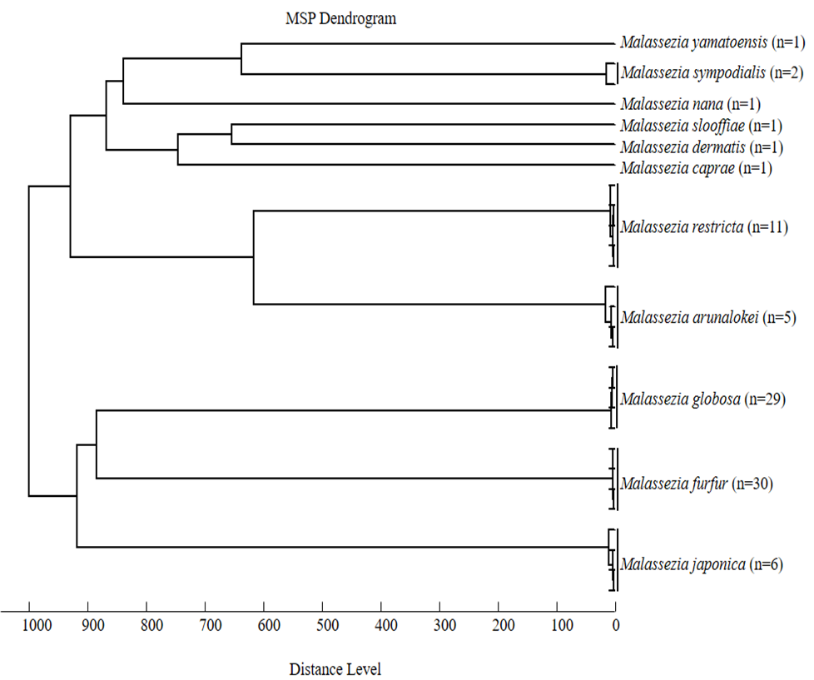
MALDI TOF MS is useful for molecular typing
All 11 different species formed different clade, correlates sequence based typing

Slide 31
Conclusions and take home massages
MALDI-TOF is a robust tool for identification of hyaline and melanized moulds accurately and rapidly.
Identification cost per sample; Sequencing Rs.650 ($10) v/s Rs.6.5 (10¢)using MALDI (only consumables)
Protocol-D extraction method showed the best in our set up for moulds
MALDI can identify moulds up to species leveleven log score of < 2.

Slide 32
Conclusions and take home massages cont.
80.3% hyaline moulds accurately identified using existing database & 19.7% were identified with improved database
only 6 (6.7%) black moulds were identified by existing database. However, all 117 isolates accurately identified by newly created in-house database
MALDI-TOF MS based identification require 3-5 days for hyaline and 5-7 days for melanized fungi in compare to PCR based identification took 4-7 days for hyaline and 7-10 days for melanized fungi

Slide 33
S. No | Candida Species
1 | Candida albicans
2 | Candida anomalus
3 | Candida auris 2016
4 | Candida catenulata
5 | Candida carpophila
6 | Candida fabianii
7 | Candida glabrata
8 | Candida gullermondii
9 | Candida inconspicua
10 | Candida jadinii
11 | Candida kefyr
12 | Candida krusei
13 | Candida lambica
14 | Candida norvequensis
15 | Candida orthopsilosis
16 | Candida parapsilosis
17 | Candida pelliculosa
18 | Candida sake
19 | Candida sorbosa
20 | Candida tropicalis
21 | Candida vishwanathi
 | Non-Candida Species
1 | Cryptococcus neoformans
2 | Cryptococcus gattii
3 | Geotrichum candidum
4 | Kodamea ohmeri
5 | Rhodotorula mucilaginosa
6 | Rhodotorula glutins
7 | Rhodotorula gramins
8 | Saccharomyces cerevisiae
9 | Trichosporon ashii
10 | Trichosporon mucoides
We are making an in-house database of clinical isolates of fungus from India
Max 10 isolates/species with max variation to be included
S.no | Species | NCCPF no | Mol seq/% | MALDI score | Isolation source | Isolated from
1 | Candida tropicalis | 420153 | Yes/100 | 2.127 | Blood Culture | Belgaum
2 | Candida tropicalis | 420156 | Yes/100 | 2.058 | Pus | Ajmer
3 | Candida tropicalis | 420172 | Yes/100 | 2.201 | ET Secreation | Orissa
4 | Candida tropicalis | 420175 | Yes/99.9 | 2.015 | Tracheal Secreation | Mumbai
5 | Candida tropicalis | 420182 | Yes/100 | 2.066 | Tissue | Dharwad
6 | Candida tropicalis | 420165 | Yes/100 | 2.127 | Blood | Kolkata
7 | Candida tropicalis | 420178 | Yes/100 | 2.136 | BAL | Sonepat
8 | Candida tropicalis | 420180 | Yes/100 | 2.015 | CSF | New Delhi
9 | Candida tropicalis | 420120 | Yes/100 | 2.027 | Blood | New Delhi
10 | Candida tropicalis | 420008 | Yes/100 | 2.082 | NA | CMC Vellore

Slide 34
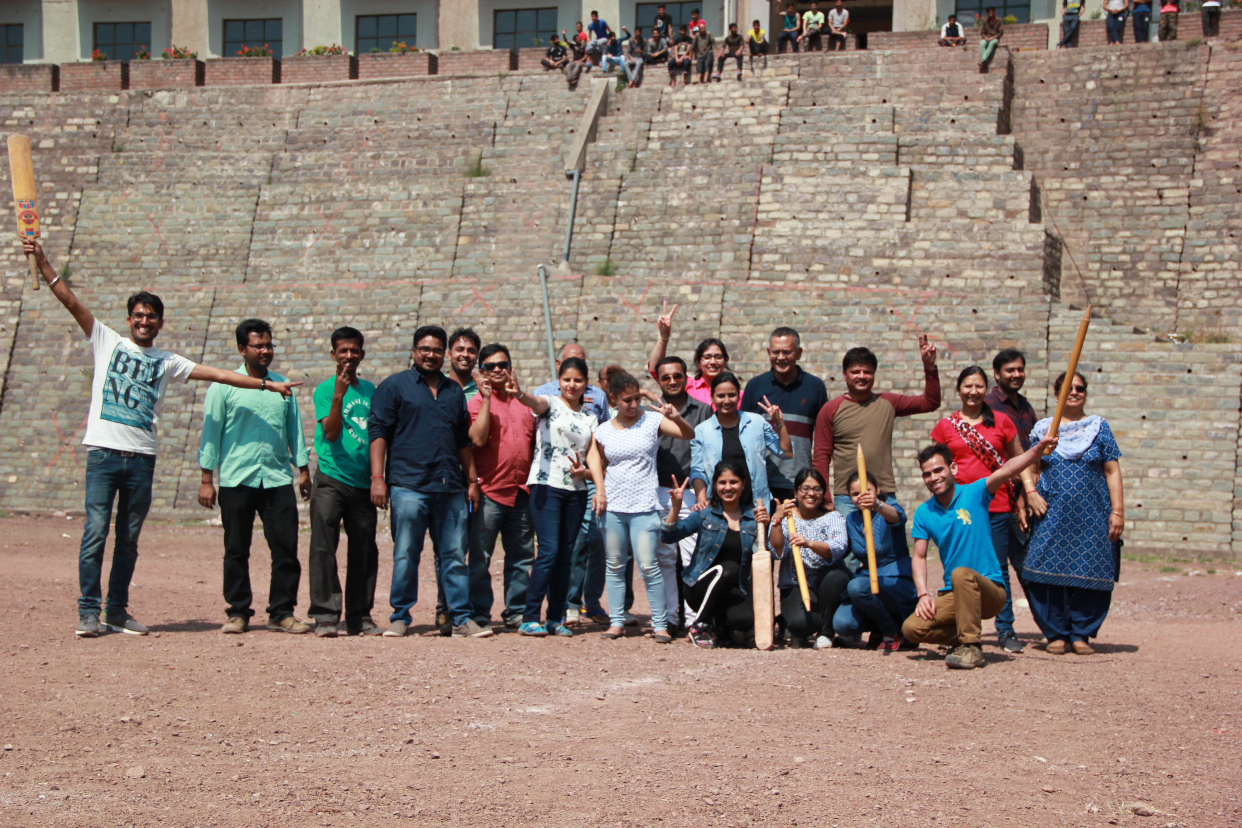
Our PGI, Chandigarh Mycology team
Thank you
Sincere thanks to Department of Science (DST) & Technology and Indian Council of Medical Research(ICMR) for financial support

