Slide 1
New ESCMID/ERS guidelines for diagnosis and treatment of chronic pulmonary aspergillosis
David W. Denning
National Aspergillosis Centre
University Hospital of South Manchester
The University of Manchester

Slide 2
Chronic pulmonary aspergillosis – where are we?
Single aspergilloma a ‘surgical disease’
Chronic cavitary – a medical disease, largely forgotten between 1980’s and 2000
Aspergillus antibody key to the diagnosis
Partially responsive to antifungal therapy
Long term antifungal therapy better than short term, but some prolonged remissions
Antifungal toxicity a substantial issue
Azole resistance increasing
Multiple genetic defects now identified
First clinical guidelines published

Slide 3

Clinical phenotypes of chronic Aspergillus spp diseases
Single/simple
aspergilloma
Aspergillus
nodule(s)
Subacute Invasive aspergillosis (SAIA) or chronic necrotizing pulmonary aspergillosis (CNPA)
Chronic cavitary pulmonary
aspergillosis (CCPA)
Chronic fibrosing
pulmonary aspergillosis
(CFPA)
Denning DW et al, Chronic pulmonary aspergillosis – Rationale and clinical guidelines for diagnosis and management. Eur Resp J 2016;47:45

Slide 4
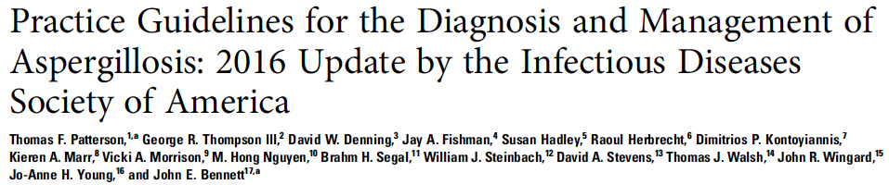
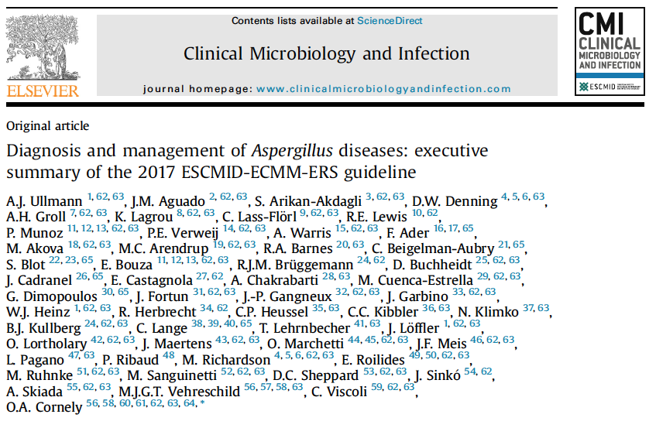
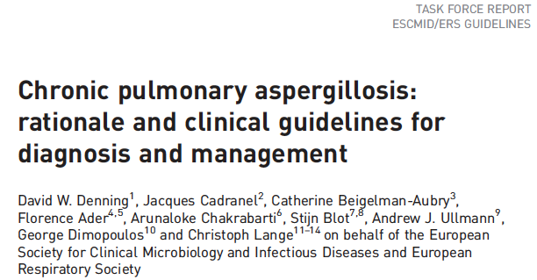

Slide 5
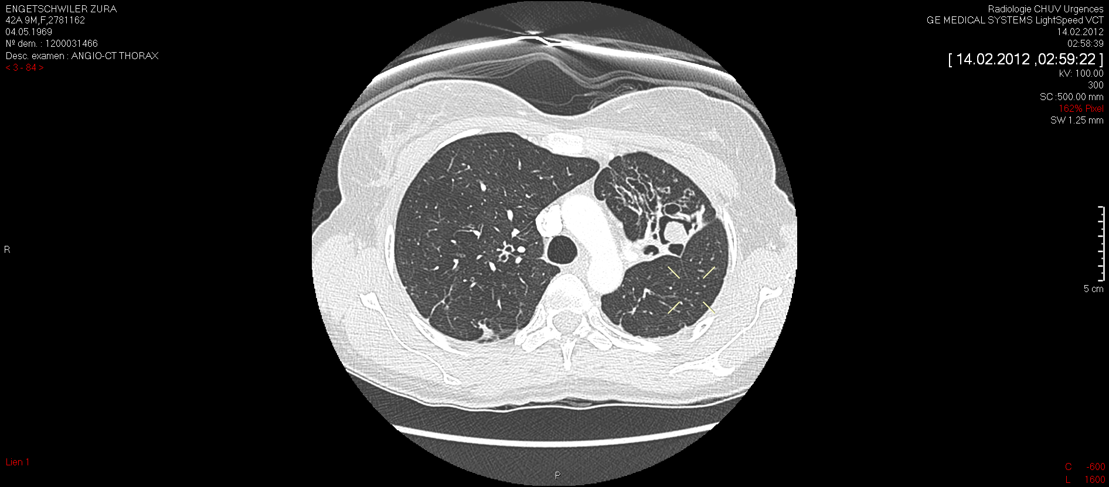
Single (simple) aspergilloma
Figure 2 Simple aspergilloma which developed within a post-tuberculous cicatricial atelectasis of the left upper lobe with saccular bronchiectasis. Surgical resection by VATS was done because of recurrent hemoptysis and a requirement for anticoagulant therapy.
Denning et al, Eur Resp J 2016;47:45

Slide 6

Indications for surgery in CPA
Population | Intention | Intervention | SoR | QoE | Reference | Comment
Simple/single aspergilloma | Cure and prevention of life-threatening haemoptysis | Lobectomy or any other segmental resection Video-assisted thoracic surgery (VATS) | A B | II II | Daly, 1986; Regnard, 2000; Kim, 2005; Pratap, 2007; Brik, 2008; Muniappan, 2014; Farid, 2013; Chen, 2012; Nacera, 2012; Lejay, 2011; IDSA 2008 Chen, 2014; Muniappan, 2014. | Ratio risks/benefits = define surgical risk assessment scale Patients should be seen in centres with experience of aspergillosis surgery May require conversion to thoracotomy
CCPA refractory to medical management (including multi-azole resistance) with antifungal treatment and/or life-threatening haemoptysis. | Improved control of disease, possibly cure | Careful risk assessment, followed by lobectomy or pneumonectomy Thoracoplasty with simultaneous cavernostomy and muscle transposition flap | A C/D | II III | Kim, 2005; Farid, 2013 (others) Grima, 2008 Igai , 2012 | Prior embolization as a temporizing procedure Highly experienced surgical team required
Denning DW et al, Denning et al, Eur Resp J 2016;47:45

Slide 7


Patterson TF et al, Clin Infect Dis 2016; 63:e1-e60.

Slide 8
Indications for surgery in CPA
Population | Intention | Intervention | SoR | QoE | Reference | Comment
Simple/single aspergilloma | Cure and prevention of life-threatening haemoptysis | Lobectomy or any other segmental resection Video-assisted thoracic surgery (VATS) | A B | II II | Daly, 1986; Regnard, 2000; Kim, 2005; Pratap, 2007; Brik, 2008; Muniappan, 2014; Farid, 2013; Chen, 2012; Nacera, 2012; Lejay, 2011; IDSA 2008 Chen, 2014; Muniappan, 2014. | Ratio risks/benefits = define surgical risk assessment scale Patients should be seen in centres with experience of aspergillosis surgery May require conversion to thoracotomy
CCPA refractory to medical management (including multi-azole resistance) with antifungal treatment and/or life-threatening haemoptysis. | Improved control of disease, possibly cure | Careful risk assessment, followed by lobectomy or pneumonectomy Thoracoplasty with simultaneous cavernostomy and muscle transposition flap | A C/D | II III | Kim, 2005; Farid, 2013 (others) Grima, 2008 Igai , 2012 | Prior embolization as a temporizing procedure Highly experienced surgical team required
Denning et al, Eur Resp J 2016;47:45

Slide 9

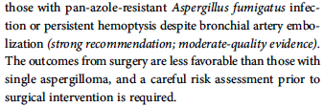
Patterson TF et al, Clin Infect Dis 2016; 63:e1-e60.

Slide 10
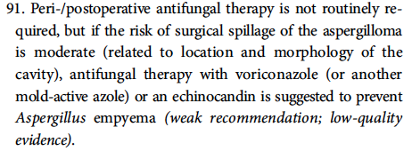
ESCMID/ERS guidance - nuanced
Patterson TF et al, Clin Infect Dis 2016; 63:e1-e60.

Slide 11
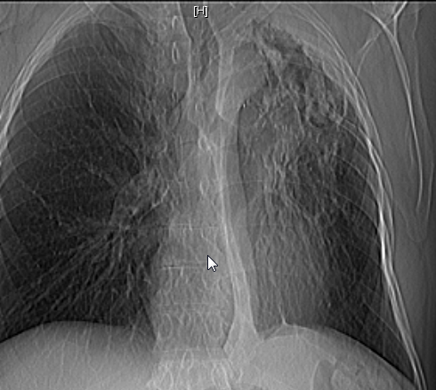
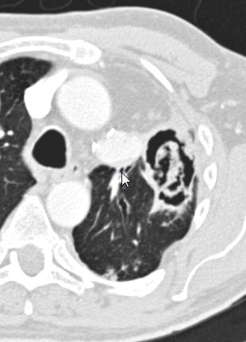
Pleural thickening and early aspergilloma formation
Figure 10 - Cavity with irregular edge and aspergilloma presenting as a coarse and irregular network in a patient with a previous left upper lobe resection. Note apical pleural thickening.
Denning et al, Eur Resp J 2016;47:45

Slide 12
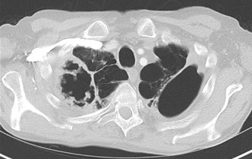
Irregular cavity walls – very characteristic of fungal growth in the cavity
Notes:
12

Slide 13
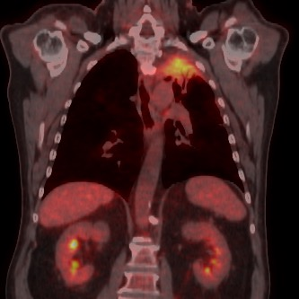
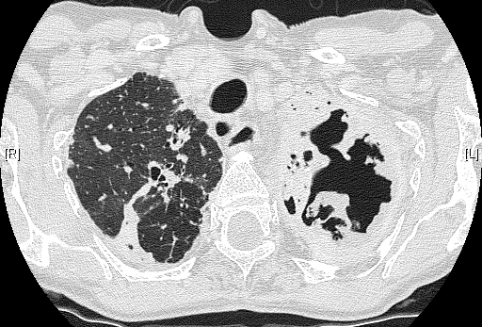
Chronic cavitary pulmonary aspergillosis
National Aspergillosis Centre

Slide 14
Radiological diagnosis of CPA
Population | Intention | Intervention | SoR | QoE | Reference | Comment
Features of cavitation, fungal ball, pleural thickening and/or upper lobe fibrosis | Raise suspicion of CPA for physicians | Radiological report must mention possible CPA | A | II | Roberts, 1987; Kim, 2000; Franquet, 2001; Denning, 2003; Greene, 2005; Kobashi, 2006; Godet, 2014 | CPA is often missed for years and patients mismanaged. Microbiological testing required for confirmation High quality CT with vessel visualisation
No IDSA guidance
Denning et al, Eur Resp J 2016;47:45
Notes:
Maiken Cavling Arendrup + SA
Red text indicates text I suggest to delete
Green text indicates proposed new text

Slide 15
Chronic Pulmonary Aspergillosis – Diagnostic criteria
  Required:
  1.1 Characteristic CT appearance of a fungus ball in a pulmonary or pleural cavity, or dilated bronchus,
  AND
  1.2 Any direct or indirect microbiological evidence of Aspergillus infection (see below).
Denning et al, Eur Resp J 2016;47:45

Slide 16
Chronic Pulmonary Aspergillosis – Diagnostic criteria
  Required:
  1.1 Characteristic CT appearance of a fungus ball in a pulmonary or pleural cavity, or dilated bronchus,
  AND
  1.2 Any direct or indirect microbiological evidence of Aspergillus infection (see below).
  OR
  Required:
  2.1 Radiological features consistent with chronic pulmonary aspergillosis (including cavity(ies), pleural thickening, extensive fibrosis or nodule)
  AND
  2.2 Clinical or radiological evidence of at least 3 months disease (sometimes inferred) [Note shorter durations of disease may be seen in SIA/CNPA, which becomes CPA because of its chronicity],
  AND
  2.3 Histological or microbiological or immunologic evidence of Aspergillus infection (e.g. histological evidence of Aspergillus-like hyphae in lung biopsy or Aspergillus culture from a percutaneous cavity aspiration; strongly positive BAL antigen; positive IgG antibody/precipitins). Respiratory tract culture or PCR positive for Aspergillus is supportive.
Denning et al, Eur Resp J 2016;47:45

Slide 17
Chronic Pulmonary Aspergillosis – Diagnostic criteria
  Required:
  1.1 Characteristic CT appearance of a fungus ball in a pulmonary or pleural cavity, or dilated bronchus,
  AND
  1.2 Any direct or indirect microbiological evidence of Aspergillus infection (see below).
  OR
  Required:
  2.1 Radiological features consistent with chronic pulmonary aspergillosis (including cavity(ies), pleural thickening, extensive fibrosis or nodule)
  AND
  2.2 Clinical or radiological evidence of at least 3 months disease (sometimes inferred) [Note shorter durations of disease may be seen in SIA/CNPA, which becomes CPA because of its chronicity],
  AND
  2.3 Histological or microbiological or immunologic evidence of Aspergillus infection (e.g. histological evidence of Aspergillus-like hyphae in lung biopsy or Aspergillus culture from a percutaneous cavity aspiration; strongly positive BAL antigen; positive IgG antibody/precipitins). Respiratory tract culture or PCR positive for Aspergillus is supportive.
  Required:
  Exclusion of histoplasmosis, coccidioidomycosis and paracoccidiodomycosis in endemic areas or those with pertinent travel history; actinomycosis.
  Active bacterial infection, including mycobacterial infection and/or malignancy may occur concurrently. Mycobacterial infections or malignancy may mimic CPA.

Slide 18
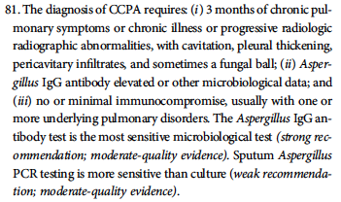
Patterson TF et al, Clin Infect Dis 2016; 63:e1-e60.

Slide 19
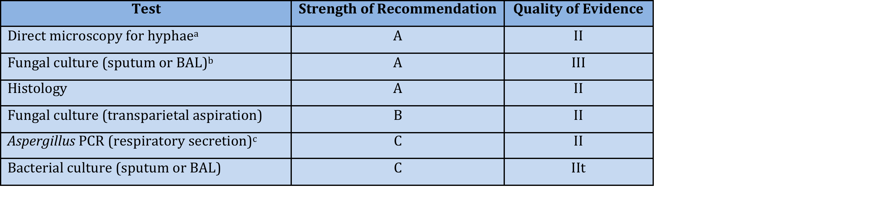
Respiratory specimen diagnosis of CPA
Denning et al, Eur Resp J 2016;47:45
Notes:
Maiken Cavling Arendrup + SA
Red text indicates text I suggest to delete
Green text indicates proposed new text

Slide 20
Aspergillus antibody diagnosis of CPA
Population | Intention | Intervention | SoR | QoE | Reference | Comment
Cavitary or nodular pulmonary infiltrate in non-immunocompromised patients In context of asthma/ABPA/CF | Diagnosis or exclusion of CPA | Aspergillus IgG antibody Aspergillus precipitins Aspergillus IgM antibody Aspergillus IgA antibody Aspergillus IgE antibody | A A D D B | II II III III II | Guitard, 2012; Baxter, 2012; Van Toorenenbergen, 2012 BTS,1970; Uffredi, 2003; Kitasato, 2009; Ohba, 2012; Baxter, 2012 Brouwer, 1988; Schonheyder 1987; Nimomiya, 1990; Denning, 2003; Agarwal, 2012 | IgG and precipitins test standardisation incomplete Most in house tests poorly validated, with uncertain sensitivity the major problem. Sensitivity for Aspergillus nodule uncertain

Slide 21
Antigen diagnosis of CPA
Population | Intention | Intervention | SoR | QoE | Reference | Comment
Cavitary or nodular pulmonary infiltrate in non-immunocompromised patients | Diagnosis or exclusion of CPA | Antigen (BAL) Antigen (serum) Antigen (sputum) | B C No data | II II | Izumikawa, 2012 Izumikawa, 2012; Kono, 2013; Shin, 2014 | Antigen studied in BAL and serum, but not sputum.
Denning et al, Eur Resp J 2016;47:45

Slide 22
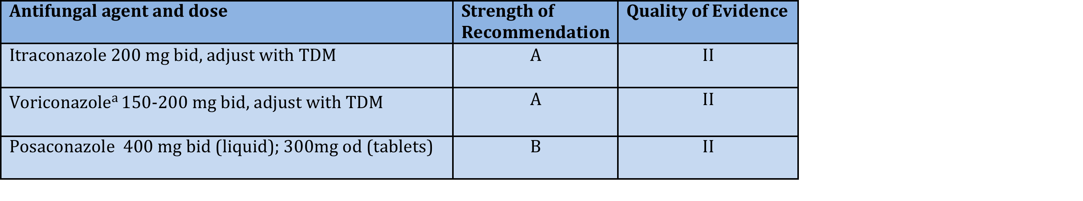
Oral triazole therapy for CPA
a Lower doses advised in those over 70 years, low weight, significant liver disease and those of NE Asian descent who may be slow metabolisers
TDM = therapeutic drug monitoring
Denning et al, Eur Resp J 2016;47:45

Slide 23

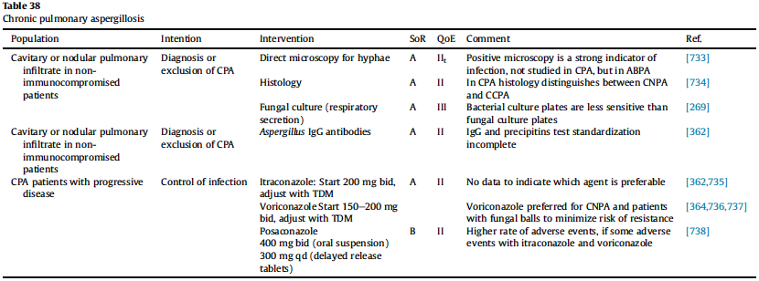
Oral triazole therapy for CPA
Ullmann et al, Clin Microbiol Infect 2018; 24 (Suppl 1):e1-e38

Slide 24

Patterson TF et al, Clin Infect Dis 2016; 63:e1-e60.

Slide 25

Patterson TF et al, Clin Infect Dis 2016; 63:e1-e60.

Slide 26
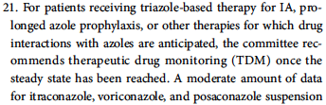

Patterson TF et al, Clin Infect Dis 2016; 63:e1-e60.

Slide 27
Duration of antifungal therapy for CPA
Population | Intention | Intervention | SoR | QoE | Reference | Comment
CPA patients on antifungal therapy Subacute IA/CNPA | Control of infection, arrest of pulmonary fibrosis, prevention of haemoptysis, improved quality of life. Cure | 6 mo antifungal therapy Long term antifungal therapy, depending on status and drug tolerance 6 mo | B C B | II III II | Agarwal, 2013: Yoshida, 2012; Nam, 2010: Felton, 2010; Camuset, 2007: Jain, 2006: Cadranel, 2012 Felton, 2010; Camuset, 2007; Jain, 2006; Cadranel, 2012 Camuset, 2007 Cadranel, 2012 | Optimal duration of therapy in CPA is unknown, indefinite suppressive therapy may be appropriate in selected patients

Slide 28


Patterson TF et al, Clin Infect Dis 2016; 63:e1-e60.

Slide 29
Alternative intravenous therapy for CPA
Population | Intention | Intervention | SoR | QoE | Reference | Comment
CPA patients with progressive disease, who fail, are intolerant of triazoles or have triazole resistance | Control of infection | Micafungin 150mg/d Amphotericin B deoxycholate 0.7-1.0mg/kg/d Liposomal AmB 3mg/kg/d Caspofungin 50-70mg/d | B C B C | II III IIa IIa | Kohno, 2011; Kohno, EJCMID 2013; Saito, 2009; Kohno, 2011; Kohno , 2004; Izumikawa, 2007; Yasuda, 2009; Nam, 2009 Denning, 2003 Newton, 2014 Kier, 2014; Kohno 2013

Slide 30
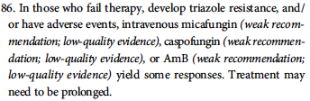
Patterson TF et al, Clin Infect Dis 2016; 63:e1-e60.

Slide 31
Therapies for haemoptysis in CPA
Population | Intention | Intervention | SoR | QoE | Reference | Comment
CPA patients with haemoptysis | Arrest of bleeding | Tranexamic acid 1.5-4g/d Factor 7 Bronchial artery embolisation Surgical resection | B C A B | II III II II | Tscheikuna, 2002; Kokturk, 1997 Jardin, 1988; Swanson, 2002; Corr, 2006; Serasli, 2008; Shigemura, 2009 Shigemura, 2009; Erdogan, 2005 | In selected cases in which BAE and antifungal disease control is not achieved
Denning et al, Eur Resp J 2016;47:45

Slide 32
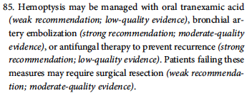
Patterson TF et al, Clin Infect Dis 2016; 63:e1-e60.

Slide 33
Local cavity therapy for CPA
Population | Intention | Intervention | SoR | QoE | Reference | Comment
CPA with aspergilloma, unwilling or unable to take oral therapy, multi-azole resistance and inoperable | Control of infection | Instillation of amphotericin B deoxycholate into cavity | C | II | Giron, 1998; Kravitz, 2013 | Experimental
No IDSA guidance
Denning et al, Eur Resp J 2016;47:45

Slide 34
Corticosteroid therapy for CPA
Population | Intention | Intervention | SoR | QoE | Reference | Comment
CPA patients with progressive disease not on adequate antifungal therapy CPA patients with progressive disease on adequate antifungal therapy | Symptom control Essential control of underlying disease | Prednisolone Prednisolone 5-30mg/d or other immunosuppressive therapy | D B | III II | Denning, 2003 | Without adequate antifungal therapy, corticosteroid accelerates progression Note azole/steroid drug interaction Common indications include sarcoidosis, rheumatoid arthritis, COPD and ABPA/asthma exacerbation s
No IDSA guidance
Denning et al, Eur Resp J 2016;47:45

Slide 35
CPA guidelines
Evidence base strong for radiology and Aspergillus antibody
Strong experiential evidence for resection of single aspergillomas – caution in multi-cavity disease
Evidence base weak on treatment, although 3 RCTs done
Basic pathogenesis not well understood
Natural history of Aspergillus nodule not well documented
Immune deficits common – long term therapy generally recommended.
Azole resistance now a major problem

Slide 36
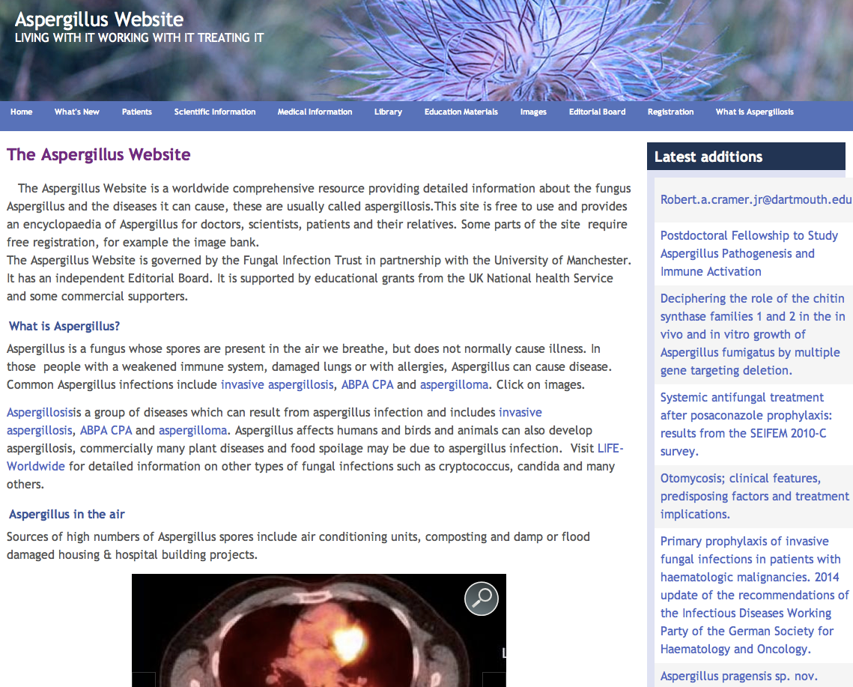
www.aspergillus.org.uk
20 year anniversary
Over 100,000 computers access monthly in >140 countries
New section on drug interactions which you can search very quickly
+ app for iphones and android (search antifungal interaction)
691 interactions were rated as minor, 919 moderate and 381 severe,
= 2216 recorded interactions
Notes:
36

