Slide 1
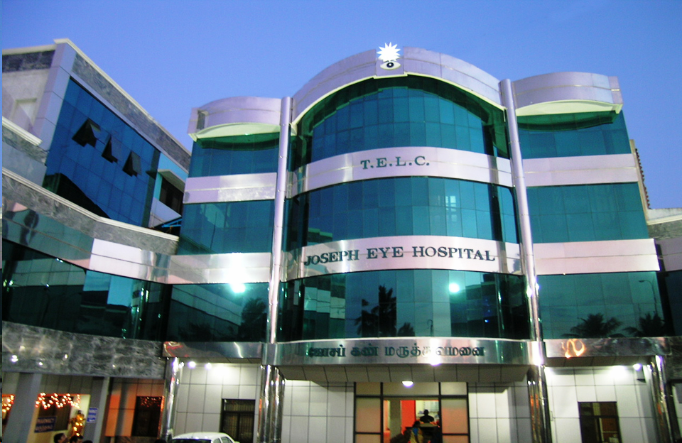
Factors influencing the outcome of therapeutic penetrating keratoplasty for mycotic & suppurative keratitis
Philip A. Thomas
J.Kaliamurthy
C.A.Nelson Jesudasan
Institute of Ophthalmology
Joseph Eye Hospital
Tiruchirapalli-620001
Tamilnadu, INDIA

Slide 2
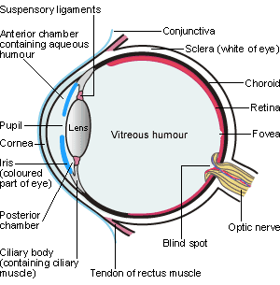
Factors influencing the outcome of therapeutic penetrating keratoplasty for mycotic & suppurative keratitis
Microbial keratitis
-- loss of corneal epithelium
-- underlying stromal infiltrates &
suppuration
-- signs of inflammation
-- hypopyon +
Microbial keratitis due to bacteria, fungi, protozoa, viruses
For successful management
-- prompt diagnosis
-- immediate institution of appropriate anti-microbial therapy.

Slide 3
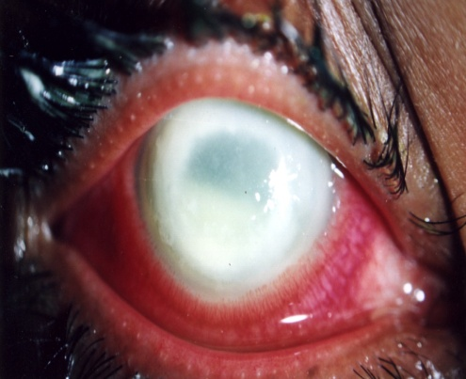
Factors influencing the outcome of therapeutic penetrating keratoplasty for mycotic & suppurative keratitis
Initial treatment of suppurative (non-viral) keratitis:
-- cefazolin / cefuroxime + gentamicin / tobramycin
-- fluoroquinolone monotherapy: (moxifloxacin
currently used widely for monotherapy of suppurative
keratitis
Treatment of suspected fungal keratitis
--topical natamycin(5%), itraconazole(1%), voriconazole (1%)
--oral ketoconazole, fluconazole, itraconazole, voriconazole
To evaluate factors leading to the need for therapeutic
penetrating keratoplasty in suppurative and mycotic keratitis.

Slide 4
Factors influencing the outcome of therapeutic penetrating keratoplasty for mycotic & suppurative keratitis
Prospective study from Jul. 2009 to Dec. 2011(30 months)
Patients with suppurative (suspected microbial)
keratitis
Inclusion criteria
-- Informed consent provided
-- Loss of corneal epithelium with clinical
evidence of infection , with/without hypopyon
Exclusion criteria
-- Consent not given for investigation or treatment
-- Incomplete follow-up
-- Had prior treatment

Slide 5
Factors influencing the outcome of therapeutic penetrating keratoplasty for mycotic & suppurative keratitis
Examination done at slit-lamp; clinical features
noted & drawing made for patient records
Length of slit-beam used to assess vertical
diameter, then turned 90 degrees to assess
horizontal diameter
Slit-beam parallelo- piped; depth of ulceration &
infiltrate graded subjectively
Standard photographs taken to check qualitative
findings & grading of response
Repeatability studies performed to ensure
uniformity in grading characteristics

Slide 6
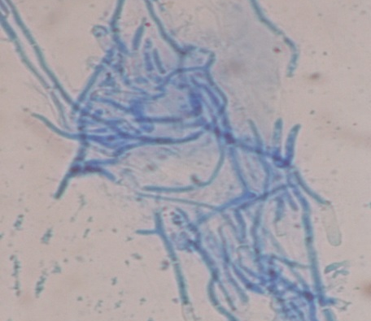
Factors influencing the outcome of therapeutic penetrating keratoplasty for mycotic & suppurative keratitis
MICROBIOLOGICAL DIAGNOSIS
Multiple scrapings from ulcer
Inoculation as `C` streaks onto solid media
to cultivate
bacteria, fungi and acanthamoebae:
-- sheep blood agar
-- Sabouraud dextrose agar
-- non-nutrient agar with Escherichia coli overlay
Material on slide for microscopic examination (LPCB,
Gram, Giemsa)
Growth on culture considered significant if :
the same organisms isolated on the `C’ streaks
of multiple media
growth on one medium with positive microscopy

Slide 7
Factors influencing the outcome of therapeutic penetrating keratoplasty for mycotic & suppurative keratitis
patients with suspected bacterial keratitis or keratitis of unknown etiology received hourly topical moxifloxacin (0.3%)
patients with suspected mycotic keratitis received hourly topical moxifloxacin and natamycin (5%).
Hourly topical drops during day; once every three hours at night
Oral analgesics & cycloplegics; anti-glaucoma agents if needed
Dacryocystectomy & dacryocysto-rhinostomy if required
Patients examined daily during 21 days of study period
TPK was performed when medical therapy failed and the eye was deemed to be at risk of serious complications.

Slide 8
Factors influencing the outcome of therapeutic penetrating keratoplasty for mycotic & suppurative keratitis
CATEGORIES OF CLINICAL OUTCOMES
Treatment success
Complete healing of the ulcer within 21 days
Healing
Progressive healing but incomplete ulcer epithelialisation at 21st day
Indolent ulceration
Persistent epithelial defect unchanged in size > 5 days of treatment
Progression
Increase in ulcer size or infiltrate necessitating other medical therapy
Therapeutic penetrating keratoplasty required

Slide 9
Factors influencing the outcome of therapeutic penetrating keratoplasty for mycotic & suppurative keratitis Statistical analysis
Analysis of putative factors influencing outcome of primary medical therapy were compared among groups
Univariate (crude) analysis was performed to identify important risk factors
A p-value of <0.05 was considered statistically significant

Slide 10
Demographic &clinical characteristics of 480 patients
satisfying all criteria
Variable
 | N= 480 | (%)
Gender (male) Age 0-20 years 21-40 years 41-60 years >60 years Microbial aetiology Bacteria only Fungi only Mixed (bacteria & fungi) Acanthamoeba No growth Clinical Features Duration >15 days Ulcer >6mm Ulcer depth >50% Hypopyon present | 252 057 179 192 052 104 167 026 007 176 033 056 154 197 | (52.7%) (11%) (37%) (41%) (11%) (21.8%) (34.9%) (5.3%) (1.1%) (31.4%) (6.9%) (11.6%) (32.2%) (41.1%)

Slide 11
Type of primary treatment as a possible determinant of outcome
Outcome of microbial keratitis | Primary Treatment Regimen |  |  | Total
 | Moxifloxacin only | Moxifloxacin and natamycin | Other combinations
Success | 107 (48%) | 104 (53%) | 34 (57%) | 245 (51%)
Healing | 058 (26%) | 043 (22%) | 03 (05%) | 104 (22%)
Indolent ulceration | 021 (09%) | 018 (09%) | 04 (07%) | 043 (09%)
Progressed | 027 (12%) | 020 (10%) | 7 (12%) | 054 (11%)
TPK | 011 (5%) | 011 (06%) | 12 (19%) | 034(7%)
 | 224 | 196 | 60 | 480
Statistical analysis: p < 0.001

Slide 12
Factors influencing the outcome of therapeutic penetrating keratoplasty for mycotic & suppurative keratitis Variables that possibly influenced the outcome of therapy
252 male
181(72%)-favorable response
A) Gender
228 female
164(72%)- favorable response
% exhibiting complete resolution
% with progression of keratitis
Age
Favorable response
1-20 86% 63% (High) 10% (Low)
B) Age
21-60 73%
Above 60 49%
31% (Low) 31% (high)

Slide 13
Factors influencing the outcome of therapeutic penetrating keratoplasty for mycotic & suppurative keratitis
Variables that possibly influenced the outcome of therapy
No of Days
Favorable response
1 to 15 74%
C) Duration of
symptoms
16 to 30 53%
More than 30 days 33%
Significant difference

Slide 14
Factors influencing the outcome of therapeutic penetrating keratoplasty for mycotic & suppurative keratitis
TPK was done for:
-- seven of 104 bacterial keratitis patients (7%)
-- 12 of 167 mycotic keratitis patients (7%)
-- three of 26 (12%) patients with mixed mycotic-bacterial keratitis
-- 12 of 183 (7%) patients with other or unknown causes of keratitis

Slide 15
Factors influencing the outcome of therapeutic penetrating keratoplasty for mycotic & suppurative keratitis
TPK was done for:
-- five of 83 patients with keratitis due to Fusarium spp. (6%)
-- three of 27 patients with keratitis due to Aspergillus flavus(11%)
-- one of nine patients with keratitis due to Aspergillus fumigatus
-- one of 18 patients with keratitis due to other or unidentified fungal species (6%)

Slide 16
Factors influencing the outcome of therapeutic penetrating keratoplasty for mycotic & suppurative keratitis Significant Predictors for Progression of Keratitis
Greatest or least diameter of corneal ulceration exceeding 6mm
Depth of ulceration exceeding 50%
Depth of infiltration exceeding 60%
The presence of a hypopyon
Patient age exceeding 40yrs
Duration of symptoms exceeding 15 days
Mixed bacterial-fungal growth

Slide 17
Factors influencing the outcome of therapeutic penetrating keratoplasty for mycotic & suppurative keratitis Significant Predictors for the need for TPK (based on univariate analysis)
Duration of symptoms > 15 days (P < 0.0001)
Smallest or largest ulcer diameter > 6 mm (P = 0.002)
Ulcer depth > 50% (P < 0.0001)
Infiltrate depth > 60% (P = 0.002)
Any growth in culture (P < 0.0001)
These factors were significantly more frequently associated with TPK being performed than duration of symptoms ≤ 15 days, ulcer diameter ≤ 6 mm, ulcer depth ≤ 50%, infiltrate depth ≤ 60%& no growth in culture

Slide 18
Factors influencing the outcome of therapeutic penetrating keratoplasty for mycotic & suppurative keratitis
Xie et al. , Br J Ophthalmol 2001; 85: 1070
-- Retrospective analysis of 108 cases of severe mycotic keratitis
-- Graft remained clear in 80% of patients
Shi et al., Ophthalmology 2010; 117: 890-896
-- Retrospective interventional case series (614 patients)
-- 57 (6.3%) patients experienced recurrences
-- Higher rates of recurrences in those with :
pre-operative hypopyon
corneal peforation
infection extending up to the limbus

Slide 19
Factors influencing the outcome of therapeutic penetrating keratoplasty for mycotic & suppurative keratitis
Yalniz-Akkaya et al. , Int Ophthalmol 2015; 35: 193-200
-- Retrospective analysis of 24 eyes with keratitis (follow-up 22 months)
-- Graft remained clear in 93 % of patients with infective keratitis & 78% of those with non-infective keratitis
Ti TE et al., Am J Ophthalmol 2007; 114: 755-762
-- Retrospective interventional case series (92 consecutive patients who had
undergone TPK)
-- Fusarium spp. accounted for 32.3% of the fungal isolates
-- 15 patients failed therapy
-- 11 of the 15 patients who had failed TPKs suffered from fungal keratitis

Slide 20
Factors influencing the outcome of therapeutic penetrating keratoplasty for mycotic & suppurative keratitis SUMMARY
480 patients with suspected microbial keratitis
420 pts. received primary topical ciprofloxacin therapy, alone or in combination with natamycin
-- Treatment success or healing in 73 %
-- Progression of keratitis or need for TPK occurred in 18 %
Patient gender not a significant determinant of response

Slide 21
Factors influencing the outcome of therapeutic penetrating keratoplasty for mycotic & suppurative keratitis SUMMARY
Factors serving as significant predictors of an unfavourable outcome of mycotic or suppurative keratitis, necessitating TPK included:
--large and/or deep ulcers
--a prolonged duration of symptoms.
Primary therapy with topical moxifloxacin, alone or in combination with natamycin, appears to be effective therapy in a high percentage of patients.

