Slide 1
Isavuconazole: spectrum of activity
George R. Thompson, MD
Associate Professor of Clinical Medicine
Department of Medical Microbiology & Immunology
Department of Internal Medicine, Division of Infectious Diseases
University of California-Davis

Slide 2
DISCLOSURES
Financial interest/arrangement
or affiliation with
Company Name/Sponsor | Nature of Relationship
Grant support | Astellas, Merck, T2, Wako, Scynexis
Consultant/honoraria | Astellas, Merck
Speakers' bureau | None
Stock holder | None
Other material support | Assoc of Cape Cod, BMS
Notes:
DISCLOSURE – list of relevant relationships to Potential Commercial Bias Standard # 6

Slide 3
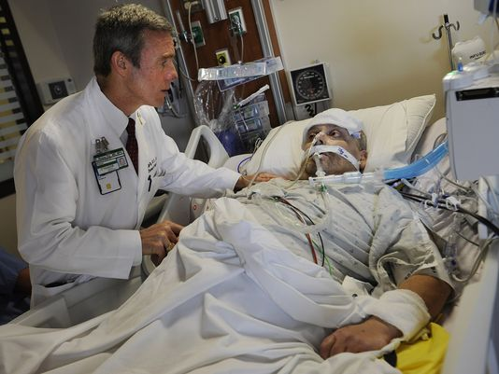
Patient Specific Factors: considerations during treatment
Increased likelihood of resistance?
Antifungal Pre-exposure
Duration of neutropenia, ongoing sepsis
PK/PD concerns
Site of infection/source control
Anticipated course
Dose adjust triazoles
Renal function
Geography
Local infection rates
Age
Concurrent Medications
Comorbidities
QTc, etc
P450 interactions
- cyclophosphamide
- vincristine
Sex
Weight
Dose adjust triazoles; echinocandins?
Need for TDM
Ethnicity
Cost
CYP2C19
Itraconazole, Voriconazole, Posaconazole??

Slide 4
Isavuconazole
Extended spectrum mould-active triazole
FDA approved for invasive aspergillosis and mucormycosis
Available in IV and oral formulations
IV and Oral:
372 mg Q8 hr x 6 doses; then 372 mg once daily
(these are equivalent to 200mg isavuconazole)

Slide 5
Isavuconazonium sulfate
Cleavage product
Plasma esterases
Water-soluble pro-drug
Specifically designed to avoid cyclodextrins in IV formulation
Isavuconazole
CYP3A4 substrate
No effect on CYP2C9 or CYP2C19
Notes:
Developed as an extended spectrum mould active triazole that does not require cyclodextrin for IV administration, available once daily,

Slide 6
Effect of ISA and VOR on CYP substrates
CYP | Substrate | Isavuconazole | Voriconazole
3A4 | Midazolam | ↑ 2.05-fold | ↑ 10.3-fold
 | Sirolimus | ↑ 1.84-fold | ↑ 11.0-fold
1A2 | Caffeine | NCS | NCS
2C8 | Repaglinide | NCS | NCS
2C9 | Warfarin | NCS | ↑ 2-fold (PT)
2C19 | Omeprazole | NCS | ↑ 4-fold
2B6 | Buproprion | ↓ 42% | ↑ 1.3-fold
2D6 | Dextromethorphan | NCS | NCS
Isavuconazonium FDA Advisory Committee Briefing Document

Slide 7
 | Fluconazole | Itraconazole | Voriconazole | Posaconazole | Isavuconaole
Formulation | IV/PO | PO | IV/PO | IV/PO | IV/PO
TDM | No | Yes | Yes | Yes* | ?? ND
Oral bioavailability | >90% | 50% | 96% | 54% | >98%
Food effect | None | ES | ES | Food | None
C_{max} | 6.7 | 1.1 | 3.0 | 7.8 | 7.5
Half-life | 30 | 24 | 6 | 25 | 130
V_{d} | 0.7 | 11 | 4.6 | 250 | 450L
CSF penetration | 50-90% | <10% | 60% | <10% | ??
Vitreal penetration | 27% | 10% | 38% | 26% | ??
Urine unchanged | >80% | 1-10% | <2% | <2% | ND

Slide 8
Invasive Aspergillosis
A Phase III, Double Blind, Randomized Study to Evaluate Safety and Efficacy of Isavuconazole Versus Voriconazole for Primary Treatment of Invasive Fungal Disease Caused by Aspergillus Species or Other Filamentous Fungi (SECURE study).
Enrolled (n=532)
Excluded (n=5)
Randomized (n=527)
Isavuconazole (n=263)
258 Received drug
Voriconazole (n=263)
258 Received drug
Maertens J et al. ECCMID 2015, Oral presentation: O230a

Slide 9
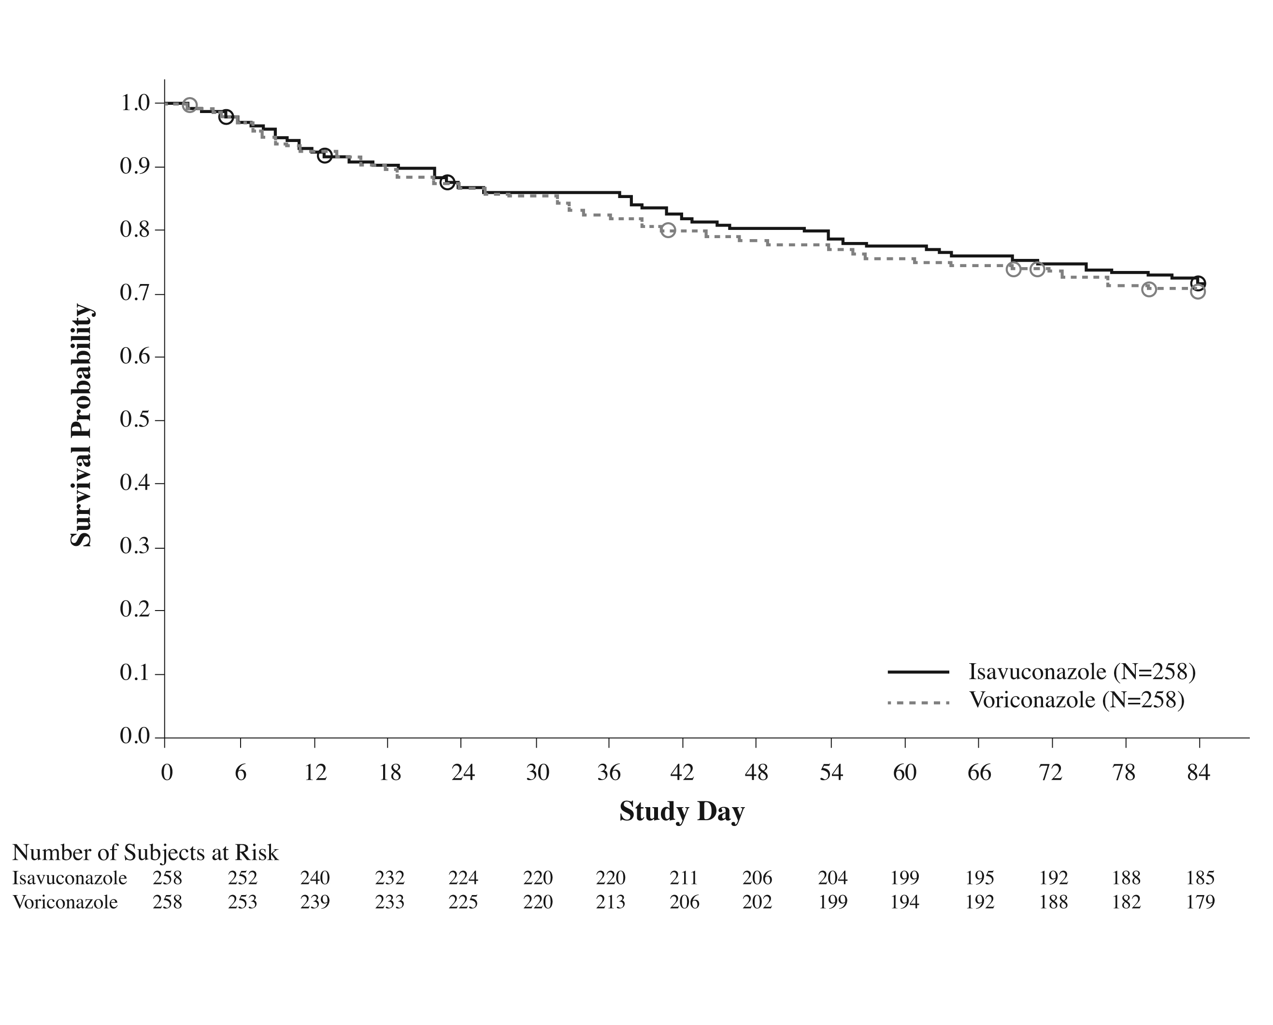
Non-inferior to voriconazole in treatment of invasive aspergillosis
Fewer side effects (17% difference; p<0.05) than voriconazole treated patients
Hepatobiliary (9 v 16%; p<0.05)
Skin (33 v 42%; p<0.05)
(Rash)
Eye (15 v 26%; p<0.05)
Visual hallucinations (1 v 4%)
Less frequent treatment discontinuation (14 v 23%; p<0.05)
Maertens J et al. ECCMID 2014, Barcelona, Spain. Oral presentation: O230a
Notes:
Day 84 survival probability (ITT population)

Slide 10
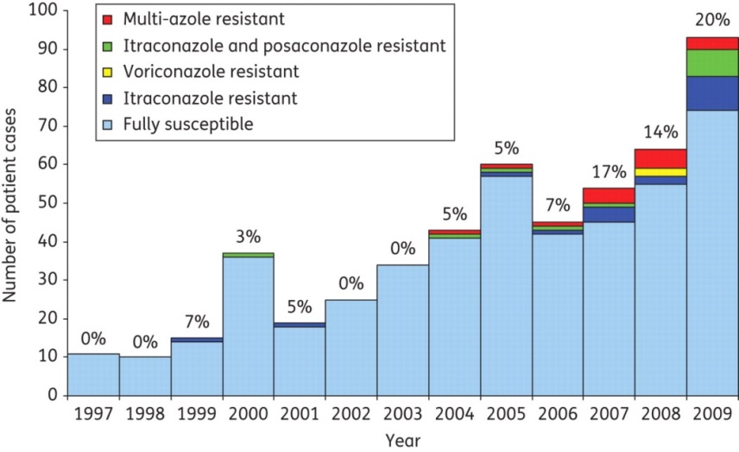
Resistant Isolates - Aspergillus
Triazole-resistant isolates
now described – cavitary disease,
also in azole naïve patients
Specific mutations in CYP51A (azole target)
Specific “hot-spots”: G54, L98, G138, M220, G448
Over expression of cyp51B
Efflux pumps: cdr1B, atrF
G54 Vori and Isa lower MICs
M220 variable
Buied A, et al. J Antimicrob Chemother. 2010 Oct;65(10):2116-8. Fraczek MG, et al. J Antimicrob Chemother. 2013 Jul;68(7):1486-96.
Buied A, et al. J Antimicrob Chemother. 2013 Mar;68(3):512-4. Gregson L, et al. Antimicrob Agents Chemother. 2013;57(11):5778-5780
Notes:
Voriconazole and isavuconazole MICs were lower in isolates with amino acid substitutions at position G54, suggesting that alterations at this position only affect itraconazole and posaconazole susceptibility
Percentages on graph are total number of resistant isolates (20% of those referred were resistant in 2009).
Itraconazole R - first described in 1997

Slide 11
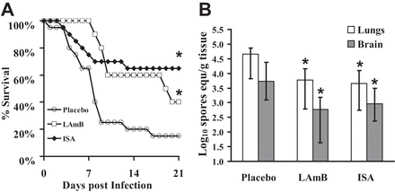
Mucormycosis
Range of MICs
In vitro – differences than posaconazole
Isavuconazole is as effective as high-dose L-AMB in improving survival; and reducing fungal burden in neutropenic mice
Thompson GR, Wiederhold NP. Mycopathologia 2010; Nov;170(5):291-313
Luo G, et al. Antimicrob Agents Chemother 2014; 58(4):2450-2453.

Slide 12
Mucormycosis
Open Label Study
(VITAL study)
ISA in patients as:
Primary therapy
Refractory
Intolerant
Hematologic
DM
Transplant
Diverse Mucorales

Slide 13
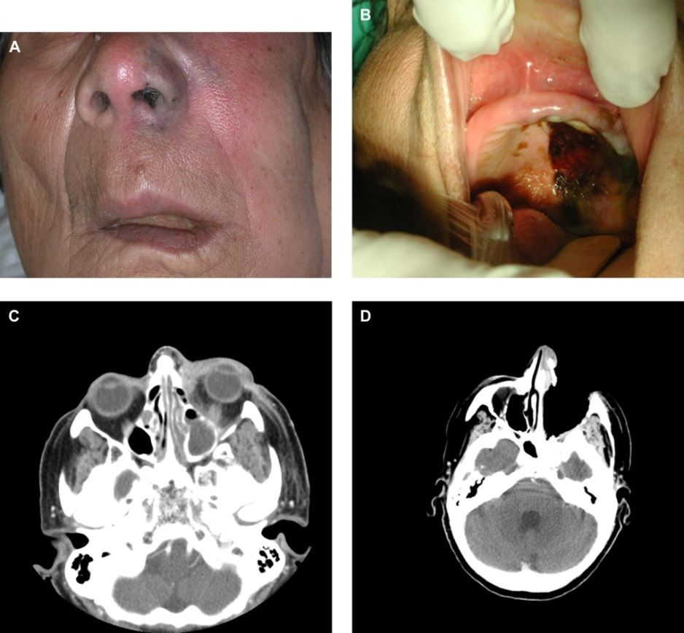
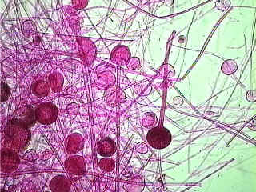
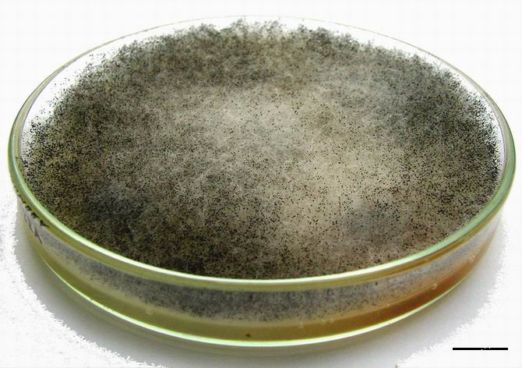
Response to therapy:
Primary treatment (n=21)
67% alive at day 42
32% overall success rate at EOT
Refractory (=11)
54% alive at Day 42
36% overall response at EOT
Intolerant (n=5)
60% alive at day 42
20% overall success at EOT
Isavuconazonium FDA Advisory Committee Briefing Document

Slide 14
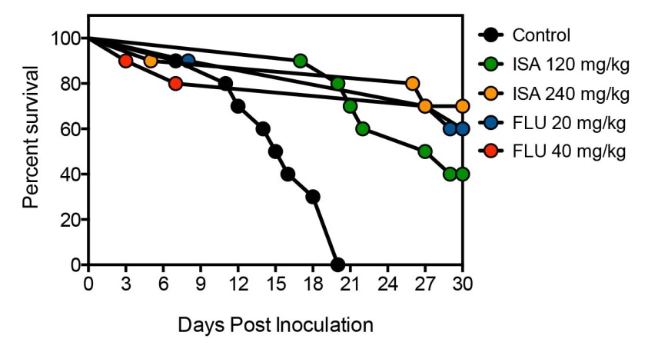
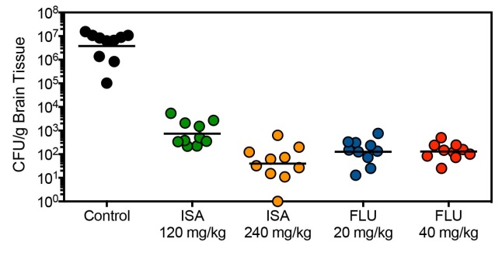
Cryptococcus spp
128 C. neoformans and C. gattii
MIC (<0.015-0.25)
MIC₉₀ 0.06
Animal Model of cryptococcal meningitis
Significant improvement in survival and fungal burden
Group | Placebo Control | ISA 120 mg/kg | ISA 240 mg/kg | FLU 20 mg/kg | FLU 40 mg/kg
Median Survival | 15 days | 28 days *p=0.0002 | >30 days *p=0.0002 | >30 days *p=0.0002 | >30 days *p=0.0022
Percent Survival | 0% | 40% *p=0.0867 | 70% *p=0.0031 | 60% *p=0.0108 | 60% *p=0.0108
Thompson GR, et al. Antimicrob Agents Chemother. 2009 Jan;53(1):309-11. Espinel-Ingroff A, et al. Antimicrob Agents Chemother. 2015 Jan;53(1):309-11. Najvar LK et al. ICAAC Washington DC 2014; Poster M-427.
Notes:
Drug half life of 130 hours

Slide 15
Successful treatment in small group of patients (6/9).
8/9 survived through day 84
CSF levels? CNS levels?
Prolonged half-life (130 hours) offer advantages over other triazoles?
Queiroz-Telles F et al. ICAAC 2014. Washington DC

Slide 16
Endemic Mycoses
Low MICs for most endemic fungi
Higher MICs for Sporothrix
Need CSF data
Thompson GR, Wiederhold NP. Mycopathologia 2010; Nov;170(5):291-313

Slide 17
A
Parameter | Paracoccidioides (n=10) | Histoplasma (n=7) | Coccidioides (n=9) | Blastomyces (n=3)
Age, median (range) | 42.5 (24-56) | 40 (24-69) | 43 (22-69) | 54 (36-67)
Organ involvement
Pulmonary | 8 (80%) | 5 71%) | 9 (100%) | 3 (300%)
CNS | 1 (10%) | 1 (14%) | -
GI | - | - | -
Liver | 1 (10%) | 2 (29%) | -
Disseminated | 7 (70%) | 4 (57%) | 0 | 2 (67%)
Successful overall response in 64% of patients with endemic mycoses.
Drug related TEAE in 38% - vomiting, nausea, headache, dizziness, diarrhea
Encouraging results for larger future studies.
Thompson GR, et al. ICAAC 2014; Washington DC. Poster M-1775.

Slide 18
Candidemia
A Phase III, Double-blind, Randomized Study to Evaluate the Safety and Efficacy of Isavuconazole Versus Caspofungin Followed by Voriconazole in the Treatment of Candidemia and Other Invasive Candida Infections
Study closed to enrollment
DRC assessment ongoing

Slide 19
Other Difficult pathogens…
Scedosporium - MIC (0.5-8 µg/mL)
Fusarium – MIC (0.25->16 µg/mL)
Exserohilum – MIC (0.5-4 µg/mL)
Trichosporon – MIC (<0.03 – 0.5 µg/mL)
No clinical data available!
Thompson GR, Wiederhold NP. Mycopathologia 2010; Nov;170(5):291-313

Slide 20
Conclusions
Aspergillosis – non-inferior to voriconazole and fewer side effects and treatment discontinuation
Mucormycosis – useful agent!
genus level identification and susceptibility testing now that have choices for these infections
Candidemia trial results forthcoming
Need additional data for endemics and traditionally “difficult” pathogens

