Slide 1


Aspergillus PCR achieving standardisation
J Peter Donnelly PhD FRCPath
Department of Haematology
Radboud University Nijmegen Medical Centre
Nijmegen, The Netherlands

Slide 2
Contents
Invasive fungal disease
The European Aspergillus PCR Initiative
Systematic review of Aspergillus PCR
Towards a standard
Specimens
Quality assurance programme
Design of a calibrator
Clinical validity
Future activities

Slide 3

Invasive fungal disease

Slide 4
Invasive infectious diseases
Host

Slide 5
Invasive infectious diseases
Host
Clinical features

Slide 6
Invasive infectious diseases
Host
Clinical features
Microbiological evidence

Slide 7
Invasive infectious diseases
Host
Disease
Clinical features
Microbiological evidence
Mycological evdence

Slide 8
Invasive infectious diseases
Host
Haematology admissions
Disease
Clinical features
Microbiological evidence
Radiology reports
Microbiology reports

Slide 9
Invasive infectious diseases
Host
Haematology admissions
Laboratory’s impression based on its findings
Microbiological evidence
Microbiology reports

Slide 10
Invasive infectious diseases
Host
Haematology admissions
Clinicians’ impression based on clinical findings
Clinical features
Radiology reports

Slide 11
Invasive infectious diseases
Host
Haematology admissions
We need all 3 elements to obtain reliable data
Disease
Clinical features
Microbiological evidence
Radiology reports
Microbiology reports

Slide 12
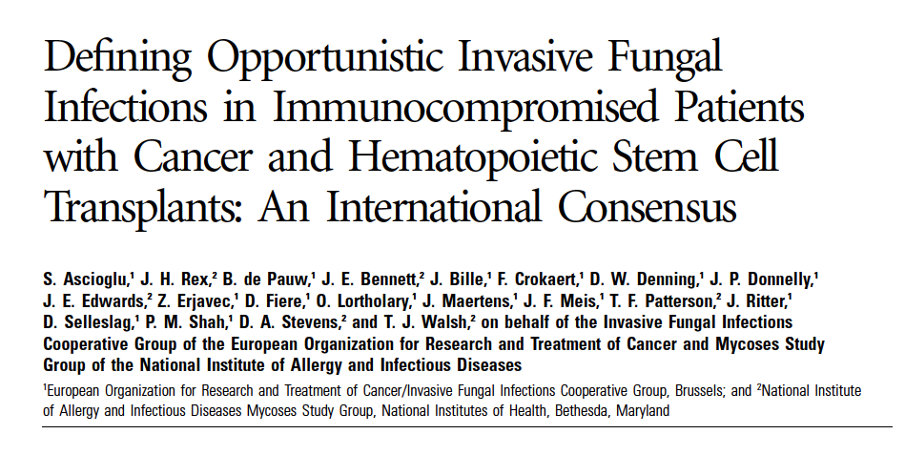

EORTC-IFICG & NIAID-MSG
2002

Slide 13
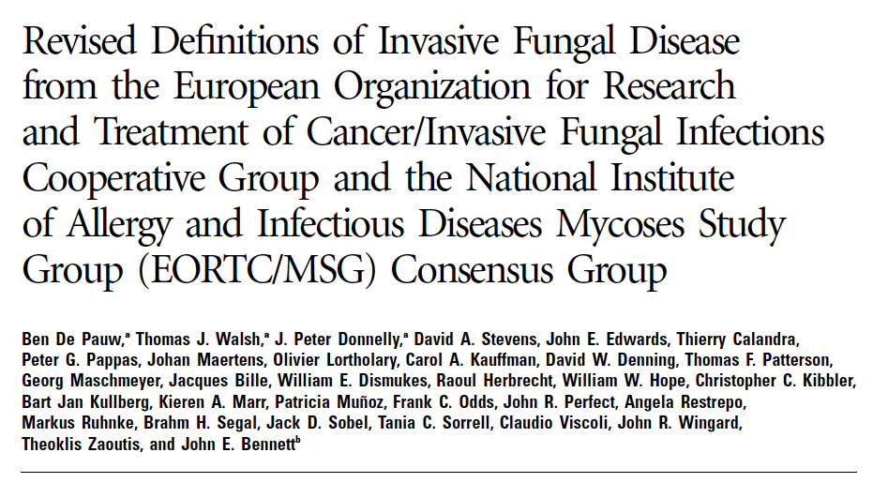

Revised definitions
2008

Slide 14
Revised EORTC/MSG definitions
“By contrast, molecular methods of detecting fungi in clinical specimens, such as PCR, were not included in the definitions because there is as yet no standard, and none of the techniques has been clinically validated.”
De Pauw et al. 2008

Slide 15
Revised EORTC/MSG definitions
“By contrast, molecular methods of detecting fungi in clinical specimens, such as PCR, were not included in the definitions because there is as yet no standard, and none of the techniques has been clinically validated.”
“We had hoped that nucleic acid–detection tests, such as PCR, would have improved enough to incorporate the results of these tests into the definitions. However, standardization and validation have not yet been attained for these platforms”
De Pauw et al. 2008

Slide 16


The main players in invasive fungal disease
Opportunity knocks!
Hi Bud!
Hi pal!
Aspergillus
Candida

Slide 17
The main player………
Aspergillus

Slide 18
The European
Aspergillus PCR Initiative

Slide 19


Sunday afternoon 25th June
Contact
p.donnelly@usa.net

Slide 20
My qualifications
Old school microbiologist
Secretary to the EORTC/MSG definitions
Trialist of antifungal drugs
Tester of galactomannan in the clinic
Confronted with invasive aspergillosis
Communicator
Not too big an ego
Solid academic network
Willing to put in the effort

Slide 21
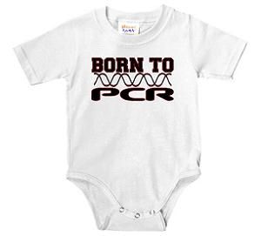
My qualifications for PCR
NOT

Slide 22


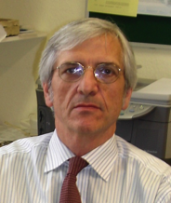





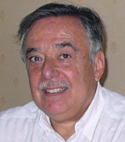
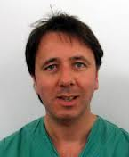





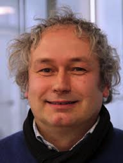

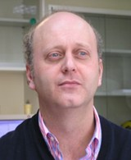
No matter we have experts…

Slide 23
We needed……………
clinic
laboratory

Slide 24
Complete cooperation
clinic
laboratory

Slide 25

www.eapcri.eu

Slide 26
Interested parties
86 participants
69 centres
24 countries

Slide 27

Interested parties
86 participants
69 centres
24 countries

Slide 28
Testing centres
Catriona Halliday, Westmead, Australia
Cornelia Lass-Florl, Innsbruck, Austria
Birgit Willinger, Vienna, Austria
Johan Maertens, Leuven, Belgium
Martina Lengerova, Brno, Czech
Petr Hamal, Olomouc, Czech
Daniel Codl, Prague, Czech
Sendid Boualem, Lille, France
Dieter Buchheidt, Heidelberg, Germany
Markus Ruhnke, Berlin, Germany
Maurizio Sanguinetti, Rome, Italy
Jose Palomares, Seville, Spain
Daniel Goldenberger, Basel, , Switzerland
Jacques Bille, Lausanne, Switzerland
Elisabeth Johnson, Bristol, UK
Richard Hobson, Leeds, UK
Chris Kibbler, London, UK
Samir Agrawal, London, UK
Malcolm Guiver, Manchester, UK

Slide 29
EAPCRI Objectives/Aims
to collaborate to develop a standard for Aspergillus PCR methodology
to validate this in clinical trials
so that
PCR could be incorporated into future consensus definitions for invasive fungal disease.

Slide 30

To each his own……
Off target
On target
3
2
1

Slide 31
Structure of the EAPCRI
Steering committee
LAB
Working party
CLIN
Working party
STATS
Working party
Commercial
section

Slide 32
Structure of the EAPCRI
Steering
committee
LAB
Working party
CLIN
Working party
STATS
Working party
Commercial
section

Slide 33
Structure of the EAPCRI
Steering committee
LAB
Working party
CLIN
Working party
STATS
Working party
Commercial
section

Slide 34
Structure of the EAPCRI
Steering committee
LAB
Working party
CLIN
Working party
STATS
Working party
Commercial
section

Slide 35
Structure of the EAPCRI
Steering committee
LAB
Working party
CLIN
Working party
STATS
Working party
Commercial
section

Slide 36
Structure of the EAPCRI
Steering committee
LAB
Working party
CLIN
Working party
STATS
Working party
Commercial
section

Slide 37
Structure of the EAPCRI
Chair
LAB
Working party
Chair
Steering committee
Chair
CLIN
Working party
Chair
STATS
Working party

Slide 38
EAPCRI
Statistical Working party

Slide 39

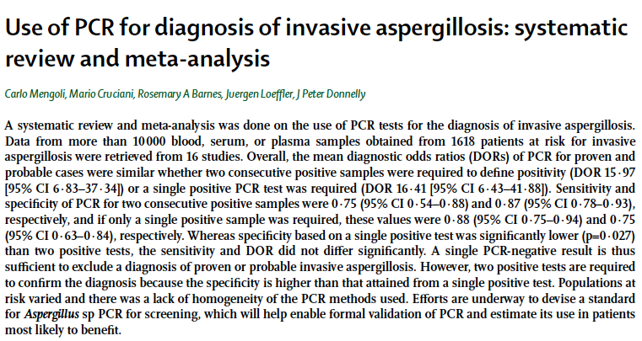
Mengoli et al 2009 Lancet Infect Dis 9:89-96

Slide 40
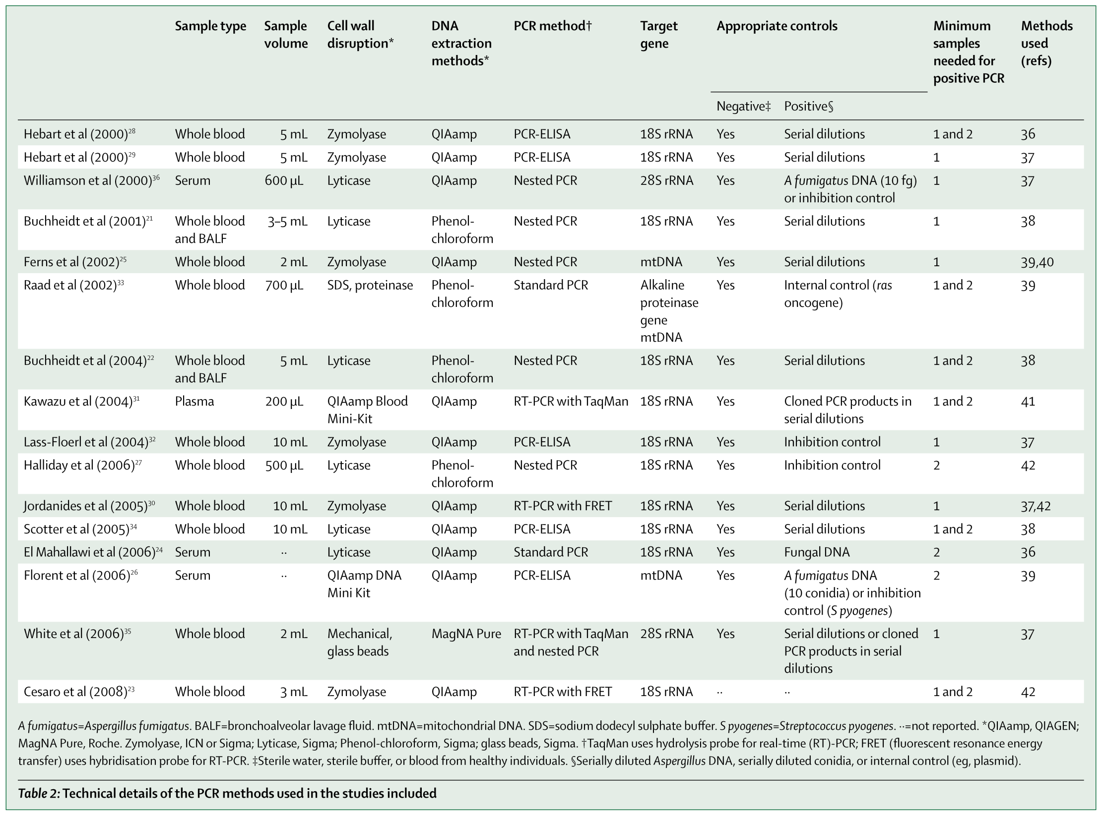
Mengoli et al 2009 Lancet Infect Dis 9:89-96

Slide 41
16 studies
Mengoli et al 2009 Lancet Infect Dis 9:89-96

Slide 42
16 studies
Extraction x 3
Disruption x 4
Volume x 3
Specimen x 3
Target gene x 3
PCR method x 4
Positive control x 7
All different
Samples for +ve result x 3
Mengoli et al 2009 Lancet Infect Dis 9:89-96

Slide 43
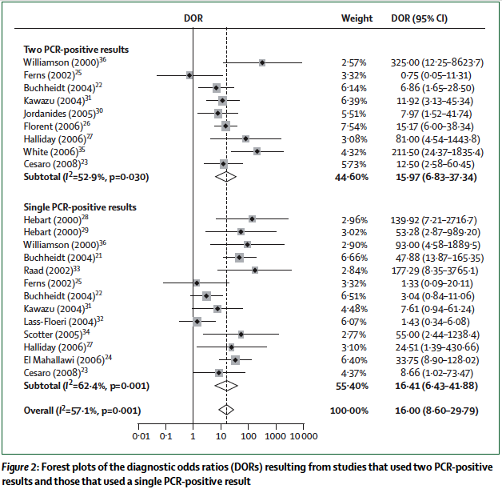
Aspergillus PCR – Forrest plots
Mengoli et al 2009 Lancet Infect Dis 9:89-96

Slide 44
Aspergillus PCR – Forrest plots
Mengoli et al 2009 Lancet Infect Dis 9:89-96

Slide 45
Aspergillus PCR – Forrest plots
9/16 “good studies”
Mengoli et al 2009 Lancet Infect Dis 9:89-96

Slide 46
Bivariate analysis
 | DOR (95 % CI) | Sensitivity (95 % CI) | Specificity (95 % CI) | LR+ | LR-
PCR , 2 samples to define positivity | 21.33 (6.86-466.30) | 0.75 (0.54- 0.88) | 0.87 (0.78-0.93) | 6.04 | 0.28
Mengoli et al 2009 Lancet Infect Dis 9:89-96

Slide 47
Bivariate analysis
 | DOR (95 % CI) | Sensitivity (95 % CI) | Specificity (95 % CI) | LR+ | LR-
PCR, 1 sample to define positivity | 22.11 (7.77-62.92) | 0.88 (0.75-0.94) | 0.75 (0.63-0.84) | 3.53 | 0.15
PCR , 2 samples to define positivity | 21.33 (6.86-466.30) | 0.75 (0.54- 0.88) | 0.87 (0.78-0.93) | 6.04 | 0.28
Mengoli et al 2009 Lancet Infect Dis 9:89-96

Slide 48
Bivariate analysis
 | DOR (95 % CI) | Sensitivity (95 % CI) | Specificity (95 % CI) | LR+ | LR-
PCR, 1 sample to define positivity | 22.11 (7.77-62.92) | 0.88 (0.75-0.94) | 0.75 (0.63-0.84) | 3.53 | 0.15
PCR , 2 samples to define positivity | 21.33 (6.86-466.30) | 0.75 (0.54- 0.88) | 0.87 (0.78-0.93) | 6.04 | 0.28
Mengoli et al 2009 Lancet Infect Dis 9:89-96

Slide 49
Differences in patient cohorts?
Raad et al 2002
Halliday et al 2005
White et al 2006
Proven/Probable IFD
Possible IFD
No IFD
Mengoli et al 2009 Lancet Infect Dis 9:89-96

Slide 50
Differences in patient cohorts?
Raad et al 2002
Halliday et al 2005
White et al 2006
54 adults with cancer (treated for haematological malignancies who had developed pulmonary infiltrates
65 adults treated for haematological malignancies or recipients of an HSCT
203 adults treated for haematological malignancies or recipients of an HSCT
Mengoli et al 2009 Lancet Infect Dis 9:89-96

Slide 51
Differences in methods?
 | Raad et al. | Halliday et al. | White et al.
Cell wall disruption | SDS, proteinase | Lyticase | Mechanical, glass beads
DNA extraction | phenol-chloroform | phenol-chloroform | MagnaPure®
TaqMan* | no | no | yes
Nested PCR | no | yes | yes
Target gene | alkaline proteinase gene mDNA | 18S rRNA | 28S rRNA
No sample for result | 1 | 1 and 2 | 2
References for methodology | Tang et al [59]; Bretagne et al. [58] | Skladny et al [43] | Williamson et al [28]
Mengoli et al 2009 Lancet Infect Dis 9:89-96

Slide 52
Differences in methods?
 | Raad et al. | Halliday et al. | White et al.
Cell wall disruption | SDS, proteinase | Lyticase | Mechanical, glass beads
DNA extraction | phenol-chloroform | phenol-chloroform | MagnaPure®
TaqMan* | no | no | yes
Nested PCR | no | yes | yes
Target gene | alkaline proteinase gene mDNA | 18S rRNA | 28S rRNA
No sample for result | 1 | 1 and 2 | 2
References for methodology | Tang et al [59]; Bretagne et al. [58] | Skladny et al [43] | Williamson et al [28]
Mengoli et al 2009 Lancet Infect Dis 9:89-96

Slide 53
Differences in methods?
 | Raad et al. | Halliday et al. | White et al.
Cell wall disruption | SDS, proteinase | Lyticase | Mechanical, glass beads
DNA extraction | phenol-chloroform | phenol-chloroform | MagnaPure®
TaqMan* | no | no | yes
Nested PCR | no | yes | yes
Target gene | alkaline proteinase gene mDNA | 18S rRNA | 28S rRNA
No sample for result | 1 | 1 and 2 | 2
References for methodology | Tang et al [59]; Bretagne et al. [58] | Skladny et al [43] | Williamson et al [28]
Mengoli et al 2009 Lancet Infect Dis 9:89-96

Slide 54
Differences in methods?
 | Raad et al. | Halliday et al. | White et al.
Cell wall disruption | SDS, proteinase | Lyticase | Mechanical, glass beads
DNA extraction | phenol-chloroform | phenol-chloroform | MagnaPure®
TaqMan* | no | no | yes
Nested PCR | no | yes | yes
Target gene | alkaline proteinase gene mDNA | 18S rRNA | 28S rRNA
No sample for result | 1 | 1 and 2 | 2
References for methodology | Tang et al [59]; Bretagne et al. [58] | Skladny et al [43] | Williamson et al [28]
Mengoli et al 2009 Lancet Infect Dis 9:89-96

Slide 55
Differences in methods?
 | Raad et al. | Halliday et al. | White et al.
Cell wall disruption | SDS, proteinase | Lyticase | Mechanical, glass beads
DNA extraction | phenol-chloroform | phenol-chloroform | MagnaPure®
TaqMan* | no | no | yes
Nested PCR | no | yes | yes
Target gene | alkaline proteinase gene mDNA | 18S rRNA | 28S rRNA
No sample for result | 1 | 1 and 2 | 2
References for methodology | Tang et al [59]; Bretagne et al. [58] | Skladny et al [43] | Williamson et al [28]
Mengoli et al 2009 Lancet Infect Dis 9:89-96

Slide 56
Differences in methods?
 | Raad et al. | Halliday et al. | White et al.
Cell wall disruption | SDS, proteinase | Lyticase | Mechanical, glass beads
DNA extraction | phenol-chloroform | phenol-chloroform | MagnaPure®
TaqMan* | no | no | yes
Nested PCR | no | yes | yes
Target gene | alkaline proteinase gene mDNA | 18S rRNA | 28S rRNA
No sample for result | 1 | 1 and 2 | 2
References for methodology | Tang et al [59]; Bretagne et al. [58] | Skladny et al [43] | Williamson et al [28]
Mengoli et al 2009 Lancet Infect Dis 9:89-96

Slide 57
Differences in methods?
 | Raad et al. | Halliday et al. | White et al.
Cell wall disruption | SDS, proteinase | Lyticase | Mechanical, glass beads
DNA extraction | phenol-chloroform | phenol-chloroform | MagnaPure®
TaqMan* | no | no | yes
Nested PCR | no | yes | yes
Target gene | alkaline proteinase gene mDNA | 18S rRNA | 28S rRNA
No sample for result | 1 | 1 and 2 | 2
References for methodology | Tang et al [59]; Bretagne et al. [58] | Skladny et al [43] | Williamson et al [28]
Mengoli et al 2009 Lancet Infect Dis 9:89-96

Slide 58
Differences in methods?
 | Raad et al. | Halliday et al. | White et al.
Cell wall disruption | SDS, proteinase | Lyticase | Mechanical, glass beads
DNA extraction | phenol-chloroform | phenol-chloroform | MagnaPure®
TaqMan* | no | no | yes
Nested PCR | no | yes | yes
Target gene | alkaline proteinase gene mDNA | 18S rRNA | 28S rRNA
No sample for result | 1 | 1 and 2 | 2
References for methodology | Tang et al [59]; Bretagne et al. [58] | Skladny et al [43] | Williamson et al [28]
Mengoli et al 2009 Lancet Infect Dis 9:89-96

Slide 59
Conclusions
Several factors might explain the variation in PCR study results
  Population under study
  Sample size
  Sample intensity
  PCR methodology
  Numbers required for a positive result

Slide 60

Aspergillus PCR standard
Who uses my PCR?

Slide 61
Aspergillus PCR standard
notme
notme
not
not
notme
notme
notme

Slide 62

Aspergillus PCR standard
?

Slide 63

Home brews

Slide 64
EAPCRI
Steering Committee

Slide 65
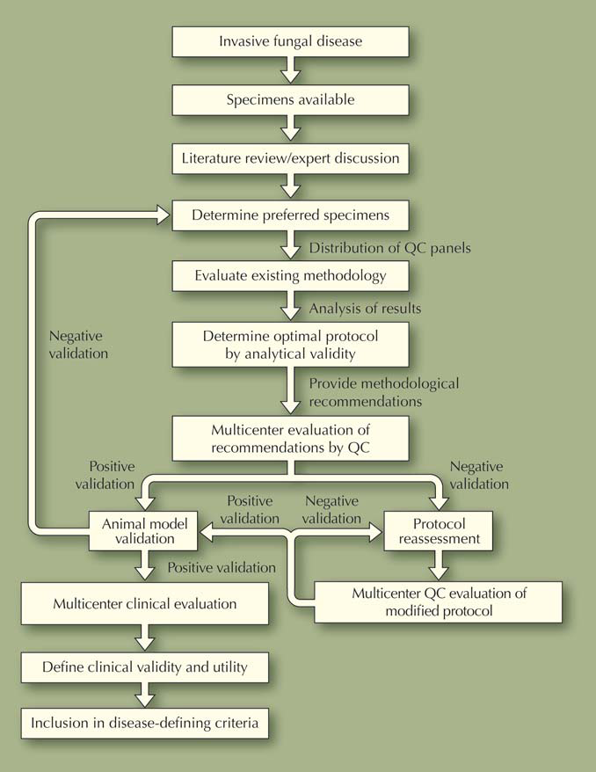
Achieving standardisation
White et al 2010

Slide 66

Achieving standardisation
White et al 2010

Slide 67

Achieving standardisation
White et al 2010

Slide 68
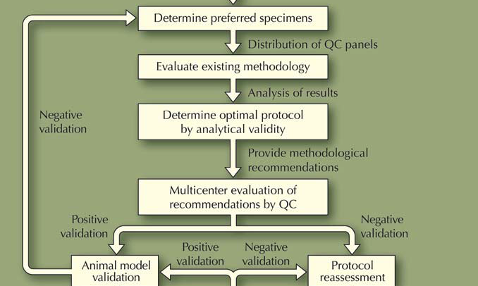
Achieving standardisation
White et al 2010

Slide 69
Achieving standardisation
White et al 2010

Slide 70
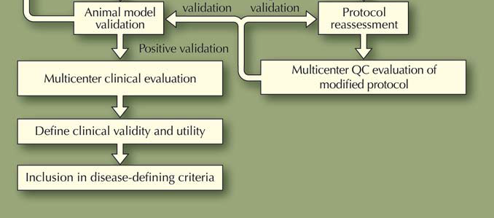
Achieving standardisation
White et al 2010

Slide 71


The ISHAM Working Group
The European Aspergillus PCR Initiative Foundation
Joint project with the QCMD

Slide 72
Outline of proposal
Development of an EQA scheme as defined by QCMD and EAPCRI.
On-line web based reporting system for EAPCRI participating laboratories.
QCMD will take responsibility for the storage and preparation of the EQA materials to the appropriate regulatory requirements.
Preparation of ‘on line’ reports
Notes:
72

Slide 73
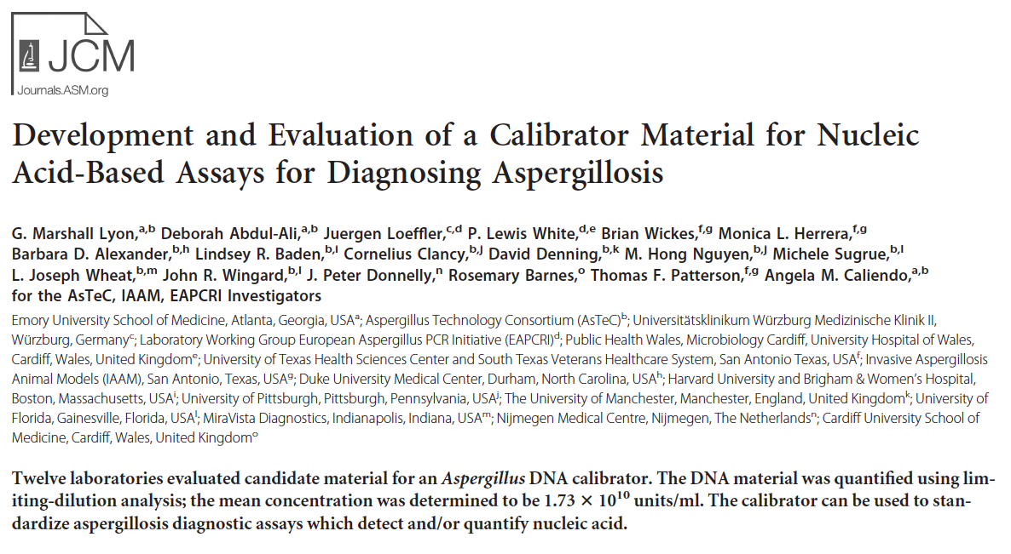
Design of a calibrator

Slide 74
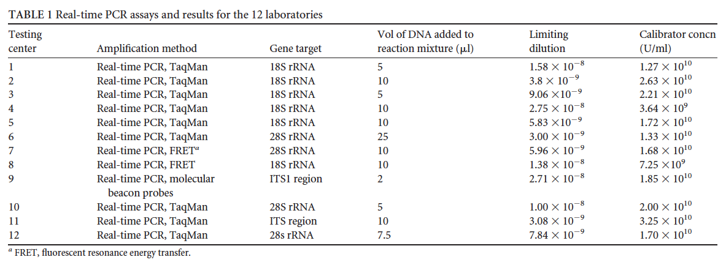
RT-PCR assays results of 12 laboratories

Slide 75
RT-PCR assays results of 12 laboratories
1-7 x 10¹⁰ U/mL

Slide 76
EQA Programme composition.
EQA programme design will follow the International standard for EQA provision (ISO17043).
The EQA programme design and panel composition will be determined by scientific experts selected from EAPCRI group and the assigned QCMD project team.
Notes:
76

Slide 77
Diagnostic tests
analytical validity
clinical validity
clinical utility

Slide 78
Diagnostic tests
laboratory
analytical validity
clinical validity
clinical utility

Slide 79
Diagnostic tests
laboratory
analytical validity
clinical validity
clinic
clinical utility

Slide 80
EAPCRI
Laboratory Working Party

Slide 81
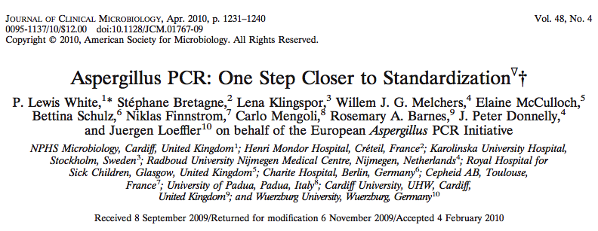
Getting closer..
White et al 2010 J Clin Microbiol 48:1231-40

Slide 82
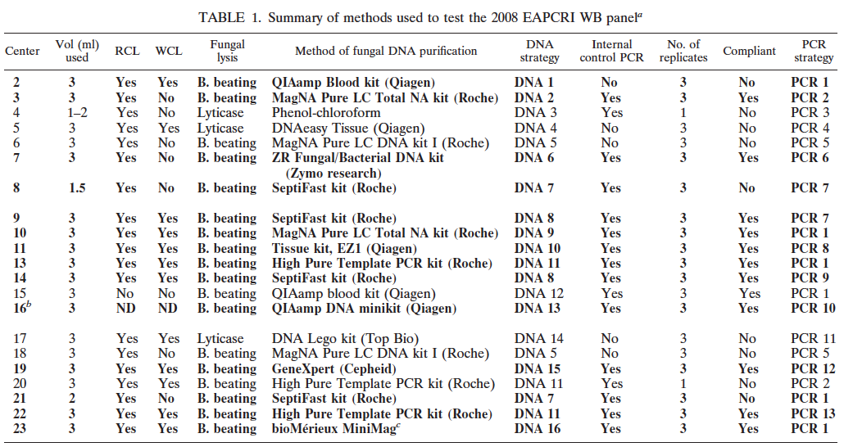
PCT strategies tested by the EAPCRI

Slide 83
PCT strategies tested by the EAPCRI
23 centres
13 PCR strategies

Slide 84
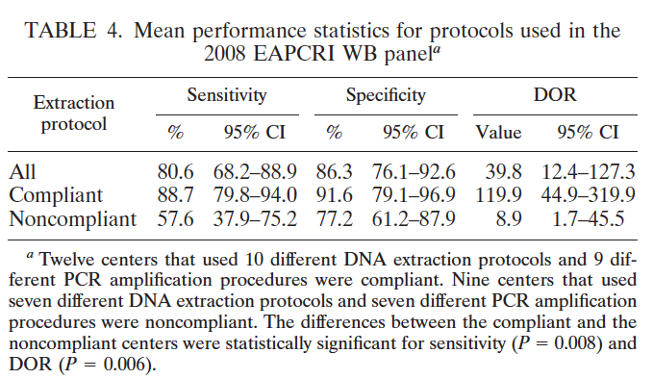
EAPCRI performance
White et al 2010 J Clin Microbiol 48:1231-40

Slide 85
EAPCRI performance
White et al 2010 J Clin Microbiol 48:1231-40

Slide 86
EAPCRI performance
White et al 2010 J Clin Microbiol 48:1231-40

Slide 87
EAPCRI performance
White et al 2010 J Clin Microbiol 48:1231-40

Slide 88
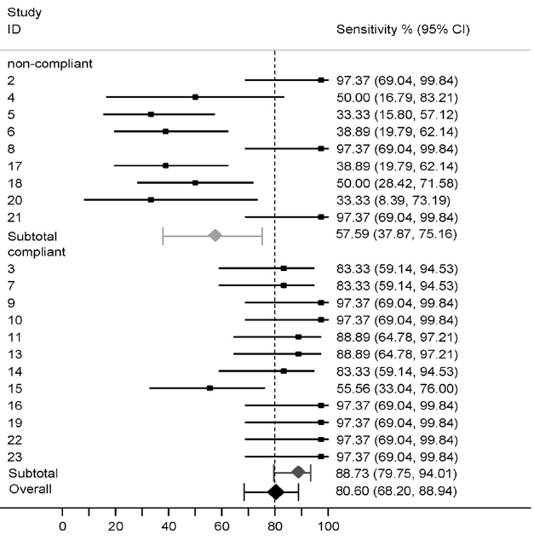
Performance of centres in the EAPCRI
White et al 2010 J Clin Microbiol 48:1231-40

Slide 89
Performance of centres in the EAPCRI
Non-compliant
White et al 2010 J Clin Microbiol 48:1231-40

Slide 90
Performance of centres in the EAPCRI
Compliant
White et al 2010 J Clin Microbiol 48:1231-40

Slide 91
Factors with most influence on PCR
Covariate | t | P
Compliant with extraction method | 2.69 | 0.018
Blood volume used | 0.22 | 0.829
RCLB | 1.12 | 0.285
WCLB | 2.08 | 0.058
NaOH | 1.59 | 0.137
Bead beating | 2.59 | 0.023
Purification | 1.14 | 0.274
More than nine manual steps | 0.46 | 0.650
ITS | 1.54 | 0.148
18S | 1.89 | 0.082
28S | 0.48 | 0.637
Internal control PCR | 2.85 | 0.015
Elution volume | 0.75 | 0.469

Slide 92
Factors with most influence on PCR
Covariate | t | P
Compliant with extraction method | 2.69 | 0.018
Blood volume used | 0.22 | 0.829
RCLB | 1.12 | 0.285
WCLB | 2.08 | 0.058
NaOH | 1.59 | 0.137
Bead beating | 2.59 | 0.023
Purification | 1.14 | 0.274
More than nine manual steps | 0.46 | 0.650
ITS | 1.54 | 0.148
18S | 1.89 | 0.082
28S | 0.48 | 0.637
Internal control PCR | 2.85 | 0.015
Elution volume | 0.75 | 0.469
Multivariate analysis
Positive correlation between sensitivity and:
WCLB t:2.95
Bead beating
Internal control PCR
Negative correlation between sensitivity and:
Elution volumes >100μL

Slide 93
Specimens

Slide 94
Recommendations for whole blood PCR
≥3 ml of blood
Lyse Red and white cell
Bead-beating for lysis of fungal cells
Real time PCR platform: multi-copy target with specific probes
Duplicate testing of extracts
An Internal control PCR is essential
Preferably non-human target
Concentrations equivalent to typical fungal burdens
Controls for DNA extraction and PCR assay
Elution volume <100μl
EDTA is the only anticoagulant to be used:
sodium citrate and heparin should not be used
All batches of reagents should be screened for contamination
White et al. 2011 JCM Epub

Slide 95
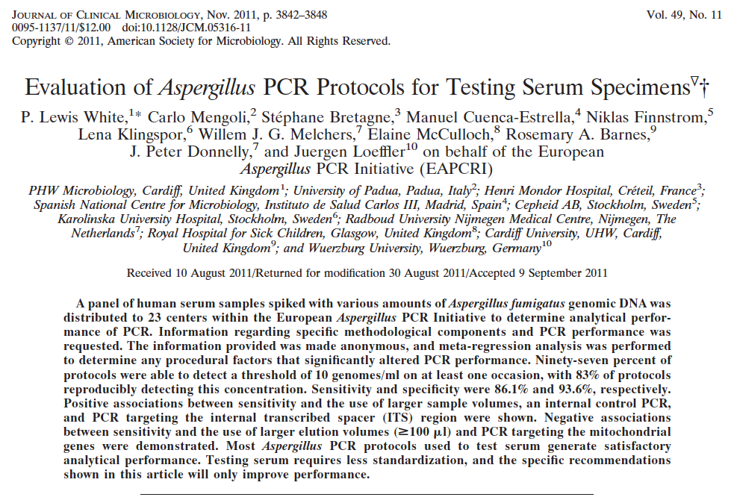
Seerum versus whole blood

Slide 96
Recommendations for serum PCR
A minimum of 0.5mL sample
Most commercially available nucleic acid extraction systems can be used Screened for contamination and a limit of detection determined prior to clinical use.
Avoid Protocols specifically designed for testing alternative specimens types (e.g. Whole blood).
Elute in volumes <100µL.
An internal control PCR should be incorporated at the start of the extraction procedure Internal control Cq values should be representative of typical Aspergillus PCR positive results (≥35 cycles) Human DNA targets avoided due to the possibility of variable target amounts within individual specimens
A PCR positivity threshold of 43 cycles provides the greatest degree of diagnostic accuracy
White et al. 2011 JCM Epub

Slide 97
Correlation between serum and plasma
Direct correlation between serum and plasma assay results (Ct)
Loeffler et al 2013

Slide 98
Correlation between serum and plasma
Correlation between Ct and log10(DNA) load, copies/ml.
Loeffler et al 2013

Slide 99
EAPCRI
Clinical Working Party

Slide 100

A phase 3, double-blind, multicenter, randomized, placebo-controlled study to assess the efficacy, safety and tolerability of prophylactic liposomal amphotericin B (Ambisome®) for the prevention of invasive fungal infections (IFI’s) in subjects receiving remission-induction chemotherapy for acute lymphoblastic leukemia (ALL)

Slide 101

Ambiguard - objectives
Primary objective:
To determine the prophylactic efficacy of AmBisome compared to placebo in preventing IFIs in subjects with ALL undergoing remission-induction chemotherapy.

Slide 102
Ambiguard - objectives
Primary objective:
To determine the prophylactic efficacy of AmBisome compared to placebo in preventing IFIs in subjects with ALL undergoing remission-induction chemotherapy.
Secondary objectives:
To determine the safety and tolerability of prophylactic AmBisome in subjects with ALL undergoing remission-induction chemotherapy.
To determine the impact of IFI prevention on the efficacy of remission-induction chemotherapy in subjects with AL

Slide 103
Ambiguard - design
placebo
twice weekly
(n = 118)
AmBisome 5 mg/kg
twice weekly
(n = 236)
 |  | Proven + probable IA
 |  | Present | Absent
PCR result | Positive | True Positive | False Positive | Positive predictive value
 | Negative | False Negative | True Negative | Negative predictive value
 |  | Sensitivity | Specificity

Slide 104






Ambiguard study - PCR test
Contractor
Secretary
Chair
LAB WP
{Subcontractors}

Slide 105
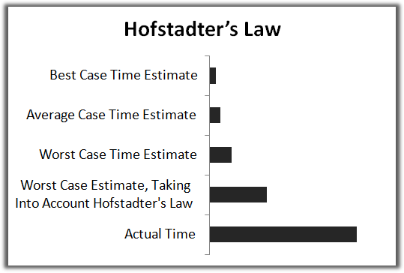
Hofstadter’s Law
Hofstadter's Law: It always takes longer than you expect, even when you take into account Hofstadter's Law.
It always takes longer than you expect, even when you take into account Hofstadter's Law.

Slide 106

EORTC 65091
Study title and number
Title | Empirical versus “pre-emptive” antifungal therapy of patients with haematological malignancies and recipients of an allogeneic HSCT following myeloablative threapy. A therapeutic phase III strategy study
Study number | 65091
EORTC classification | 1A randomized phase III (new standard of care)

Slide 107
Translational research question
Translational research
Objective correlative study 1
Validation of a standardised Aspergillus PCR proposed by the ISHAM Working Group EAPCRI
Rationale
Despite extensive experience in the past decade using polymerase chain reaction for diagnosing aspergillosis, the technique was not included as mycological evidence in either the first consensus definitions of invasive fungal disease or in recent revisions because there was no standardized or validated method. The analytical validity of Aspergillus PCR has been established but the clinical validity and utility remains to be determined. Consequently several research groups joined forces and formed a working party of the International Society of Human and Animal Mycology (ISHAM) to establish a standard for Aspergillus PCR testing Its clinical validation is the main objective of this correlative study.
Estimated sample size | All patients
Laboratory technique/expertise | European Aspergillus PCR initiative
LRD contacted | no
Name of laboratory and contact person | Jurgen Loeffler (Wurzburg, Germany) and Rosemary Barnes (Cardiff,UK)
Aspergillus PCR

Slide 108
EORTC 65091
Timelines
Start | Spring 2011
Patients needed | 556
End | Summer 2014
Report | Summer 2015

Slide 109
EAPCRI
Future Initiatives

Slide 110
Future activities
Establish for Aspergillus PCR
An international standard for screening and diagnosis in blood with and without cells
a proficiency programme
a standard for bronchoalveolar fluids and other samples

Slide 111

www.eapcri.eu

