Slide 1


ABPA in Cystic Fibrosis:
How is it Different from ABPA in Asthma?
ABPA complicating asthmatics working group symposium
19th ISHAM Congress, Melbourne, 6 May 2015
Richard B. Moss MD
Center for Excellence in Pulmonary Biology
Department of Pediatrics

Slide 2
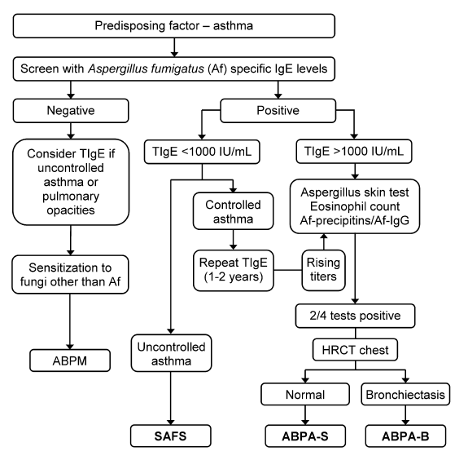
ABPA Working Group Unified Diagnostic Algorithm
Agarwal, Clin Exp Allergy 2013;43:850

Slide 3

Typical Phenotypic Features
Cystic Fibrosis
  Most common lethal genetic disease of Caucasians
  --also seen in Hispanic, African, Asian populations
    1 in 2500-10000 births; 70-100,000 CF patients worldwide
  Autosomal recessive monogenetic MULTISYSTEM disease, resulting from mutations in CFTR, a transmembrane anion channel and multifunctional regulator; phenotype affected by many genetic and environmental modifiers
Malnutrition, growth
defects
Fat-soluble vitamin deficiencies
Dermal salt loss
Sinusitis & chronic progressive
pulmonary disease
Gastrointestinal abnormalities
pancreatic insufficiency (90%),
diabetes, hepatobiliary,
intestinal
Obstructive azoospermia
Notes:
One typical phenotypic feature of CF is chronic sino-pulmonary disease such as persistent colonization or infection with pathogens typical of CF lung disease (Staphylococcus aureus, Haemophilus influenzae, Pseudomonas aeruginosa and Burkholderia cepacia).
This may manifest as endobronchial disease characterized by chronic cough and thick sputum production, or as airway obstruction characterized by wheezing, air trapping or by pulmonary function tests.
There may also be evidence of nasal polyps or digital clubbing.
Gastrointestinal abnormalities such as meconium ileus, pancreatic insufficiency, distal intestinal obstruction syndrome, rectal prolapse, recurrent pancreatitis or chronic hepatobiliary disease manifest by biliary or multilobular cirrhosis are also common among CF patients.
The majority of CF men have obstructive azoospermia, a lack of spermatozoa in the semen, due to congenital bilateral absence of the vas deferens.
Many CF patients have nutritional problems such as malnutrition demonstrated by a failure to thrive and hypoproteinemia-edema as well as fat-soluble vitamin deficiencies (vitamins A, D, E, and K).
Salt-loss syndromes such as acute salt depletion and chronic metabolic alkalosis are also characteristic features of CF.
Cystic Fibrosis Foundation. Clinical Practice Guidelines for Cystic Fibrosis. 1997.
Rosenstein BJ, Cutting GR. The diagnosis of cystic fibrosis: a consensus statement. J Pediatr. 1998;132:589-595.

Slide 4



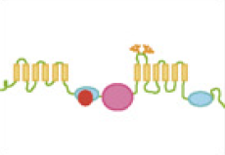
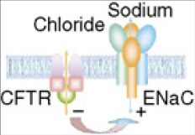
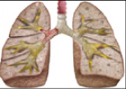
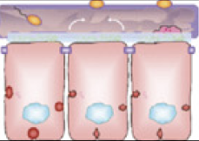

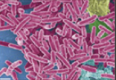
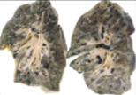

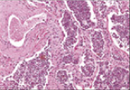
Primary Defects and Secondary Pathophysiologies in CF Lung Disease
CFTR gene
mutation
Defective CFTR
protein
Altered anion
transport & mucus
Gene therapy
CFTR modulators
Ion transport modulators
Hyperosmotic Therapy
Primary Defects
Bronchodilators
Infection
Obstruction
Anti-infectives
Impaired mucociliary
clearance
Mucolytic Treatment
Anti-inflammatories
Lung Transplant
Inflammation
Bronchiectasis,
lung function loss
Secondary Pathophysiologies
Notes:
1) Intro
Cystic fibrosis is the most common lethal autosomal recessive genetic disease among Caucasians,¹ affecting an estimated 30,000 Americans and in excess of 100,000 patients worldwide. The current predicted median survival age for the patients captured in the CFF registry is 37 years. The median age at death in 2008 was 26 years. So while we have made good progress over last 5 decades, much work remains.
2) Paradigm shift
Over the past decade, the drug discovery and development underwent a paradigm shift from focusing on therapies targeting downstream pathophysiologies of CF to therapies targeting the basic defect of CF. In the current view of the etiology of CF, there are four basic defects of CF starting with the mutation in the CFTR gene, which leads to a defective CFTR protein, subsequently resulting in defective ion and fluid transport, leading to impaired mucociliary clearance. These four basic defects give rise to repeating bouts of obstruction and mucus plugging, infection, inflammation, scarring and irreversible loss of lung function. Majority of the currently used therapies focus on the treatment of downstream pathophysiologies. One of the exceptions hypertonic saline that addresses with impaired MCC with remaining treatments targeting.
In contrast, the therapies currently in clinical development target the basic defects, thus having an arguably better chance to alter the course of the disease.
The scenario we hope for is that the therapies with disease modifying mechanism of action will ultimately obviate the need for the supportive care at the later stages of the disease. Denufosol has a potentially disease modifying mechanism of action as it aims to correct the ion transport defect in CF.
Transition
The following slides outline what we believe to be the most essential features of future therapies for CF lung disease.
4

Slide 5
Similarities Between CF and ABPA
Allergic sensitization to A. fumigatus
  Positive skin test
  Serum IgE Af antibodies
Episodic obstructive airways disease
Pulmonary infiltrates
Bronchiectasis
Mold allergy (50-70% CF)
Early, pervasive adaptive immune responses to A. fumigatus
  Serum IgG, IgE, IgA antibodies
  Serum precipitins
Elevated total IgE (25-33% CF)

Slide 6
ABPA Differences in Asthma & CF:
Diagnosis

Slide 7
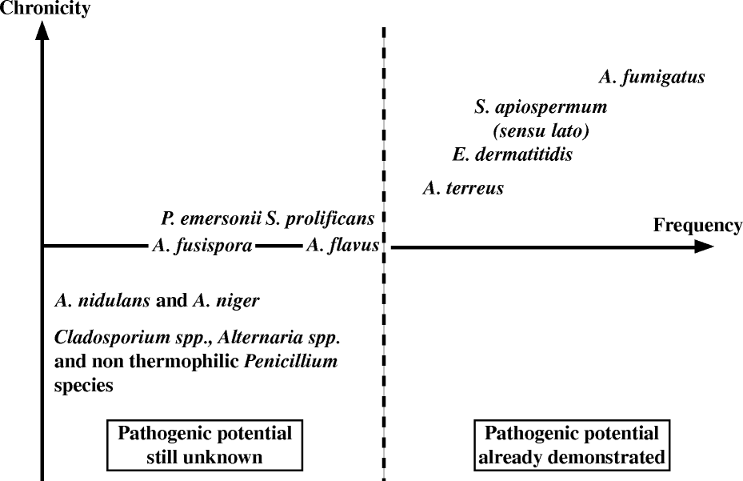
Filamentous Fungi Cultured in CF
Pihet, Med Mycol 2009;47:387
Notes:
Reproduced from Pihet et al Medical Mycology 2009;47:387-97

Slide 8
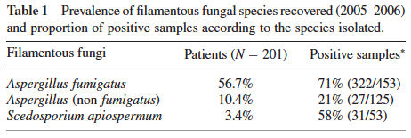
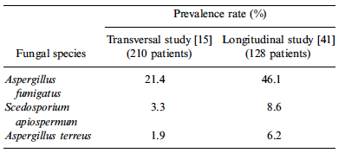
Fungal Colonization in CF –
A. fumigatus Most Prevalent
Paugam, Med Myc 2010;48:S32
Pihet, Med Myc 2009;47:387
Notes:
Paugam – Hôpital Cochin adult Paris CF center
Pihet - 2 French CF Centers – Angers & Giens
Longitudinal study 5 yrs
8

Slide 9
CFTR Modulator (Ivacaftor) Effect on Respiratory Microbes in CF-G551D Patients
Heltshe, Clin Infect Dis 2015:60:703

Slide 10
Roche 454 ITS amplicon sequencing
Harrison, J Cyst Fibros 2013;12:S16
Notes:
ITS

Slide 11
Fungal Class/Phylum Relative Abundance in Healthy, CF and Asthma Sputum
Healthy
CF
Asthma
Nguyen, Front Micro 6:1-9, 2015

Slide 12
Lung Genera/Species of Healthy, Asthma and CF Mycobiomes
Red = opportunist
pathogen
Nguyen, Front Micro 6:1-9, 2015

Slide 13
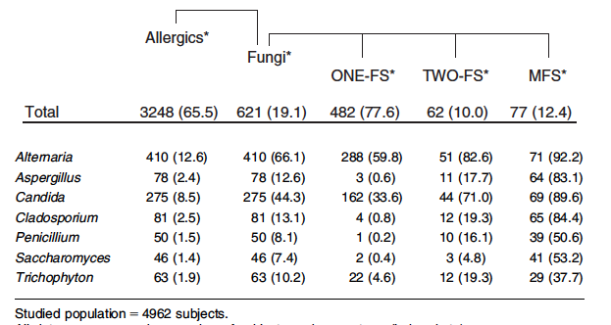
Fungal Allergy in Respiratory Allergist Referrals
19.1% overall prevalence of fungal sensitization in patients undergoing
evaluation for respiratory symptoms
Mari A et al, Clin Exp Allergy 2003;33:1429-38

Slide 14
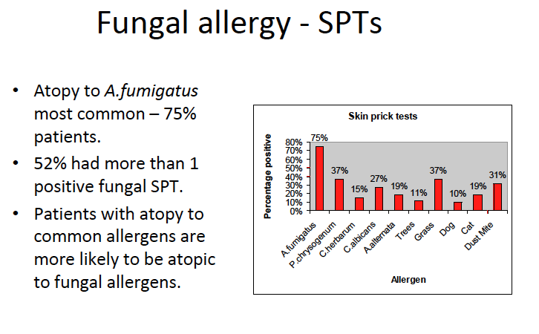
Aspergillus Sensitization in CF
Manchester UK adult CF clinic n=54
Baxter, ISHAM 2009
Notes:
14

Slide 15
Diagnostic Criteria for ABPA in CF
1. Acute or subacute clinical deterioration (cough, wheeze, exercise intolerance, exercise induced asthma, change in pulmonary function, increased sputum) not attributable to another etiology
2. Total serum IgE >500 IU/mL
Immediate skin test reactivity, or in vitro demonstration of
IgE antibody, to A. fumigatus
4. One or both of the following:
a. Serum precipitins, or IgG antibody, to A. fumigatus.
b. New or recent abnormalities on the chest
radiograph (infiltrates, mucus plugging) or chest CT
(bronchiectasis) that have not cleared with antibiotics
and standard physiotherapy
Stevens, Clin Infect Dis 2003;37:S225-64

Slide 16
Screening for ABPA in CF
Annual total serum IgE after age 6
If total IgE >500 IU/mL: Aspergillus skin test or A. fumigatus serum antibody test
If total IgE <500 IU/mL: repeat if increased suspicion for ABPA (such as pulmonary exacerbation) and do skin test or serum antibody test
Stevens, Clin Infect Dis 2003;37:S225-64

Slide 17
Survey of ABPA Diagnostic Criteria in UK CF Centers
Data obtained from 45/58 Centers (78%)
Cunningham, Arch Dis Child 2001;84:89

Slide 18
Center-Based Diagnostic Criteria -
The Leeds Regional CF Unit Example
•ABPA: IgE ≥400 IU/mL, Af-sIgE >3.7 U/L, Af-sIgG>90 mg/L,
≥10% drop in FEV1, wheeze
•Aspergillus bronchitis: ≥4 cultures in 12 mos, IgE≤400, Af-sIgE<3.7, ≥10% drop in FEV1, wheeze, cough
Lauren, J Cyst Fibros 2013;12:S88
Notes:
ABPA 12/474 = 2.5%
Af bronchitis 19/474 = 4%

Slide 19
Recombinant Af Allergens in Serodiagnosis of ABPA
Antigen | Sensitivity, n/N (%) |  | Specificity, n/N (%)
 | ABPA | Aspergillus sensitized asthma | Asthma/controls | References
rAsp f1 | 84/105 (80) | 30/60 (50) | 0/13 (100) | Moser 1994; Crameri 1996, 1998
rAsp f2 | 24/25 (96) | Not done | 0/20 (100) | Banarjee 1997
rAsp f3 | 66/71 (93) | 26/48 (54) | 0/24 (100) | Hemmann 1998, Crameri 1998
rAsp f4 | 58/72 (81) | 0/52 (0) | 0/25 (100) | Hemmann 1999, Crameri 1998
rAsp f6 | 38/72 (53) | 0/52 (0) | 0/25 (100) | Crameri 1998, Hemmann 1999
rAsp f34 | 60/64 (94) | 11/24 (46) | 0/7 (100) | Glaser 2009
rAsp f1 or f3 | 58/60 (97) | 30/40 (75) | 0/20 (100) | Crameri 1998
rAsp f4 or f6 | 65/72 (90) | 0/52 (0) | 0/25 (100) | Crameri 1998, Hemmann 1999

Slide 20
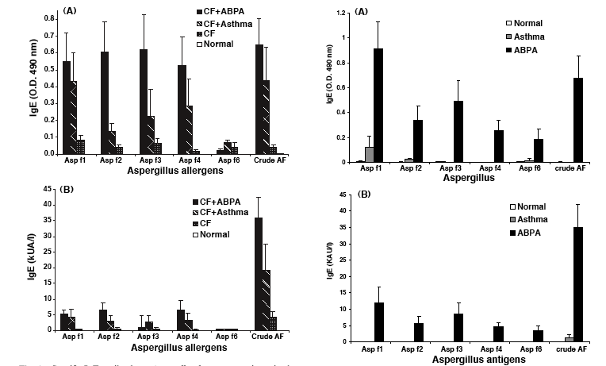
IgE Antibodies to Recombinant A. fumigatus Allergens in Asthmatics vs CF Patients
Kurup, Med Mycol 2005;43:S189

Slide 21
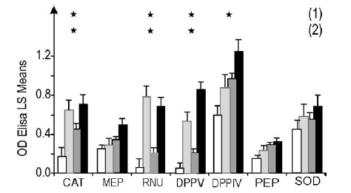
IgG Antibodies to A. fumigatus Antigens in Serodiagnosis of ABPA
CF-ABPA (16), black
ABPA (12), dark gray
CF (51), light gray
Control (37), white
RNU, ribonuclease
CAT, catalase
DPPV, dipeptidylpeptidase
DPPIV, dipeptidylpeptide IV
MEP, metalloprotease
PEP, aspartic protease
SOD, superoxide dismutase
Sarfati, Diagn Microbiol Infect Dis 2006;55:279
Notes:
Insittute Pasteur; patients from Toulouse (CF), Grenoble,(CF); Strasbourg, Hosp St Louis Paris

Slide 22
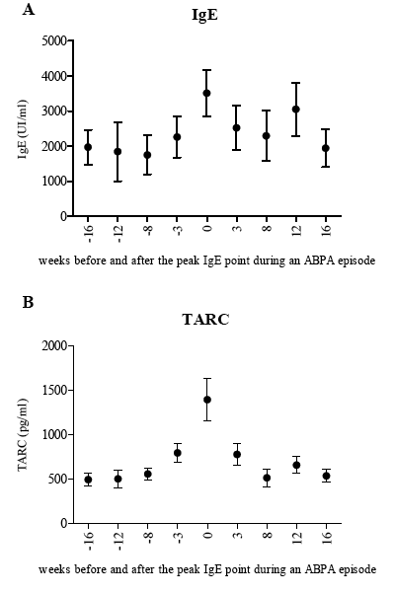
Thymus Activated and Regulated Chemokine (TARC/CCL17) and IgE in CF-ABPA
 | TARC | IgE | rAsp f1 | rAsp f3 | rAsp f4 | rAsp f6 | IgG
Sensitivity [%] | 89 | 64.7 | 68.3 | 65.9 | 81.7 | 64.6 | 53.7
Specificity [%] | 91.2 | 81.0 | 83.3 | 85.9 | 71.2 | 86.5 | 83.7
Diagnostic accuracy [%] | 93.4 | 74.3 | 78.1 | 79.0 | 74.8 | 79.0 | 73.2
Positive Likelihood ratio | 17.3 | 3.4 | 4.1 | 4.7 | 2.8 | 4.8 | 3.3
Negative Likelihood ratio | 0.09 | 0.44 | 0.38 | 0.40 | 0.26 | 0.41 | 0.55
Area under the ROC | 0.98 | 0.84 | 0.83 | 0.82 | 0.79 | 0.80 | 0.73
Hartl, Am J Res Crit Care Med 2006;173:1370
Latzin, Eur Resp J 2008;31:36
Notes:
Hartl, Children’s Hosp Munich Thymus and Activation-Regulated Chemokine
Latzin, Children’s Hosp Berne

Slide 23
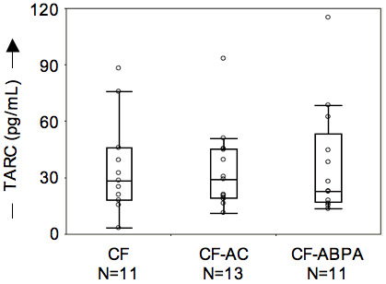
Plasma TARC Levels in CF-ABPA, CF with A. fumigatus colonization, and A. fumigatus-negative CF
Gernez, J Cystic Fib 2012;11:502-10
TARC did not correlate with standard diagnostic ABPA tests
Wiliams, J Cyst Fibros 2011;10:S37
Notes:
23
Wiliams et al – Glasgow. n=?, 2-14 yrs (avg 9)

Slide 24
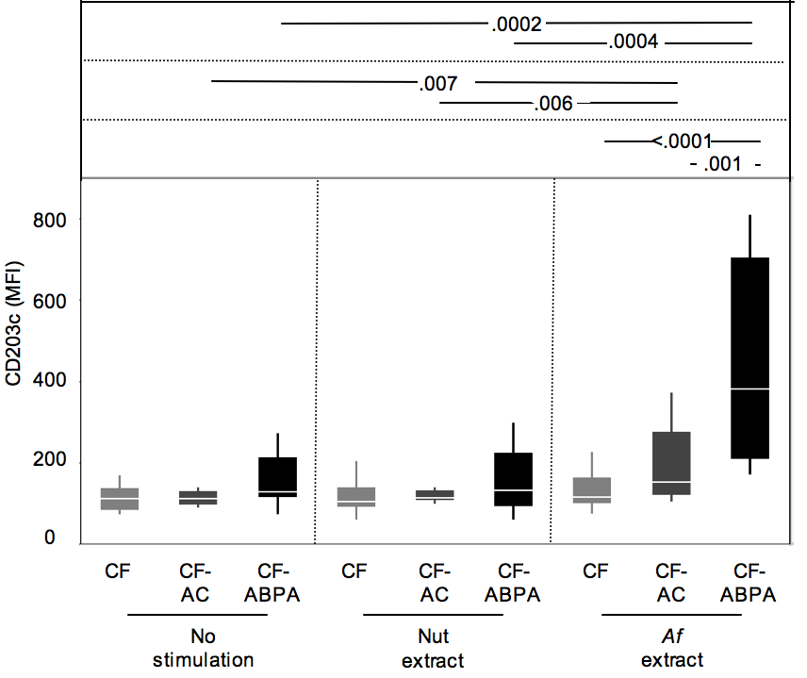
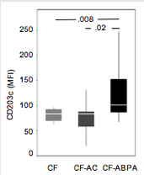
Blood Basophils are Activated & Hyper-responsive to Aspergillus in ABPA vs Infected or Control CF Patients
At baseline
Cross-sectional study
n=37
Gernez, J Cystic Fibros 2012;11:502-510
Notes:
24
(centered around the sample mean, with endpoints spanning the 95% confidence interval) for CF-ABPA, CF-AC CF-NEG and HC groups (N=8, 11, 12, and 11, respectively) measured for blood basophil CD203c expression in median fluorescence intensity units (MFI), upon Af antigen (mixed extract) stimulation. Note the clear distinction between CF-ABPA and CF-AC groups (area under the ROC curve is .93, P=.0002), which is promising in view of developing a clinical diagnostic assay, contrasting with the gray areas in current differential diagnostic criteria

Slide 25
ABPA Differences in Asthma & CF:
Treatment

Slide 26
Aspects of CF Affecting ABPA Therapeutic Choices
•Pervasive, age-related glucose intolerance and diabetes
•Frequent osteopenia/osteoporosis
•Pervasive biochemical hepatic dysfunction (clinical disease
relatively rare)
•Frequent GI symptoms and problems (hyperacidity, malabsorption,
obstruction, reflux)
•Use of cytochrome P450-metabolized CFTR modulators
(eg ivacaftor,lumacaftor)
•Complex pulmonary microbial infection and early onset of
recalcitrant neutrophilic inflammation
•Episodic airway hyperreactivity and asthma-like symptoms

Slide 27
ABPA Therapy Can Exacerbate Common CF Complications
2013 CFF Annual Data Report to Center Directors

Slide 28
Is Oral Steroid Treatment of CF-ABPA a Risk Factor for Nontuberculous Mycobacteria?
• 139 CF patients 2-52 yr
• 12 (8.6%) sputum + for NTM, 6 (4.3%) met criteria for NTM lung disease
• 5 of these had ABPA (vs 1/133 w/o NTM)
• 5 had received systemic steroids
Mussafi, Eur Respir J 2005;25:324

Slide 29
Pulse IV Steroids for CF-ABPA
• 4 children with CF and ABPA (3.5-12 yrs), relapses despite daily oral steroids and itraconazole, toxicity
• IV methylprednisolone 15-20 mg/kg/day x 3, then every 4-9 wks
• Improvements in ABPA in 2 with less toxicity
• Side effects in 2 (hypertension, lethargy/malaise) led to
stopping; no improvement in 1
Thomson, Pediatr Pulmonol 2006;41:164-70
8 patients (9-48 yrs) with relapsing ABPA despite po steroid & azoles, 15 mg/kg/day x 3, monthly (x1-11). Improved PFT, serologies, CXR/CT
Skov & Pressler, Ped Pulmonol 2006;S29:345
9 patients (7-36 yr), 10-15 mg/kg/day x 3 every month for 6-12 months. Better tolerated than prednisone. Equal responses, shorter duration
Cohen-Cymberknoh, J Cyst Fibros 2009;8:253-7
Notes:
JM Thomson – Auckland NZ

Slide 30
Itraconazole PK and Drug-Drug
Interactions in CF
Variable absorption and peak levels
  Often <100 ng/mL. Take with acidic liquid (cola). Cyclodextrin suspension bioavailability 2X > capsule
Plasma peak 3-6 hr, sputum 2-6 hr. CYP3A4 metabolism.
Af susceptibility 70% @ 100 ng/mL, >99% @ ≥1 µg/mL
• Inhibits CYP3A4: will level of methylprednisolone, budesonide, fluticasone, midazolam, cyclosporin, tacrolimus
Absorption by gastric acid suppression
  To optimize, take 1 hr before acid suppressor
Metabolism by CYP3A4 inducers (e.g. phenytoin, rifampin, INH)
PK modeling suggests adult CF dose of 500 mg bid optimal
Hennig, Br J Clin Pharmacol 2006;63:438-50
Notes:
S Henning, Brisbane Australia

Slide 31
Voriconazole for CF-ABPA
Better bioavailability than itra, but more complex metabolism (CYP2C9, CYP2C19, CYP3A4, CYP3A5)
• 21 children with CF (5-16 yrs)
• 13 with ABPA; 8 with sputum Af+ but no ABPA
• Voriconazole for 1-50 weeks, monotherapy in 2
• Improvements in ABPA but not Af+ patients
• Side effects in 7 (33%)
Hilliard, J Cyst Fibros 2005;4:215-20
100% AE rate (photosensitivity 5/6; 6/6 visual disturbances)
MOA? - Inhibits hepatic metabolism of retinols
Cheng, Pediatr Pulmonol 2010;45:661-6
CYP3A inhibition in setting of 10-100X interpatient level range and 10X CFTR modulator (ivacaftor) level range results in complex DDI when co-employed in CF.
Harrrison, Pulm Pharmacol Ther 2015;31:49-50
Notes:
T Hilliard, Royal Brompton London (A Bush, I Balfour-Lynn)
Other studies – 25-50% CF patients do noht achieve good levels even with high doses. Target trough variously given as ≥1.3-2
MP Cheng – Montreal Children’s McGill (L Lands)
Clancy ECCMID: 25% CF lung tx recipients d/c vori d/t Aes; 33% fail to achieve target troughs
Dalboge ECCMID: 8-fold variation in CYP3A4 activity in 22 CF adults

Slide 32
Voriconazole for CF-ABPA
6/8 children had sub-therapeutic
steady-state levels
Markantonis, J Cyst Fibros 2012;11:246-52
Notes:
SL Markantonis, Athens pharmacy faculty

Slide 33
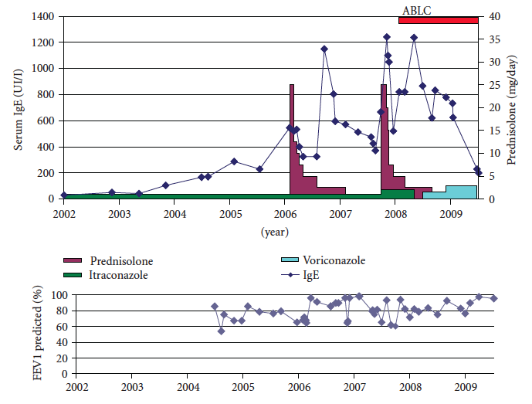
Response to Inhaled Amphotericin in CF-ABPA
50 mg BIW
Proesmans, Int J Ped 2010;2010:376287
Notes:
Kris De Boeck’s Lueven Belgium group 7 CF-ABPA patients
Ampho B 20 mg tiw or ABLC/Abelcet 50 mg biw

Slide 34
Moss, Ann NY Acad Sci 2012;1272:49
Notes:
1st publ CK van der Ent, Utrecht case report 2007

Slide 35
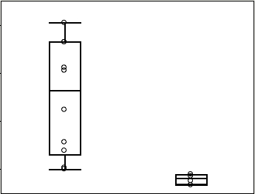
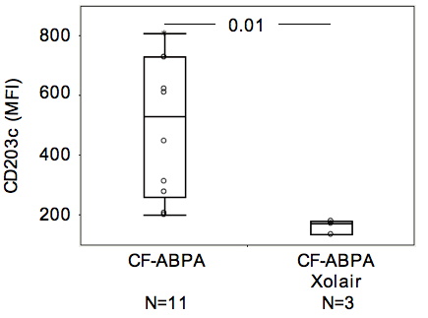
Omalizumab Ablates Basophil
CD203c Upregulation in CF-ABPA
Peanut allergy
CF-ABPA
.004
4
Gernez, Int Arch Allergy Immunol 2011;154:318-27
Notes:
35
Preliminary from CF-ABPA patients undergoing (N=3) or not (N=8) Omalizumab treatment show similar difference in basophil CD203c levels upon Af antigen stimulation.

Slide 36
ABPA in CF v. Asthma - Conclusions
•Aspergillus fumigatus more frequently colonizes, infects and sensitizes
CF patients than asthmatics.
•CF adaptive immune responses are earlier and more robust than
asthmatics, esp B, T17 and perhaps Th2 responses.
•CF itself has features common to ABPA, thus diagnosis is more difficult.
•Although oral glucocorticosteroids remain the mainstay of ABPA treatment, greater toxicity in CF is a more limiting factor than in asthma.
-Pulse IV therapy is an attractive option.
•Triazole issues of absorption, metabolism, hepatotoxicity, drug-drug
interactions and resistance are greater concerns in CF. TDM is more
crucial.
-Inhaled amphotericin is a viable option but formulation, dose
and regime are empirical.
•Immunomodulation with omalizumab is safe and likely effective in CF but
dose and duration are empirical.
•Controlled trials remain a major unmet goal in CF (and asthma) ABPA.

