Slide 1
Case Presentation on CPA – Patient AV
David Denning
Director, National Aspergillosis Centre
Professor of Infectious Diseases in Global Health
University of Manchester

Slide 2
Andy, 67 yr Male
Past Medical History
Complicated asthma - diagnosed 1979, age 33 yrs
Nasal polyps and recurrent rhinosinusitis
Initial presentation: April 1010, 62 yo
Blinding headaches for four months
Self medicating on steroids
August 2010
Shortness of breath, marked fatigue, worsening asthma following sphenoid sinusitis
? Sphenoid sinusitis
December 2010
Andy’s wife believed he was getting hypopituitary symptoms
Later diagnosed pituitary abscess
partial ACTH, gonadotropin growth hormone and TSH deficiency

Slide 3
CXR on Feb 2011

Slide 4
CT Chest March 2011

Slide 5
March 2011
Aspergillosis suspected because of imaging in March 2011
Weight 90.4 kg, MRC score 2 to 3 (normal = 1, 5 is breathless talking and eating)
Bilateral apical cavitation was noted with a positive PET scan
What would you do?

Slide 6
March 2011
Aspergillosis suspected because of imaging in March 2011
Weight 90.4 kg, MRC score 2 to 3 (normal = 1, 5 is breathless talking and eating)
Bilateral apical cavitation was noted with a positive PET scan
Aspergillus antibodies were markedly elevated at 113mg/L (normal is <40mg/L)
Lung biopsy was negative showing inflammatory cells without hyphae demonstrable on histology
Peak flow readings 350L/sec (normally 550 L/sec)
Referred to National Aspergillosis Centre – diagnosis of chronic pulmonary aspergillosis (CPA) made (May)

Slide 7
CXR on May 2011

Slide 8
CT Chest May 2011

Slide 9
August 2011
What would you do?

Slide 10
August 2011
Started itraconazole treatment 200mg twice daily
Itraconazole level monitored and was found to be high
Dose of itraconazole reduced to 300mg once daily
Clinical improvement whilst on itraconazole
However, progression of disease radiologically

Slide 11
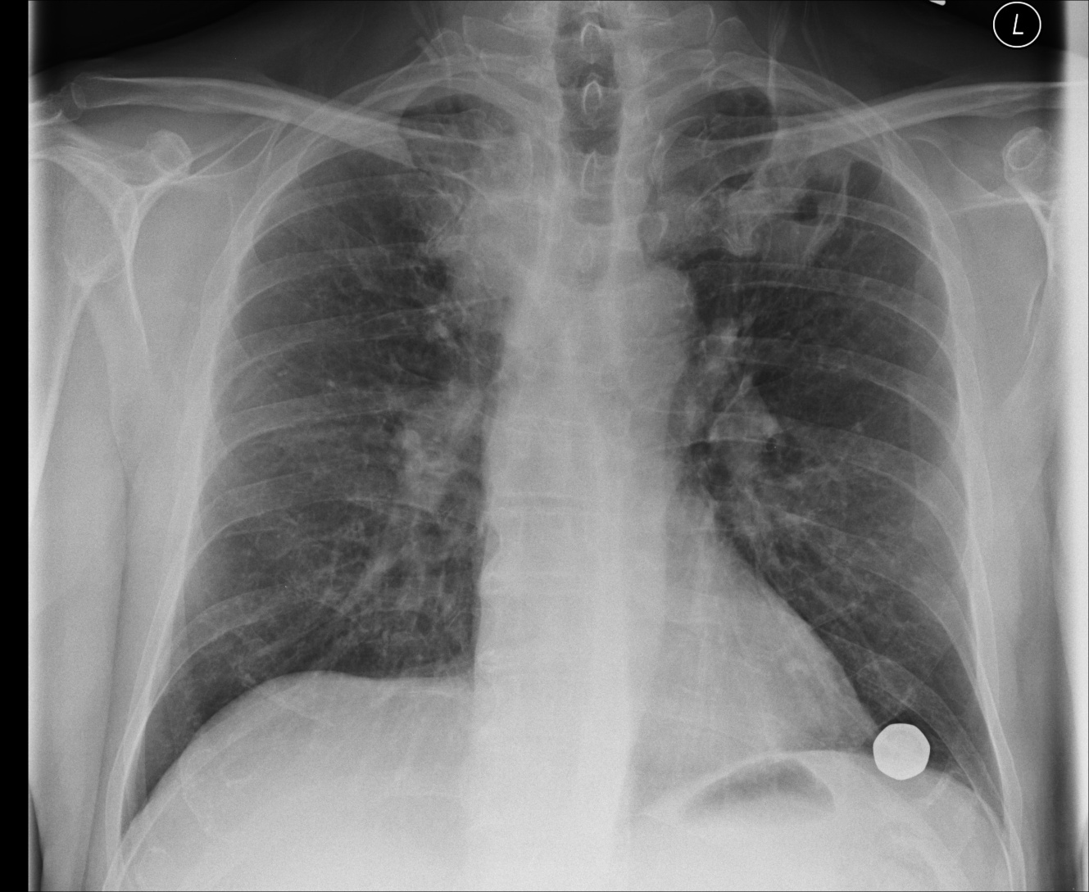
CXR - November 2011
CXR - September 2012

Slide 12
CT chest December 2012

Slide 13
December 2012
Worsening on CXR and CT chest with no increase of symptoms
Lung biopsy was done: showed acute inflammation without fungal hyphae
Patient was switched to voriconazole 200mg twice daily
Subsequently developed some photosensitivity (as is common with voriconazole)
Would you do any immunological investigations?

Slide 14
December 2012
Worsening on CXR and CT chest with no increase of symptoms
Lung biopsy was done: showed acute inflammation without fungal hyphae
Patient was switched to voriconazole 200mg twice daily
Subsequently developed some photosensitivity (as is common with voriconazole)
Referred to immunology at Addenbrookes Hospital, Cambridge
Was found to be IL12 deficient
IL12 required to drive gamma interferon production

Slide 15
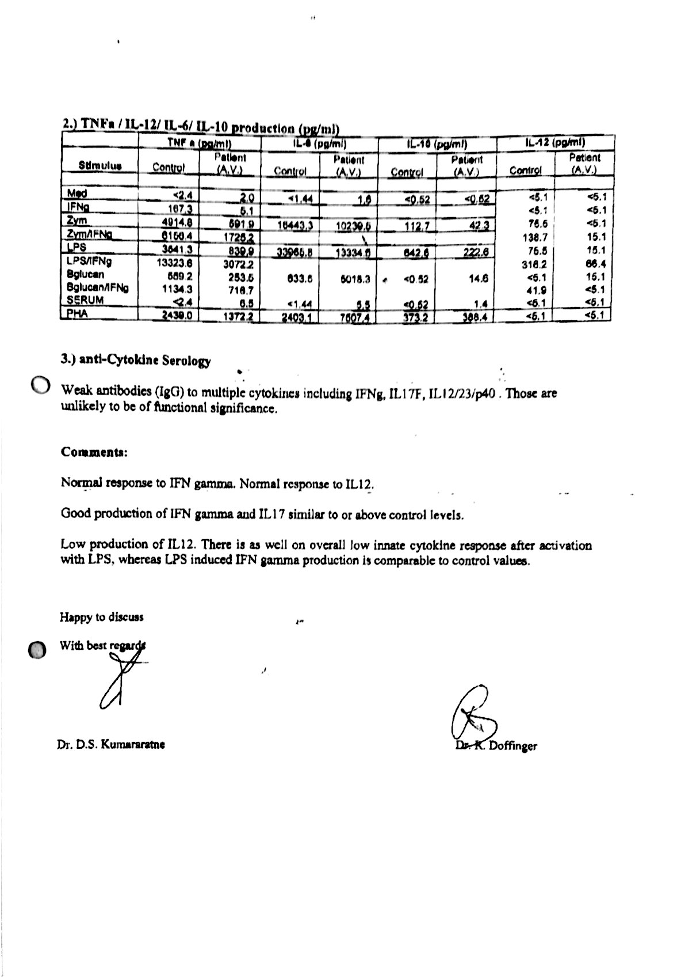

Slide 16
June 2013
Weight 84kg, MRC 2 (slight deterioration)
Developed peripheral neuropathy whilst on voriconazole
Peak flow which was typically 550L/sec but sometimes fell to 400L/sec
Started on gamma interferon 50mcg subcutaneously, three times a week

Slide 17
November 2013
Progression of peripheral neuropathy
Started with only his left toe, but now progressed to half the soles of both feet
Previously intermittent, now constant
Abdominal feelings, feel as though they are ‘fat and swollen’
Tingling of half of his toes
Nocturia
Poor libido
Investigated with nerve conduction studies
Generalised peripheral neuropathy, predominantly sensory
Asymetrical findings, with right ‘zonal’ reduced in size indicating some axonal loss with the left normal for age
Reduction in amplitude response, pointing to additional motor component
L7 radiculopathy

Slide 18
November 2013, cont.
Voriconazole was stopped , followed by immediate clinical deterioration
Weight 77.3 kilos, MRC 3
Worsening of peripheral neuropathy symptoms
Worsening cough
Peak flow deteriorated to 300L/sec
Poor quality of life
Feeling exhausted and not sleeping well at night
What would you do now?

Slide 19
November 2013, cont.
Voriconazole was stopped , followed by immediately deterioration
Weight 77.3 kilos, MRC 3
Worsening of peripheral neuropathy symptoms
Worsening cough
Peak flow deteriorated to 300L/sec
Poor quality of life
Feeling exhausted and not sleeping well at night
No antifungal treatment was given at this point in the hope that his peripheral neuropathy would improve
February 2014
Weight 76.1 kilos
Peak flow was only 280L/sec
Limited improvement in his peripheral neuropathy
Repeat CT chest done, commenced on posaconazole 400mg twice daily combined with gamma interferon (50 ug, subcutaneously, 3 times weekly at night)

Slide 20
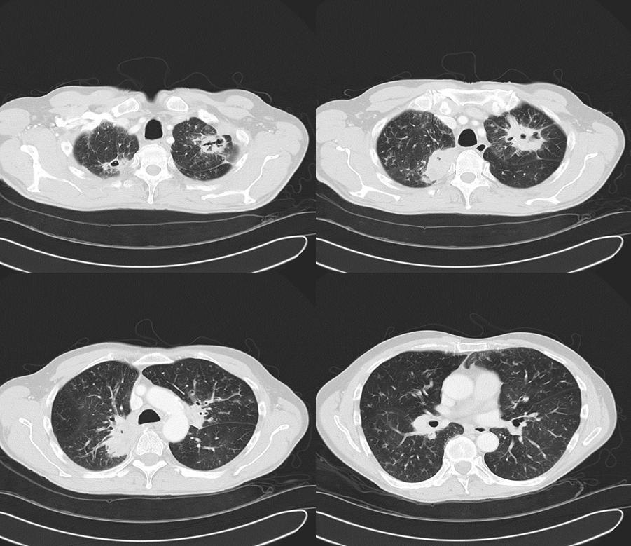
CT chest Feb 2014

Slide 21
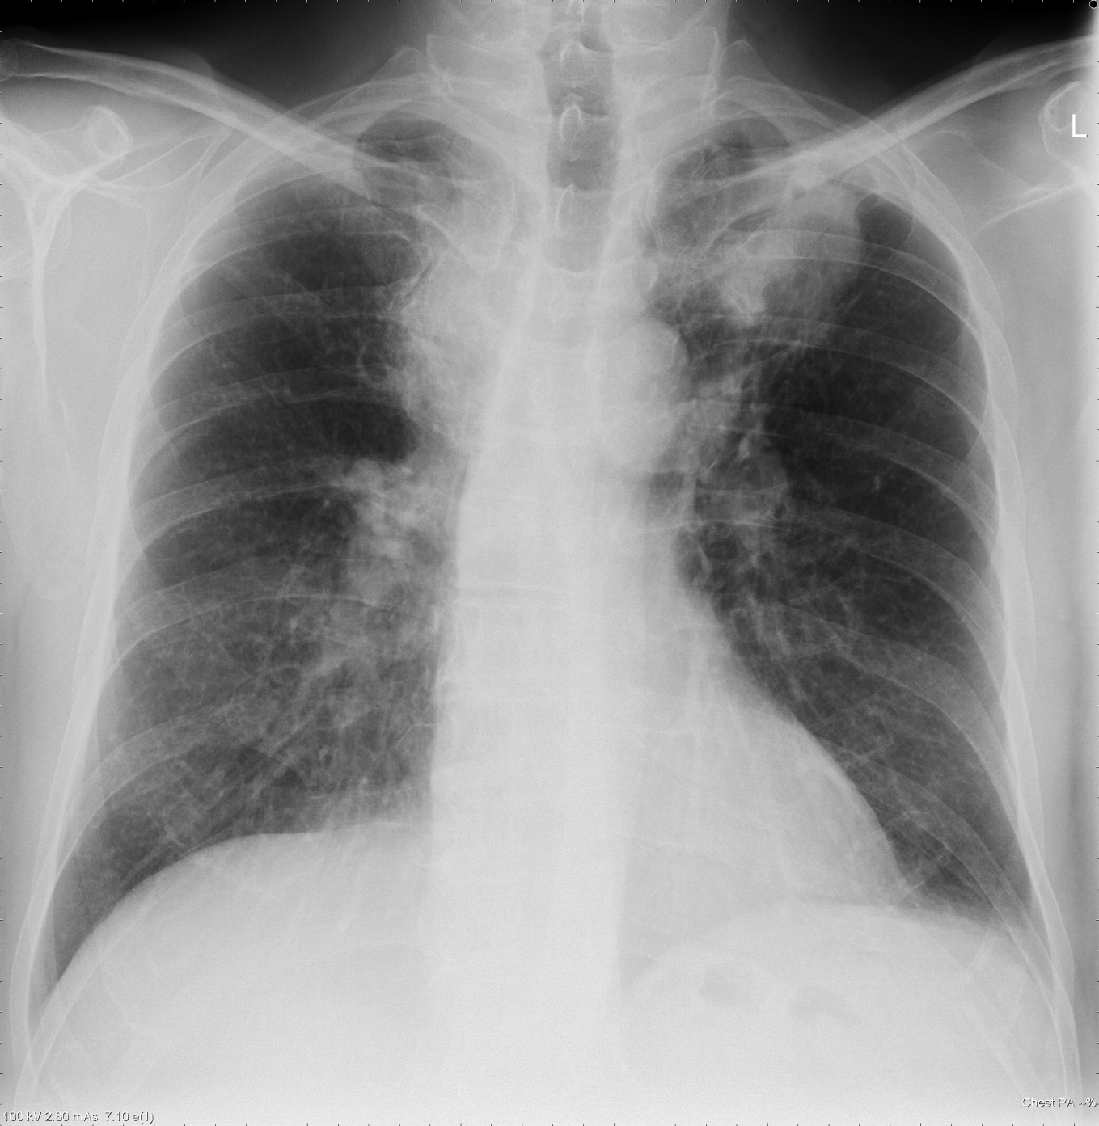
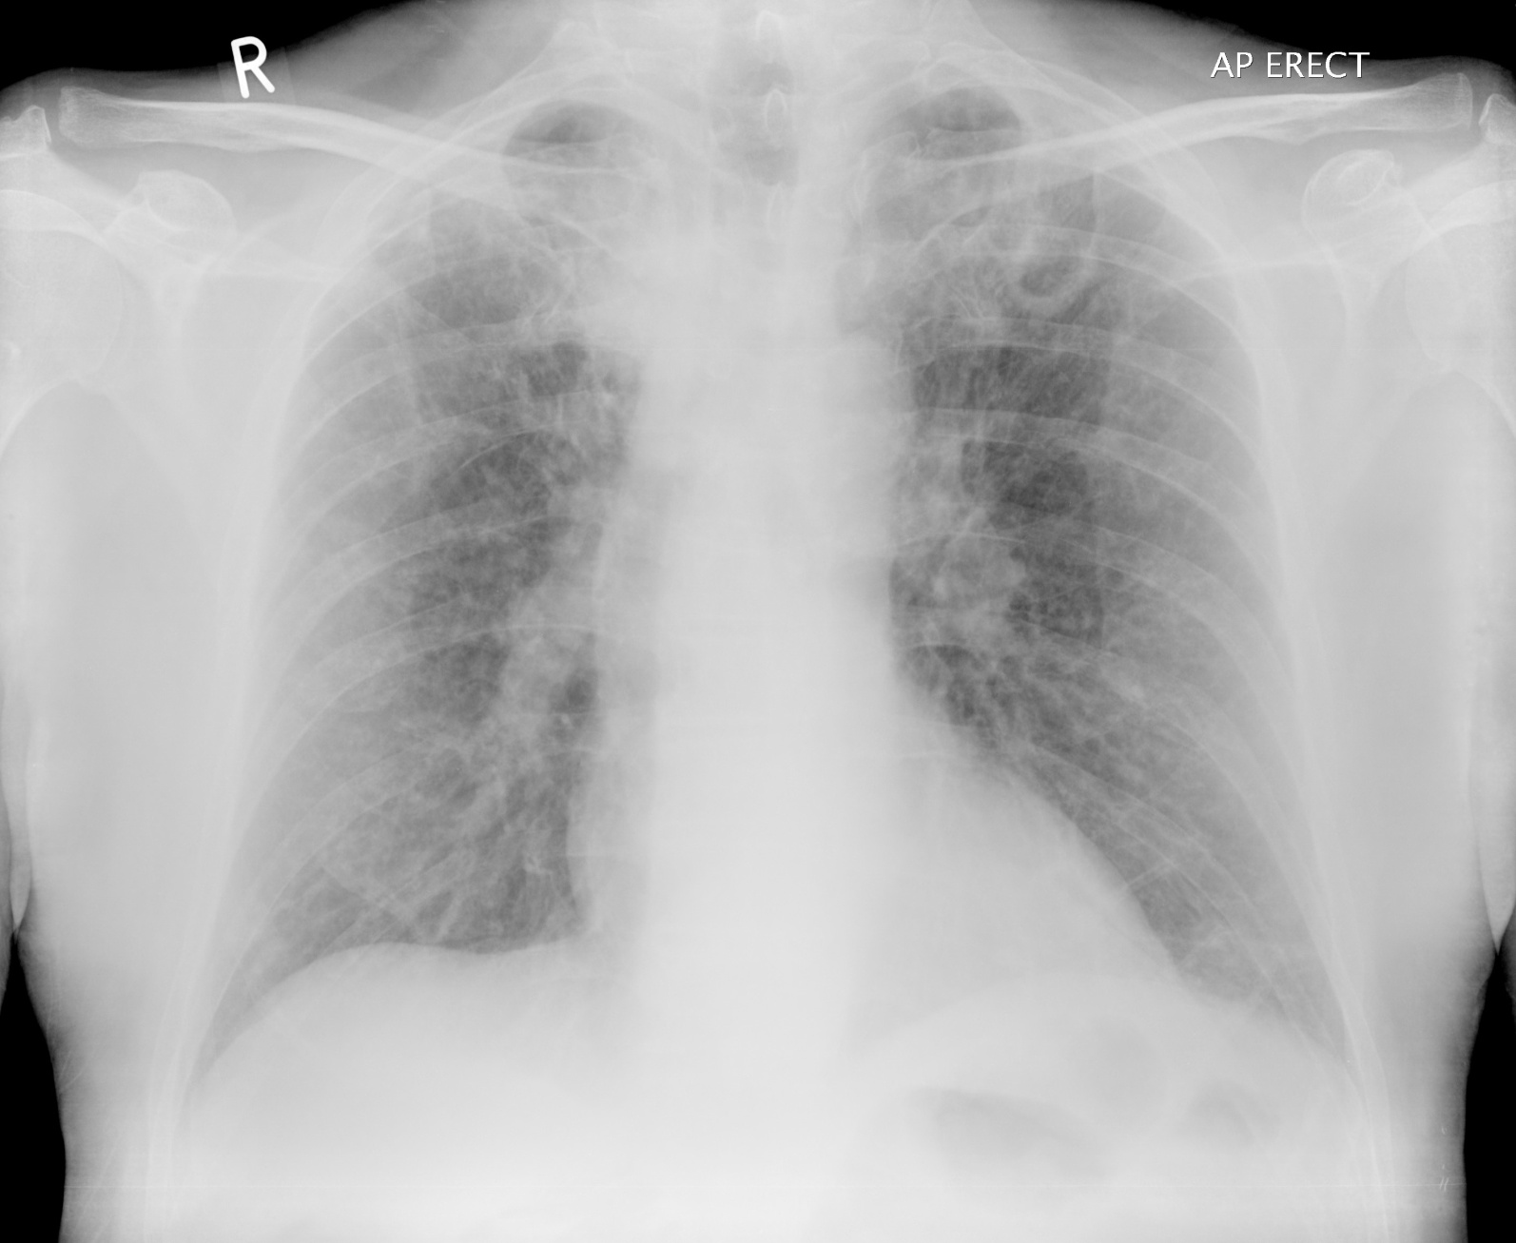
CXR May 2011
CXR May 2014

Slide 22
April 2014
Weight increased to 79 kilos, MRC 2
May 2014
Weight 81.6 kg, MRC remained at 2
His peak flow 480L/sec
Haemoptysis had increased having been mild and intermittent it was happening on most days
Developed a large number of additional side effects:
Gamma interferon
Severe fatigue
Stopped working the day after he had taken his treatment
He stopped this at the end of May but the symptoms improved. His tiredness and other facets of his chronic pulmonary aspergillosis symptomatology were not improved
Posaconazole
Peripheral neuropathy in his feet and toes were worse and going up to his ankles
Losing his balance
Hair had changed in character, becoming finer
Anaemia
Overall NOT doing well

Slide 23
June 2014
Continued to deteriorate
Much more short of breath
Worsening productive, intractable cough
His pruritus was very marked to the point that he was spending half his day itching his legs, buttocks and arms
His peripheral neuropathy had also deteriorated
Dose of posaconazole was therefore reduced to 300mg BID
Subsequently stopped, although gamma IFN continued.
Discussion of next treatment option
A. Intermittent intravenous therapy with amphotericin B
Limited by likely toxicity
Three weeks of in-patient stay in hospital
40% chance of minor improvement
Relapse inevitable
B. Resection of both lesions, with 2 thoracotomies, and IV micafungin for each

Slide 24
Summary
Diagnosis of CPA
Relevance of steroid use in patients and the development of CPA
IL12 deficiency and the use of gamma interferon
Choice of investigation and radiological findings of CPA
Treatment options for CPA
Side effect profile for treatments including Itraconazole, Voriconazole, Posaconazole

