Slide 1
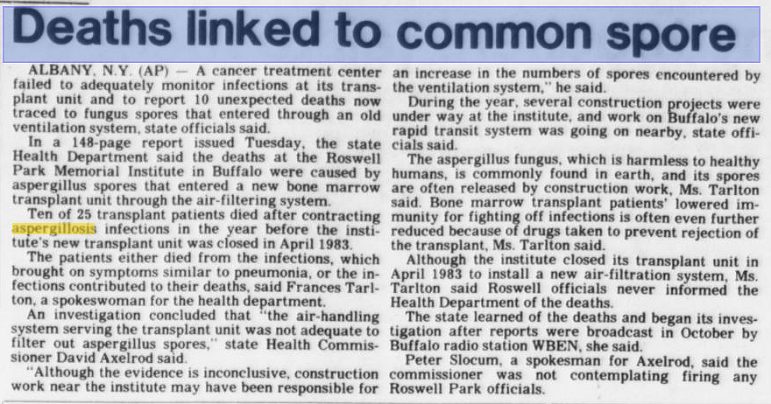

Original Story
Spokane Daily Chronicle June 6 1984

